Slide 1
Unit 8 Topic 3
He said the fashion show
was wonderful.
Section C
WWW.PPT818.COM

Slide 2
1.What is she wearing?
2.What do you think of her dress?
3.How does she look like?

Slide 3
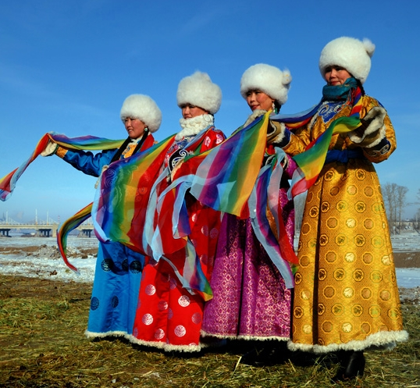
What are they wearing?
They are wearing Mongolian costumes.
n.蒙古人

Slide 4
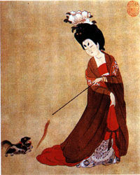
The people during the Han and Tang dynasties designed this kind of clothes.
dynasty
n.王朝，朝代
Tang costume

Slide 5
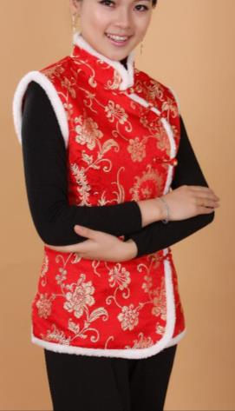
She is wearing a Tang costume.
There are many beautiful silk knots and other decorations on her Tang costume .
She looks very attractive .
knot n.结
decoration n.装饰，修饰
attractive adj.迷人的

Slide 6
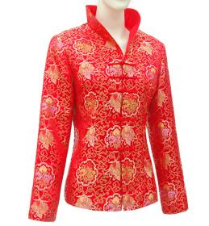
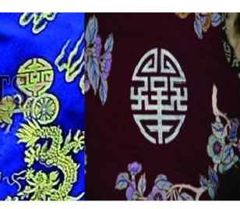
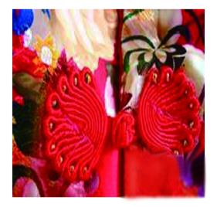
1a
Look at the pictures and match the words with them. Then discuss in groups about the Tang costume.
decoration
silk knot
the Tang costume

Slide 7
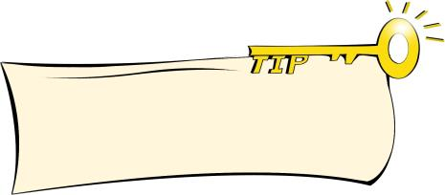
1b
Read 1a and complete the diagram.
A mind map can help you understand or express ideas more easily, clearly and logically.
It got its name when China became known to other countries during the Han and Tang dynasties.
silk knots
History
Style
decorations
Tang costume
different
personal style
Fashion
Feature
attractive
China's traditional culture

Slide 8
Key points of 1a
1. It got its name when China became known to other countries during the Han and Tang dynasties. From then on, people called Chinese clothes,"Tang costumes".唐装是因为中国在汉唐时期闻名于世而得名。从那时起，人们叫这种服装为“唐装”。
(1) get its name 得名 如：
The village got its name from the lake in it.这个村庄因村内的湖泊而得名。
(2) become known to 变得为......所熟知，意思相当于be famous to 如：
Beijing is/becomes known (famous) to all the people in the world because of the 2008 Olympics.北京因2008年奥运会为全世界的人所熟知。
(3) from then on 从那时起
2. Today people can design the Tang costume as either formal or casual clothes. 现在人们既可以把唐装设计成正装，也可以设计成休闲装。
(1) design …as… 把······设计成······ 如：
设计师把这块布设计成一条漂亮的裙子。
The designer designed this piece of cloth as a beautiful dress.
(2) either… or… 或者......或者......，要么......要么......，通常连接同等成分。连接主语时，其谓语动词的形式服从“就近原则”，即取决于最靠近动词的那个名词或代词的单复数形式。如：
Either he or I am going.要么他去，要么我去。
Either Kangkang or Michael is right. 要么康康对，要么迈克尔对。

Slide 9
Listen and follow.
The Tang Costume
Fashion is full of culture. The Tang costume stands for Chinese history and fashion culture. It got its name when China became known to other countries during the Han and Tang dynasties. From then on, people called Chinese clothes, “Tang costumes”.
Chinese fashion is different not only from western fashion, but also from that in other Asian countries, such as Japan and Korea. The beautiful silk knots and the other decorations on Tang-style clothes are popular all over the world now.
Today people can design the Tang costume as either formal or casual clothes. It shows both the personal style and China’s traditional culture. So we say the Tang costume is very attractive and very different from western-style suits.

Slide 10
Retell the passage with the help of key words.
The Tang Costume
Fashion ________culture. The Tang costume stands for ______ __________________. It________name when __________________ _______________ during ______________________. ___________, people called ______________________.
Chinese fashion is different____________________, but also ____ _____________________, such as ______________. The beautiful __________________________ are ________________ now.
Today people _______________________either _____ or______ ________. It shows both ___________ and________________ ________. So we say ________________________ and ___________ from ________________.

Slide 11
1c
Read again and answer the following questions. Then try to retell the passage in your own words.
1. Does the Tang costume stand for Chinese history and fashion culture?
Yes, it does.
2. Why did people call Chinese clothes"Tang costumes"?
Because it got its name when China became known to other countries during the Han and Tang dynasties.
3. Is Chinese fashion different from western fashion?
Yes, it is.
4. Why is the Tang costume popular all over the world?
Because it is very attractive and very different from western-style suits.
5.What does the Tang costume express?
It shows both the personal style and China's traditional culture.

Slide 12
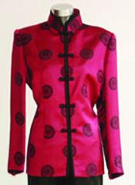
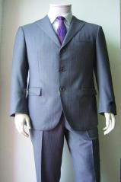
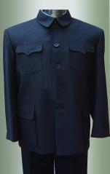
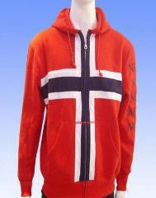
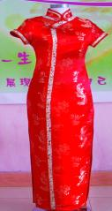
2a
Choose the correct name for each picture and write it down on the line.
Tang costume Zhongshan costume cheongsam business suit sportswear
Tang costume
business suit
Zhongshan costume
sportswear
cheongsam
____________ ____________ ____________ _____________ ___________

Slide 13
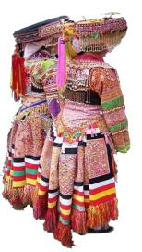
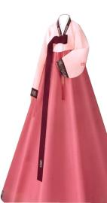
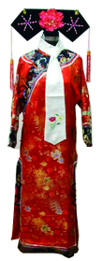
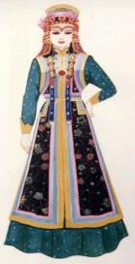
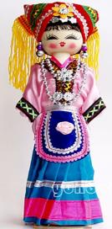
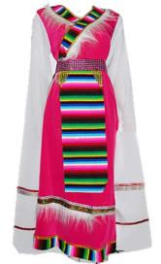
2b
Look at the pictures and match them with the correct Chinese minorities.
a.Titetan b. Man c. Zhuang d. Mongolian e. Miao f. Korean
e
f
b
d
c
a

Slide 14
Project
3
Work in groups and discuss the following questions. Then make a poster about a fashion show for it.
adv.在(或向)上面；prep.在......上面
1. Which costume above do you like best ?
2. Why do you like it most?
3. Can you list more costumes and give more information?

Slide 15
Exercises in class
根据首字母或句意完成句子。
1. Pan Jiwen（潘基文）is the secretary of the UN（联合国）.He is from Korea,an A______ country.
2. Ice cream is a__________ to children.
3. She put some d__________ on the Christmas tree.
4. The Qing d__________ ended in 1911.
5.Do you have your p________ computer at home ?
sian
ttractive
ecorations
ynasty
ersonal

Slide 16
Exercises in class
单项选择
( )1. He asked when _____.
A .they will go to the zoo
B. they would go to the zoo
C .would they go to the zoo
( )2. There is a _____shop. You can buy some ____.
A. clothes; clothing B. clothes; clothes C .clothing; clothes
( )3. The teacher asked_____.
A. if we were reading English
B. if we are reading English
C. if were we reading English
( )4. — When are you going to Tibet for your holidays?
— I haven’t decided. ____this Sunday ____ next Sunday is OK.
A. Either; or B. Neither; nor C. not only; but also
( )5. Sun Yang became known ____ the world in the 2012 London Olympic Games.
A. for B. as C. to
B
C
A
A
C

Slide 17
Summary
We learn:
1. Learn some new words and phrases:
decoration,knot,dynasty,Asian,personal,attractive,above,
western-style,Mongolian, from then on,either..or...
2. Some useful expressions about the Tang costume:
◆The Tang costume stands for Chinese history and fashion culture.
◆Chinese fashion is different not only from western fashion, but also from that in other Asian countries, such as Japan and Korea.
◆It shows both the personal style and China’s traditional culture.
We can:
◆Talk about the Tang costume and some other Chinese minorities costumes.

Slide 18
Homework
1.Read 1a aloud and try to repeat.
2.Finish Section C in your workbook.
3.Preview Section D.

Slide 19
Thank you

