Slide 1
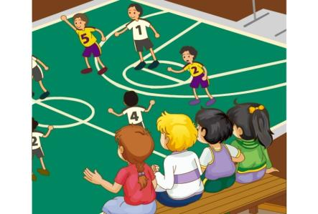
Unit 6 We’re watching the games.
WWW.PPT818.COM

Slide 2
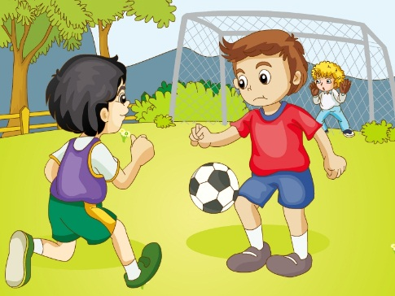
>>Presentation
football
play football

Slide 3
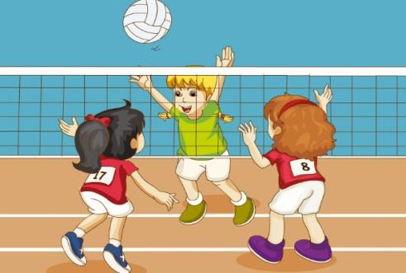
>>Presentation
volleyball
play volleyball

Slide 4
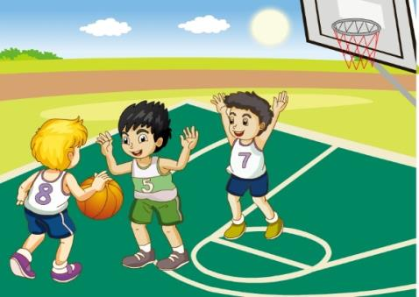
>>Presentation
basketball
play basketball

Slide 5
>>Practice
---What are they doing?
---They’re_________________.
playing basketball
playing football
playing volleyball

Slide 6
>>Lead-in
Review
---What are they doing?
---They’re_________________.
playing basketball
playing football
playing volleyball

Slide 7
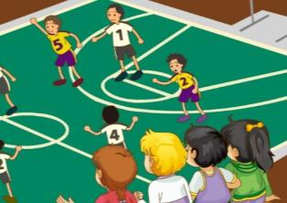
>>Practice
They are v-ing.

Slide 8
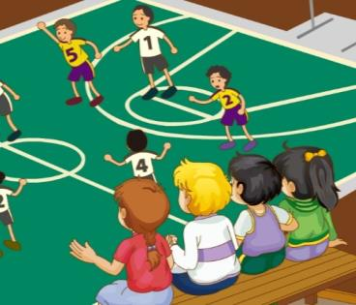
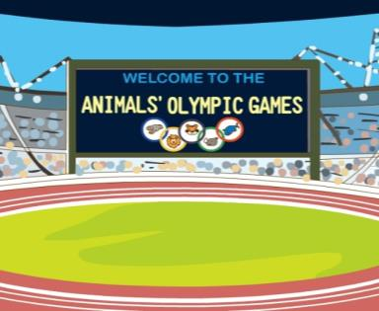
>>Presentation
watch the games
playground
We’re watching the games on the playground.

Slide 9
>>Presentation
The boys are playing football.
The girls are playing volleyball.

Slide 10
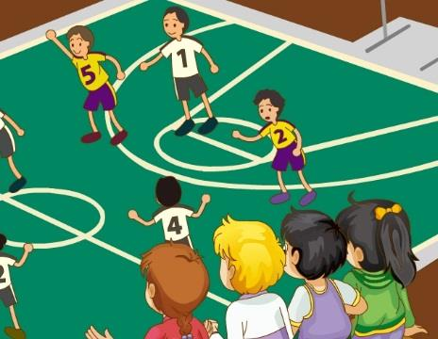
>>Presentation
The teachers are playing basketball.
We are watching the games.

Slide 11
>>Practice
Pair Work
What are they doing?
They are v-ing.

Slide 12
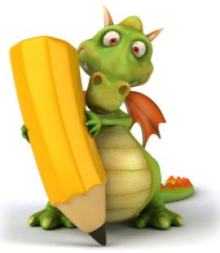
>>Presentation
Just write
watch
看
game
游戏
foot(feet)
脚（复数）
football
basketball
足球
篮球
playground
操场
We are watching the games.
我们正在看比赛。

Slide 13
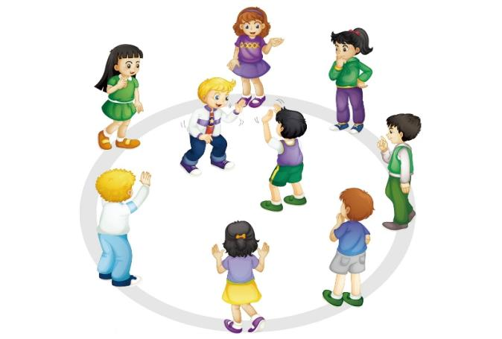
>>Practice
Let’s play
They’re playing football.
Look! What are
they doing?
No, I don’t think so.
They’re playing basketball.
Right!

Slide 14
>>Presentation
Just talk
Gao Wei: Hello, everyone. Let’s go and watch
the games on the playground!
Students: OK. Let’s go!
Gao Wei: Look at those boys. They are
playing football.
Li Yan: And the girls are playing volleyball.

Slide 15
>>Presentation
Just talk
Gao Wei: How about the teachers?
Peters: Look! They’re playing basketball.
Students: Wow! They’re playing very well.
PE teacher: Hi, boys and girls! What are you
doing here?
Students: Oh, we’re watching the games.

Slide 16
>>Practice
Group Work
分角色朗读

Slide 17
>>Practice
Let’s act!
Li Yan
Peter
Gao Wei
PE teacher

Slide 18
>>Summary
重点词组：
play football
play volleyball
play basketball
watch the games
如何表达“他们正在踢足球/打排球/打篮球” ？
They are playing football/volleyball/basketball.
如何表达“我们正在看比赛” ？
We are watching the games.

