Slide 1
Module 5 My school day
Unit 3 Language in use
WWW.PPT818.COM

Slide 2
maths
Chinese
English
history
art
music
science
PE
break
English 2:15
art 7:00
P.E. 1:30
Chinese 4:30
math 8:30
history 10:00
Science 9:15
Break 6:10
Subjects
music 3:00
记忆大挑战!
Memory Challenge!

Slide 3
8:30
maths 8:30
Chinese :30
English :15
history 0:00
art 7:00
music 300
science 15
PE :00
break 6:10
记忆大挑战!
4:30
Memory Challenge!
2:15
10:00
We have maths at ...
7:00
3:00
9:15
1:30
6:10

Slide 4
Discuss in pairs.
Talk about your activities in a week.
I don’t go to school on Sunday. I go to the park on Sunday.
go to school
get up very late
see my grandparents
play games with friends
play basketball
read a book
watch TV
do my homework

Slide 5
Match the words in Column A with the words and expressions in Column B.
A
B
dinner
your homework
to school
a break
an English lesson
to bed
home
1. have
2. do
3. go

Slide 6
Read the phrases and then complete the passage.
do homework get up go to school
have a break have breakfast
have lunch start work
On Friday I have a busy day. I ______ at half past six in the morning. Then I wash my hands and face, and ______
________ at seven. At half past seven,
get up
have
breakfast

Slide 7
I __________, and __________ at eight. There are four lessons in the morning. At twenty to ten, we ___________ for twenty minutes. We go to the playground and I talk with my friends. We _________ in the school dining hall. In the afternoon, we have two lessons and go home at half past three. I don’t _____________ on Friday evening. I do it on Saturday.
go to school
start work
have a break
have lunch
do homework

Slide 8
Discussion
Talk about the differences between Chinese and English, American school days. E.g.
We have classes at seven o’clock.
They have classes at nine o’clock. They don’t have classes at about three o’clock in the afternoon.

Slide 9
Around the world
Read and list some activities
when students in the UK.
1. 5 lessons one day
2. Finishing school at half past three in the afternoon.
3. They go swimming, play football, have music lessons and play with their friends after school.
4. Doing homework like you.

Slide 10
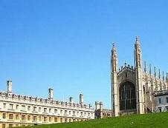
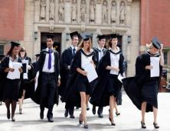
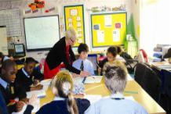
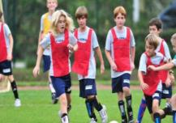
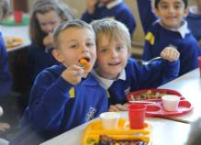
Schools in Britain
Most schools have a five-day week.

Slide 11
Schools in Britain
There is a break of 15 or 20 minutes in the morning and sometimes also in the afternoon.

Slide 12
Schools in Britain
Many students take a packed lunch (午餐盒) from home, others have school meals for which parents must pay.

Slide 13
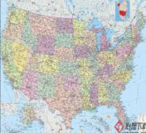
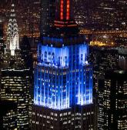
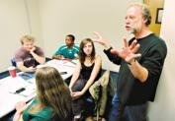
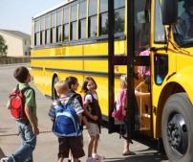
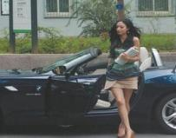
Schools in the USA
Students must study a science, but they can choose whether (是否) to take chemistry, physics or biology.

Slide 14
Schools in the USA
Many students go to school in a school bus. But many students study to drive at 16. They go to school in their own car.

Slide 15
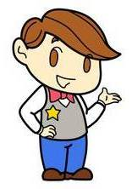
What do you do and enjoy?
get up
have breakfast
go to school
lessons start
study Chinese / …
have lunch

Slide 16
have … lesson
do sports
finish school / leave school / go home
have dinner / have supper
do your homework
watch the news on TV
go to bed

Slide 17
Fill the table with your favorite activities.
8:00 am | go to school
10:00 am | ...
12:00 am
...

Slide 18
Talk about your ideal school day.
I go to school at half past seven in the morning.
We start work at nine o’clock.
At eleven o’clock, we have a break in the playground and I talk to my friends.
…

Slide 19
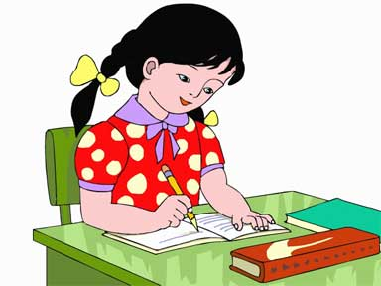
Writing
Write a passage about your school day.

Slide 20
A sample
I’m Huang Zeyang, a student at Wuning No. 1 Primary School. Every day I get up at 6:30. I have breakfast at about 6:45. Then I go to school on foot, because my home is not far from the school and my parents are both busy. I get to school at 7:20. At 7:50 I read English and Chinese. I do morning exercise at 8:20. Classes begin at 8:55.

Slide 21
We have three classes in the morning. I have lunch at 11:20. The lunch is very good, and I like it. Afternoon classes begin at 12:40. We have three classes in the afternoon. At 3:15 I play sports or play the flute. I go home at 4:00. Then I do my homework. I have dinner at about 5:20. I often watch CCTV news at 7:00. I go to bed at 8:00.
What about your school day? Can you tell me, please?

Slide 22
行为动词的一般现在时
在英语中，一般要通过句中的谓语动词和时间状语的变化来表达动作发生的时间，这就是英语的时态。今天我们将和大家一起初步了解一下行为动词的一般现在时。

Slide 23
行为动词指的是描述实际动作的动词，包括及物动词和不及物动词，如go, have, dance等这样的表示行为动作的动词。行为动词的一般现在时具体用法：
（1）要描述经常性的、习惯性的或反复发生的动作。如：
I go to school at 8 o’clock every day.
The students have lunch at 12 o’clock.
I do my homework at nine.

Slide 24
（2）要描述存在的状态，也要用到行为动词的一般现在时。如：
You dance well.
I like maths very much.
You sing very well.

Slide 25
在行为动词作谓语的句子中，当句子主语为第一、二人称或表示复数概念的名词或代词时，一般现在时的陈述句结构一般为：“主语+行为动词原形 + 其他”。其否定句形式要借助于don’t (don’t是do not的缩写，在一般现在时结构中，do not中的do是助动词，没有词义，但不能省略)。如：

Slide 26
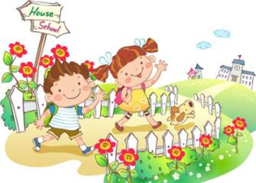
They don’t have an English class today.
We go to school from Monday to Friday.
We don’t go to school on the weekend.

Slide 27
行为动词在一般现在时的句子中作谓语时，当句子的主语为第三人称单数的名词或代词(如she, he, it, Jenny, my teacher等)时，谓语动词要发生变化。变化规律如下:
①通常情况下在动词后直接加“-s”。如：
walk →walks ride →rides
②动词以s, x, ch, sh结尾时, 直接在词尾加
“-es”。 如：
watch →watches wash →washes

Slide 28
③当动词以辅音字母加o结尾时，一般在动词后直接加“-es”。如：
go →goes do →does
④当动词以辅音字母加y结尾时，要先变y为i， 再加“-es”。如：
cry → cries
⑤有些行为动词变第三人称单数形式时属于不规则变化，这样的词需要在平时认真积累, 重点记忆。 如：
have → has

Slide 29
根据句意, 用所给单词的适当形式填空。
1. I have a cat. It _____ (eat) fish.
2. My father often ________ (watch) the basketball match on TV.
3. Tony likes films. He usually ____ (go) to the
cinema on Saturday.
4. Li Lei is a good student. His father never
_________ (worry) about him.
5. Lisa _____ (have) a dog. Its color is yellow.
eats
watches
goes
worries
has

Slide 30
at, in, on的用法
在表示地点方面，at + 点，on + 面，in +内。如:
at the table “在桌子旁”，强调的是具体的地点；
on the chair “在椅子上”，与椅子的面有接触，强调接触面；
in the room “在房间里”，强调内部空间。

Slide 31
2. 在表示时间方面：
in表示时间段，即在较长的一段时间内，如：in the afternoon, in a week, in autumn, in 1996
at通常表示时间点，如：at six o’clock
on表示具体的某一天或某天的某个时间，如：on Sunday, on Monday afternoon, on a cold winter morning, on my birthday

Slide 32
3. 在有些时间短语中，at可以表示时间段，如:
at night, at Christmas
Practice
用介词at, in, on填空。
The football match is ________ Dalian
Stadium.
2. My coat is ______ the bed.
at
on

Slide 33
3. —Where is my pen? —It’s _____ your pencil-box.
4. I don’t like watching TV _____ the evening.
5. Helen goes to school _____ half past seven.
6. Do you have history _____ Saturday?
7. Don’t go out _____ night.
in
in
at
on
at

Slide 34
Read and choose the best answer.
We go to school in / on / at the morning.
We don’t go to school in / on / at Sunday.
I get up in / on /at half past six.
You have an English lesson in/on/at two o’clock.
They have a maths lesson in/on/at Wednesday.
I do my homework in/on/at the evening.
__
__
__
__
__
__

Slide 35
We usually have a football match _____ Sunday.
A. in B. on C. at D. to
解析：在具体的某一天、某一天的上午、下午、晚上或星期几前要用介词on。所以选 B。

Slide 36
They have an English lesson ____ three o’clock ____ Tuesday.
A. at; on B. in; on C. at; in
解析：英语在表示不同的时间概念时要用不同的介词，at是表示在几点钟或几时几分；on表示在某月某日或星期几或特制某天的上午、下午或晚上；in表示在上午（下午、晚上），或在某周、某季、某月、某年。

Slide 37
— What time do you usually have your first class?
— ______ eight o’clock _____ the morning.
A. At, on B. At, in C. On, in
解析：在钟点前面要用介词 at；在不特指的上午、下午或晚上前用介词 in。所以选 B。

Slide 38
连词成句
1. today, maths, break, have, after, we
We have maths after break today.
2. favorite, it’s, maths, I, subject, like, my
I like maths. It’s my favorite subject.
3. teacher, good, our, very, and, makes,
maths, it, interesting, she.
Our maths teacher is very good and she makes it interesting.

Slide 39
4. because, like, it’s, I, interesting, it
I like it because it’s interesting.
5. homework, day, I, maths, first, every, after, do, school
I do maths homework first after school every day.

Slide 40
Exercises
I. 根据句意用所给词的适当形式填空。
In the afternoon lessons ______ (start) at
2 o’clock.
2. We ______ (play) football on Sunday morning.
3. I ______ (watch) TV at half past six.
4. They ___________ (not have) lunch at half past twelve.
5. At ten o’clock we _______ (go) to bed.
start
play
watch
don’t have
go

Slide 41
II. 根据句意,从方框中选择适当的短语填空。(每个短语限用一次)
have a break go to school get up watch TV have dinner
In the morning I _________ at seven and
have breakfast at half past seven.
2. I ____________ with my friends at 7:30.
get up
go to school

Slide 42
3. At half past ten we ___________ and I
play football with my friends.
4. I _____________ at 19:00. I like fish and
vegetables.
5. Some students do their homework and
some ____________ at home.
have a break
have dinner
watch TV

Slide 43
III. 根据汉语提示，完成下列英文句子。(每空一词)
1. 我和爸爸妈妈去公园。
I ____ ____ ____ _____ with my parents.
2. 我不喜欢这件外套。
I _____ _____ this coat.
3. 我们下午4点钟回家。
We ____ _____ at 4 o’clock in the afternoon.
4. 课不是3点结束。
Lessons ______ _____ at 3 o’clock.
5. 我们没有数学课，你们呢？
We ____ _____ maths. __________ ______ you?
go to the park
don’t like
go home
don’t finish
don’t have
What / How about

Slide 44
Thanks

