Slide 1
Unit 1 Winter Holidays
What did you do in the holidays?
WWW.PPT818.COM

Slide 2
holiday
假期，休息日

Slide 3
summer holiday
winter holiday
Chinese holiday

Slide 4
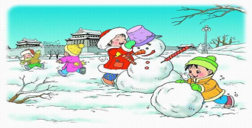
They go swimming in
_______________.
summer holidays
They make a snowman
in_______________.
winter holidays

Slide 5
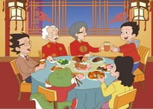
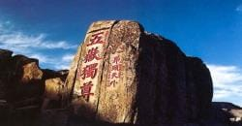
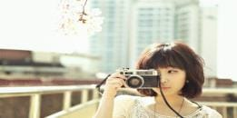
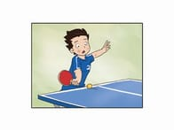
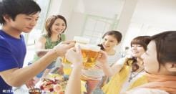
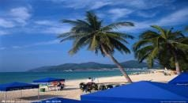
had a big dinner
went to Mount Tai
took pictures
visited my friends
went to Hainan
played table tennis

Slide 6
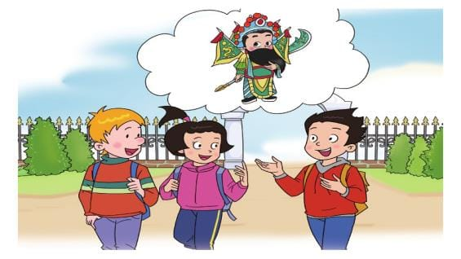
Watch and find:
What are they talking about?

Slide 7
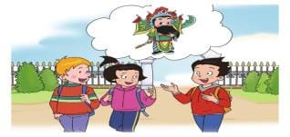
Watch and find:
What are they talking about?
A. Winter holidays
B. Summer holidays

Slide 8
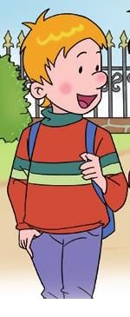
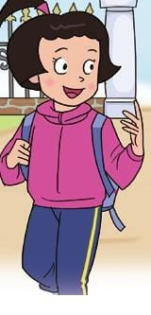
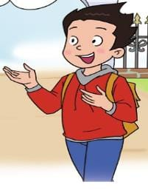
?
?
?
?

Slide 9
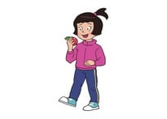
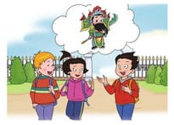
winter holidays
How were your ?
Wonderful
!
I learned .
Beijing Opera

Slide 10
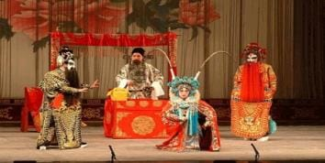
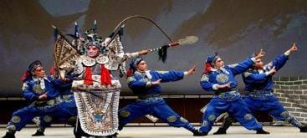
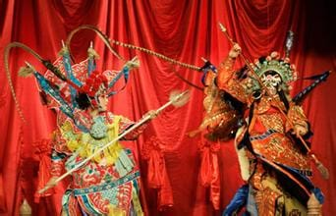
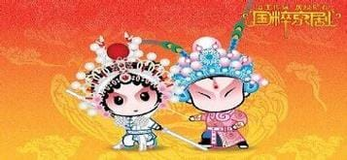
Beijing Opera

Slide 11
Was it fun?
a little difficult
Yes, but .

Slide 12
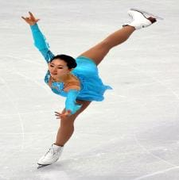
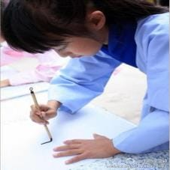
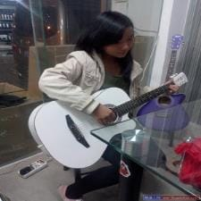
It’s _________________.
a little difficult
very difficult

Slide 13
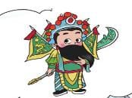
?
?
?
?

Slide 14
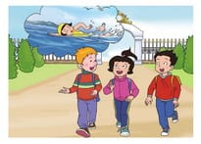
listen and find
What did you do
in the holidays,Wanghong?
I went to Hainan.

Slide 15
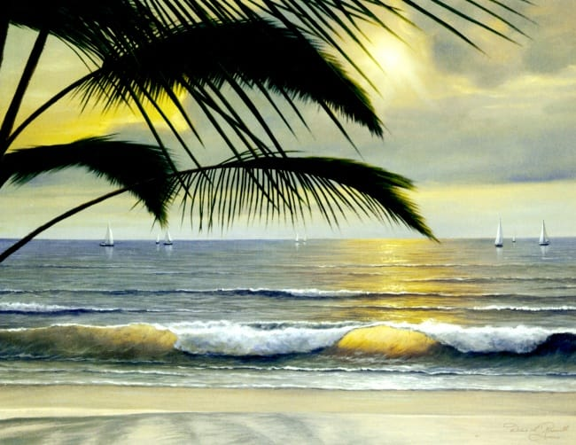
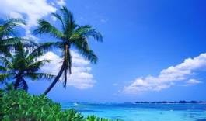
海 南
It's a beautiful place.

Slide 16
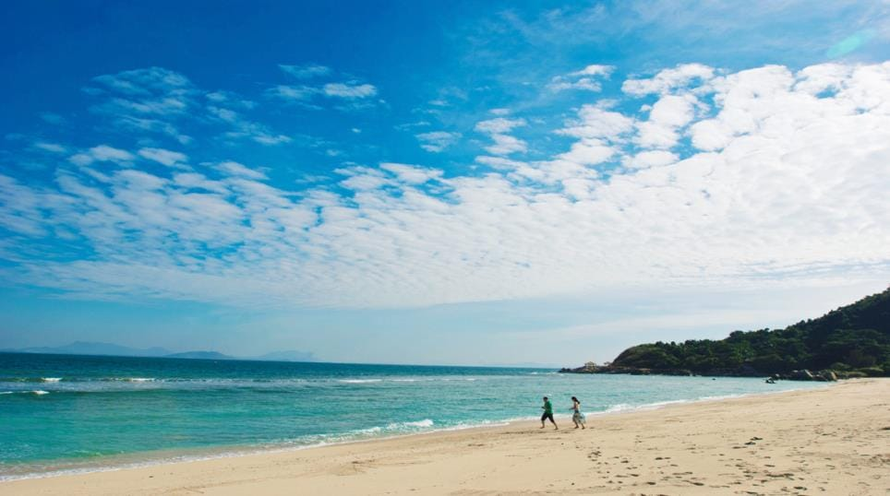
Watch and find
What did you do
in the holidays?
海 南
I went to Hainan.
（go 的过去式）
It's a beautiful place.
It’s a beautiful .
place

Slide 17
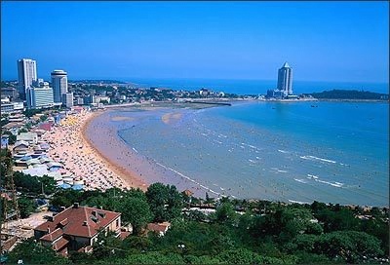
It's a beautiful ______.
place
Qingdao

Slide 18
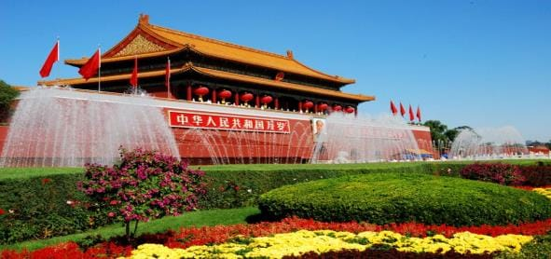
It's a beautiful ______.
place

Slide 19
?
?
?
?

Slide 20
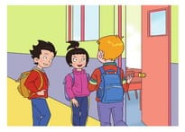
enjoy
Did you your holidays, Peter?
went back
Yes. I to Canada. I visited my and many pictures.
friends
took

Slide 21
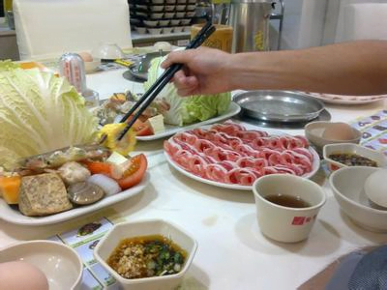
Let’s nice food.
enjoy

Slide 22
Let's______ the music.
enjoy

Slide 23
Let’s chant
Holiday, holiday, enjoy holiday, Opera, opera, Beijing Opera,
Difficult, difficult, a little difficult,
Place, place, a beautiful place.

Slide 24
Let’s talk
A: Hi!...What did you do in the holidays?
B: I........
A: What did you do in the holidays?
B: I........
A: Goodbye!
B: Bye!
took pictures
went to Hainan
visited my friends
played table tennis

Slide 25
My winter holidays
In the winter holidays, I visited
relatives with my family.
We had a big dinner.
We had a good time.

Slide 26
My winter holidays
In the winter holidays, I __________.
I __________.And I _______.
We had a good time.
went to... watched films set off fireworks
visited my relatives and friends
climbed the hill had a big dinner
went shopping played computer games...

Slide 27
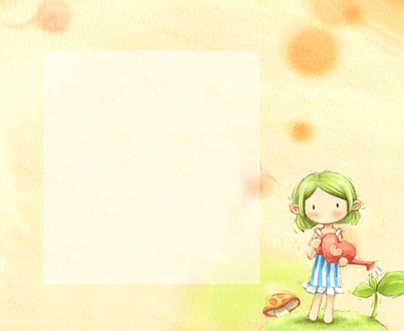
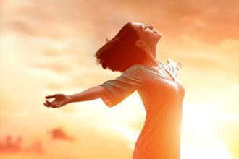
Let's______ the sun.
enjoy
enjoy our holidays,
enjoy our life!

Slide 28
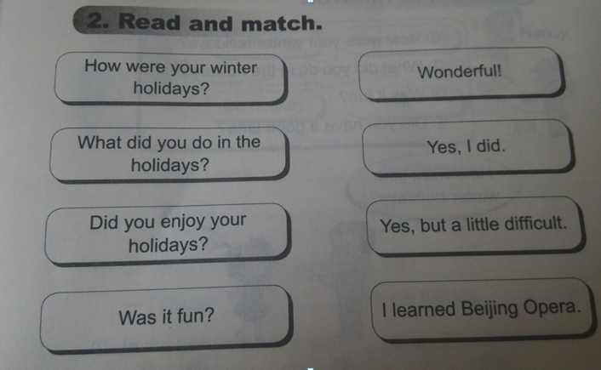
Test

Slide 29
Homework:
Talk about your winter holidays
with your friends.

