Slide 1
陕旅版四年级上册 Unit3 What’s for breakfast? 第1课时
WWW.PPT818.COM

Slide 2
教学目标： 1.听说读写单词breakfast, meat, lunch, soup, noodles, chicken, dumplings, rice.
2.根据教师指令灵活运用上述单词。

Slide 3
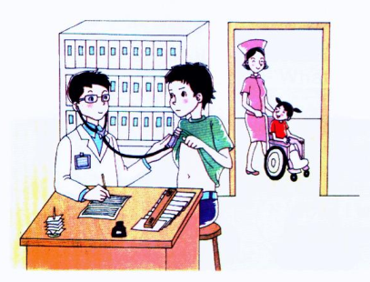
Let’s chant-What’s your father?

Slide 4
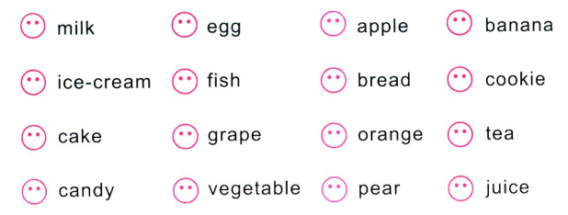
Draw your likes, or dislikes
What do you like? Can you tell me?

Slide 5
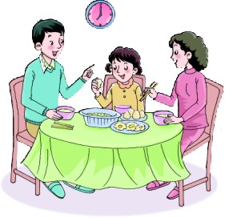
Let’s learn
breakfast

Slide 6
I have…for breakfast.

Slide 7
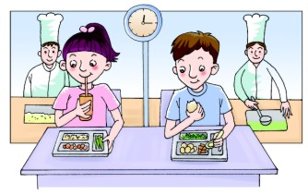
lunch

Slide 8
I have…for lunch.

Slide 9
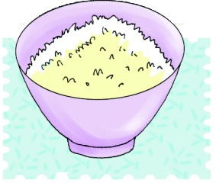
rice

Slide 10
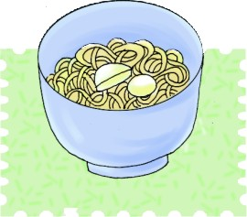
noodles

Slide 11
soup

Slide 12
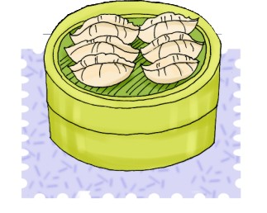
dumplings

Slide 13
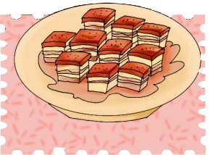
meat

Slide 14
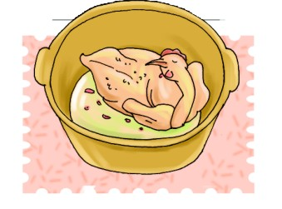
chicken

Slide 15
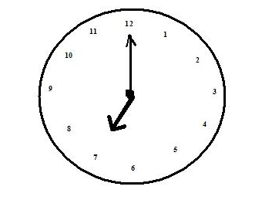
Look！It’s 7 o’clock, we should have____.
Look！It’s 12 o’clock, we should have____.

Slide 16
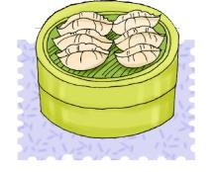
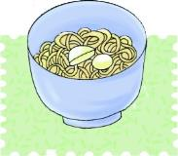
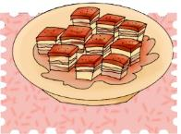
快速反应说单词
—What’s for breakfast?
—I have____ for breakfast.

Slide 17
Listen and circle

