Slide 1
PE lessons
第二课时
WWW.PPT818.COM

Slide 2
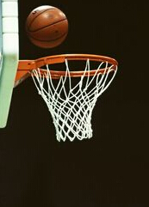
Review
I like… I am good at….

Slide 3
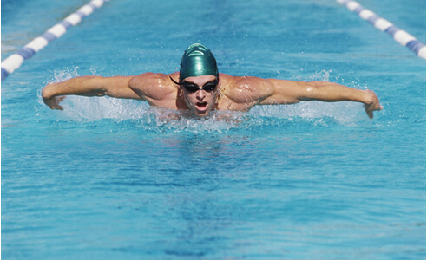
Warming
Do you like swimming?
What do you need for a swimming lesson?

Slide 4
Presentation
We need a swimsuit for a swimming lesson.

Slide 5
Presentation
We need a swimming cap for a swimming lesson.

Slide 6
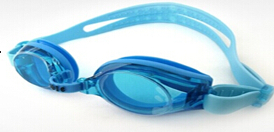
Presentation
We need a swimming goggles for a swimming lesson.

Slide 7
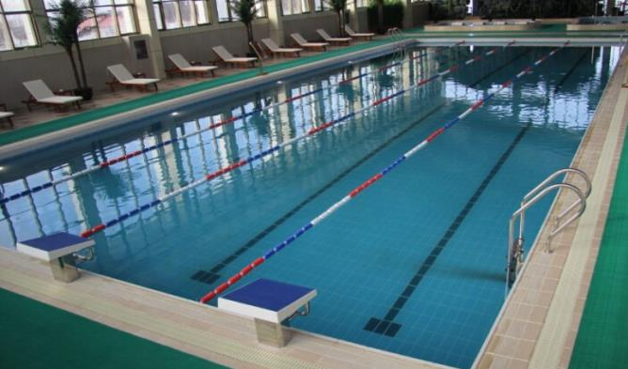
Presentation
We need a swimming pool for a swimming lesson.

Slide 8
Discussion
What should we do in a swimming lesson?

Slide 9
Presentation
The swimsuit should not be too big or too small.
Wear a pair of swimming goggles, so the water doesn’t get into your eyes.

Slide 10
Presentation
Wash yourself before you go into the swimming pool. Do it after swimming too.

Slide 11
Presentation
Do warm-up exercises before you go into the water.

Slide 12
Presentation
Swimming is fun. It helps you stay healthy and fit.
Enjoy your swimming lessons!

Slide 13
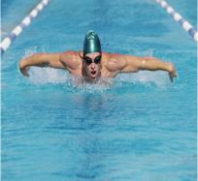
Discussion
We need…for wimming.
We should …

Slide 14
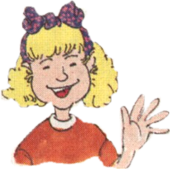
Work in pairs.
What do we need for swimming?
Let’s go swimming. I’ll teach you how to swim.
We need….

Slide 15
Work in pairs.
First , we should….
Next, we should….
What should we do first?
Now let’s go into the water.

Slide 16
Work in groups
Do a survey. What’s your favorite activity in PE lessons? Ask and answer the questions with your classmates.
What’s your favorite activity in PE lessons?
I like playing football.

Slide 17
Summary
本课重点句型：
We need … for a swimming lesson.
We should …

Slide 18
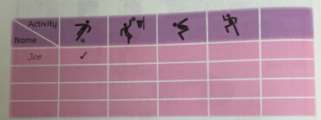
Homework.
Write a report about your survey.
In our PE lessons, we _______________________.
I like ____________________________________.
In my class, ________ students like ____________.
_______ students like _______________________.
_________________________________________.

Slide 19
The End

