Slide 1
陕旅版英语六年级上册
Unit6 What Did You Do Last Weekend?
第2课时
WWW.PPT818.COM

Slide 2
教学目标：
1. 掌握动词过去式的构成规律和发音规律。
2. 能正确使用一般过去时态描述过去发生的动作或活动：What did you do last weekend? I did some housework. I cleaned the rooms,…并能正确模仿对话，做到语音语调自然。
3. 理解并会用I’m sorry to hear that.对别人的不如意表达关切。

Slide 3
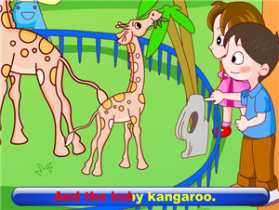
Listen to a song: What did you do?

Slide 4
Free talk
What did you do yesterday?
What did you do last Saturday?

Slide 5
Free talk
What do you often do on the weekend?
I do…
What did you do last weekend?
I did...

Slide 6
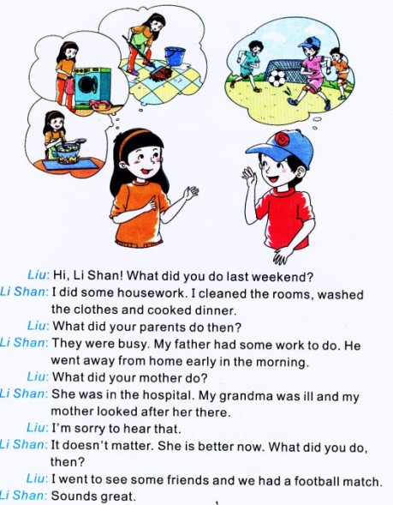
Let’s talk
读一读，圈出对话中出现的几个行为动词的过去式。

Slide 7
Can you answer the questions?
1. What did Li Shan’s parents do?
2. What did Li Shan you do?

Slide 9
Answers
1. What did Li Shan’s parents do?
2. What did Li Shan do?
She went to see some friends and we had a football match.
Her father had some work to do. He went away from home early in the morning.
Her mother looked after my grandma in the hospital.

Slide 10
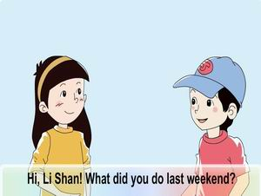
观看课文动画并大声跟读

Slide 11
Summary:动词过去式的变化规律
1. 一般情况下，在动词原形后直接加-ed。如：cooked, looked。
2. 以不发音的字母e结尾的动词，直接加-d。如：liked, lived。
3. 重读闭音节单词需双写最后一个字母，再加-ed。如：stopped。
4. 以辅音字母+y结尾的动词变y为i，再加-ed。如：studied, tried。
5. 有些动词不符合上面的规则，需要特殊记忆。如：
go — went eat — ate see — saw
swim — swam buy — bought teach — taught bring — brought think — thought fall — fell
hurt — hurt break — broke win — won
lose — lost

Slide 12
Practice
cook —
wash —
look —
go —
see —
jump —
take —
fly —
swim —
do —
listen —
say —
play —
want —
cooked
flew
washed
swam
looked
did
went
listened
saw
said
jumped
played
took
wanted

Slide 13
小贴士
动词过去式发音规律根据词尾读音的不同有3种情况：
1.在浊辅音和元音后读[d]，如lived, watered, listened, played；
2.在清辅音后读[t]，如liked, helped, watched；
3.在[t]，[d]音后读[id]，如planted, wanted, handed。

Slide 14
Role play
分角色扮演文中的刘朝阳和李珊。

Slide 15
Let’s play—你秀我答
—What did you do last weekend?
—I...
教师将所准备的其中一张活动卡片展示给一名学生，让该生根据图片做出相应的动作，然后由教师提问，全班学生根据动作提示作答。

Slide 16
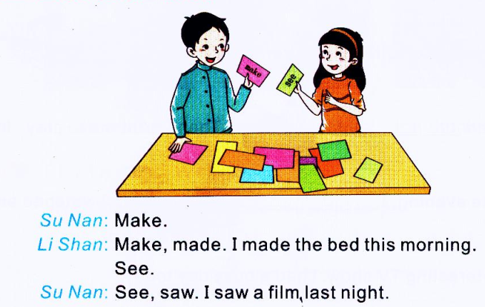
Part C Look and talk
(1) 教师将所准备的动词原形卡片贴在黑板上，然后将全班分成男女生两组进行接力比赛。
(2) 每组各派一名代表以猜拳的方式决定先后，胜利的那—方选择黑板上的一个动词，并指定对方组的一名成员开始造句。

Slide 17
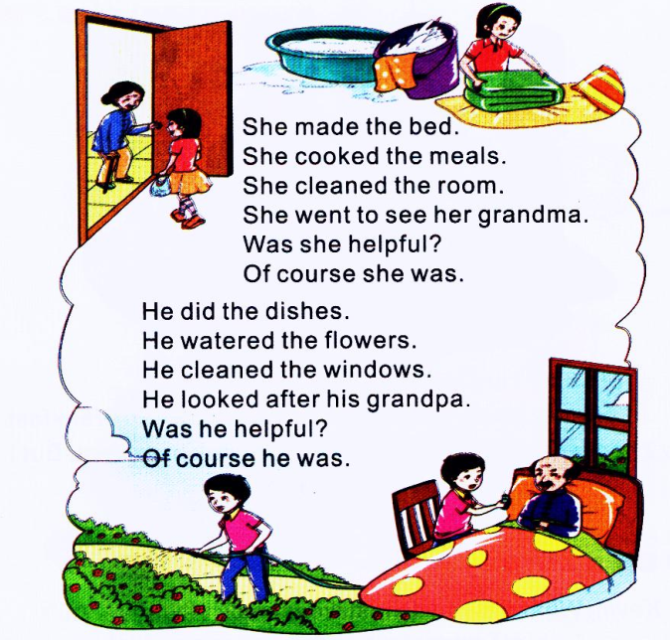
Part B Let’s chant
学生自己练习说唱歌谣，可以以小组为单位进行表演，也可以参考本部分的内容创编新的歌谣。同伴间比一比，看看谁的表演最生动，谁编的歌谣最有趣。

