Slide 1
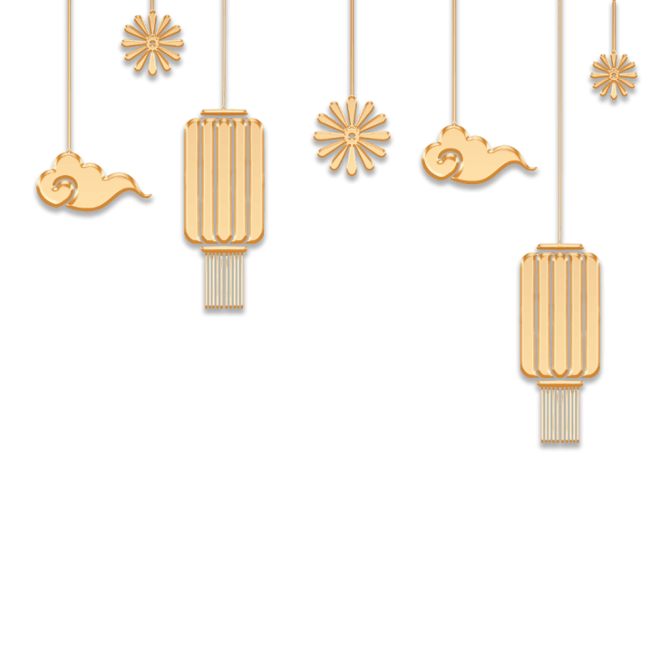

Slide 2
Contents
01.
Synergistically utilize technically sound portals with frictionless chainsSynergistically
04.
Synergistically utilize technically sound portals with frictionless chainsSynergistically
02.
Synergistically utilize technically sound portals with frictionless chainsSynergistically
05.
Synergistically utilize technically sound portals with frictionless chainsSynergistically
03.
Synergistically utilize technically sound portals with frictionless chainsSynergistically
06.
Synergistically utilize technically sound portals with frictionless chainsSynergistically

Slide 3
ONE.
/单击此处添加标题/
Synergistically utilize technically sound portals with, Synergistically utilize technically sound

Slide 4
Synergistically utilize technically sound portals with, Synergistically utilize technically sound, , Synergistically utilize technically sound portals with, Synergistically utilize
1PPT.COM
Synergistically utilize technically sound portals with, Synergistically utilize technically sound, , Synergistically utilize technically sound portals with, Synergistically utilize

Slide 5
01
Synergistically utilize technically sound portals with, Synergistically utilize technically sound, , Synergistically utilize
$150M
02
Synergistically utilize technically sound portals with, Synergistically utilize technically sound, , Synergistically utilize
$200M
03
Synergistically utilize technically sound portals with, Synergistically utilize technically sound, , Synergistically utilize
$15M

Slide 6
1
Synergistically utilize technically sound portals with, Synergistically utilize technically sound, , Synergistically utilize technically sound portals with, Synergistically utilize
2
Synergistically utilize technically sound portals with, Synergistically utilize technically sound, , Synergistically utilize technically sound portals with, Synergistically utilize
3
Synergistically utilize technically sound portals with, Synergistically utilize technically sound, , Synergistically utilize technically sound portals with, Synergistically utilize

Slide 7
1PPT.COM
Synergistically utilize technically sound portals with, Synergistically utilize technically sound, , Synergistically utilize technically sound portals with, Synergistically utilize
Synergistically utilize technically sound portals with, Synergistically utilize technically sound, , Synergistically utilize technically sound portals with, Synergistically utilize

Slide 8
Two.
/单击此处添加标题/
Synergistically utilize technically sound portals with, Synergistically utilize technically sound

Slide 9
Synergistically utilize technically sound portals with frictionless chainsSynergistically，Synergistically with
Synergistically utilize technically sound portals with frictionless chainsSynergistically，Synergistically with
Synergistically utilize technically sound portals with frictionless chainsSynergistically，Synergistically with
Synergistically utilize technically sound portals with frictionless chainsSynergistically，Synergistically with

Slide 10
10M
6M
4M
Synergistically utilize technically sound portals with, Synergistically utilize technically sound, , Synergistically utilize
Synergistically utilize technically sound portals with, Synergistically utilize technically sound, , Synergistically utilize
Synergistically utilize technically sound portals with, Synergistically utilize technically sound, , Synergistically utilize

Slide 11
Synergistically utilize technically sound portals with, Synergistically utilize technically sound, , Synergistically utilize technically sound portals with, Synergistically utilize
Synergistically utilize technically sound portals with, Synergistically utilize technically sound, , Synergistically utilize technically sound portals with, Synergistically utilize
Synergistically utilize technically sound portals with, Synergistically utilize technically sound, , Synergistically utilize technically sound portals with, Synergistically utilize

Slide 12
Synergistically utilize technically sound portals with, Synergistically utilize technically sound, , Synergistically utilize
Synergistically utilize technically sound portals with, Synergistically utilize technically sound, , Synergistically utilize
Synergistically utilize technically sound portals with, Synergistically utilize technically sound, , Synergistically utilize
Synergistically utilize technically sound portals with, Synergistically utilize technically sound, , Synergistically utilize
Synergistically utilize technically sound portals with, Synergistically utilize technically sound, , Synergistically utilize
Synergistically utilize technically sound portals with, Synergistically utilize technically sound, , Synergistically utilize

Slide 13
Three.
/单击此处添加标题/
Synergistically utilize technically sound portals with, Synergistically utilize technically sound

Slide 14
1
2
Synergistically utilize technically sound portals with frictionless chainsSynergistically，Synergistically utilize
Synergistically utilize technically sound portals with frictionless chainsSynergistically，Synergistically utilize
3
4
Synergistically utilize technically sound portals with frictionless chainsSynergistically，Synergistically utilize
Synergistically utilize technically sound portals with frictionless chainsSynergistically，Synergistically utilize

Slide 15
$150M
Synergistically utilize technically sound portals with, Synergistically utilize technically sound
1PPT.COM

Slide 16
Four.
/单击此处添加标题/
Synergistically utilize technically sound portals with, Synergistically utilize technically sound

Slide 17
01
Synergistically utilize technically sound portals with, Synergistically utilize technically sound
02
Synergistically utilize technically sound portals with, Synergistically utilize technically sound
03
Synergistically utilize technically sound portals with, Synergistically utilize technically sound
04
Synergistically utilize technically sound portals with, Synergistically utilize technically sound

Slide 18
Five.
/单击此处添加标题/
Synergistically utilize technically sound portals with, Synergistically utilize technically sound

Slide 19
01.
02.
03.
Synergistically utilize technically sound portals with, Synergistically utilize technically sound, Synergistically utilize
Synergistically utilize technically sound portals with, Synergistically utilize technically sound, Synergistically utilize
Synergistically utilize technically sound portals with, Synergistically utilize technically sound, Synergistically utilize

Slide 20
01
Synergistically utilize technically sound portals with, Synergistically utilize ，Synergistically utilize technically sound portals with, Synergistically utilize technically sound
technically sound
03
Synergistically utilize technically sound portals with, Synergistically utilize ，Synergistically utilize technically
02
04
Synergistically utilize technically sound portals with, Synergistically utilize ，Synergistically utilize technically sound portals with, Synergistically utilize technically sound
technically sound
Synergistically utilize technically sound portals with, Synergistically utilize ，Synergistically utilize technically sound portals with, Synergistically utilize technically sound
technically sound

Slide 21
Six.
/单击此处添加标题/
Synergistically utilize technically sound portals with, Synergistically utilize technically sound

Slide 22
0 1
0 1
0 1
1PPT.COM
1PPT.COM
1PPT.COM
Synergistically utilize technically sound portals with, Synergistically utilize technically sound, , Synergistically
Synergistically utilize technically sound portals with, Synergistically utilize technically sound, , Synergistically
Synergistically utilize technically sound portals with, Synergistically utilize technically sound, , Synergistically

Slide 23
$150M
$200M
$15M
01
02
03
Synergistically utilize technically sound portals with, Synergistically utilize technically sound, , Synergistically utilize
Synergistically utilize technically sound portals with, Synergistically utilize technically sound, , Synergistically utilize
Synergistically utilize technically sound portals with, Synergistically utilize technically sound, , Synergistically utilize

Slide 24
01
02
Synergistically utilize technically sound portals with, Synergistically utilize ，Synergistically utilize technically sound portals with, Synergistically utilize technically sound
technically sound
Synergistically utilize technically sound portals with, Synergistically utilize ，Synergistically utilize technically sound portals with, Synergistically utilize technically sound
technically sound
03
04
Synergistically utilize technically sound portals with, Synergistically utilize ，Synergistically utilize technically sound portals with, Synergistically utilize technically sound
technically sound
Synergistically utilize technically sound portals with, Synergistically utilize ，Synergistically utilize technically sound portals with, Synergistically utilize technically sound
technically sound

