Slide 1
Unit5 Country Life
He goes to school by school bus.
WWW.PPT818.COM

Slide 2
Free talk.
What do you usually do after school/ at the weekend?
play games
play football
read books
watch TV
play with my dog
do my homework
I _________.

Slide 3
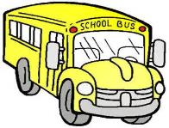

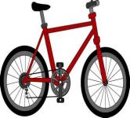
Free talk.
How do you go to school every day?
I go to school by_____. /I walk to school.

Slide 4
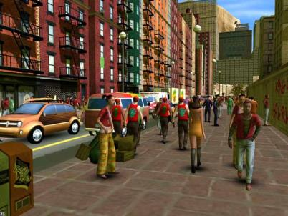
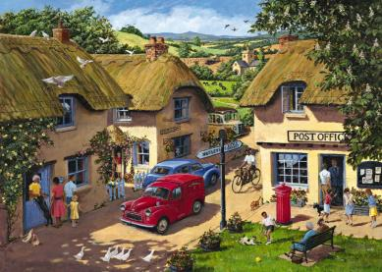
Let’s talk.
I live in the_________.
City
Country

Slide 5

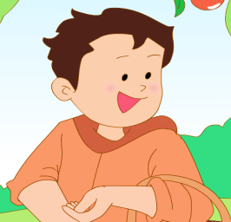
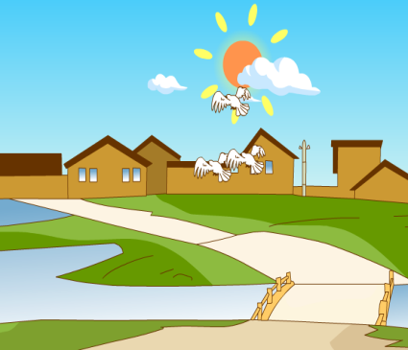
Let’s look and read.
(填空并朗读句子)
Country
Four
is in Grade____.He lives in the _________.
Guo Liang
country

Slide 6
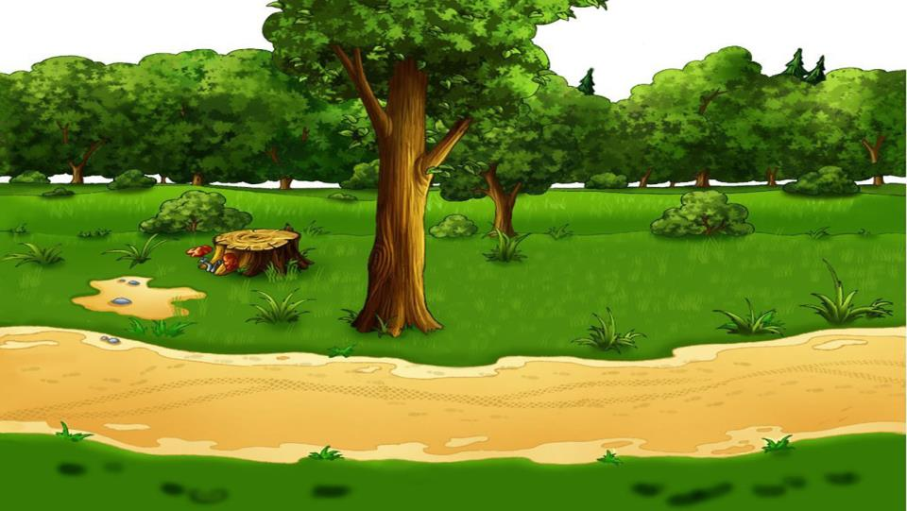
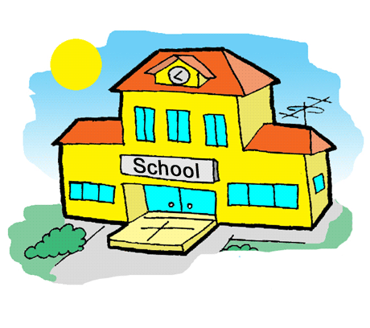





Let’s guess.
1). How does Guo Liang go to school?
He goes to school by _______ .

Slide 7

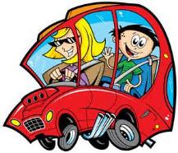

Let’s ask and answer.
A:How does Guoliang go to school?
school bus.
B:He goes to school by .
Tom
Jim
car
bike

Slide 8
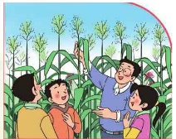
Questions
What class does Guo Liang like?
He likes science.
Where does he have the class?
Sometimes he has science classes in the field.

Slide 9
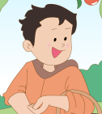
Questions.
2). What does he often do after school?
3). What does he usually do at the weekend?

Slide 10
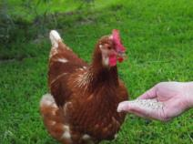
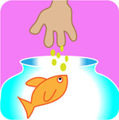
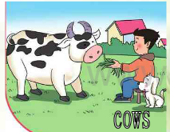
Let’s discuss and answer.（讨论并回答）
2). What does he often do after school?
After school he often helps his
parents .
feed the cows
c

Slide 11
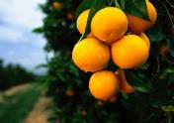
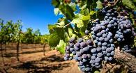

Let’s answer.
3). What does he usually do at the weekend?
At the weekend, he usually goes to his father’s .
orchard

Slide 12

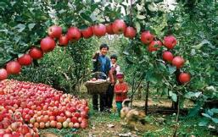
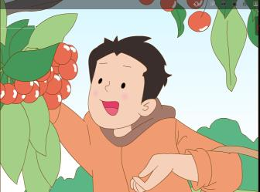
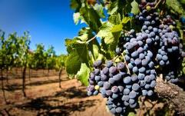
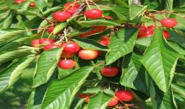
Let’s read.
e
s
s
o
n
3
L
There are many fruit trees in father’s orchard.
What is Guoliang doing ?
He is picking cherries.

Slide 13
Practice.
Read in groups.

Slide 14
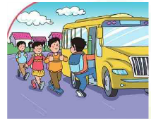
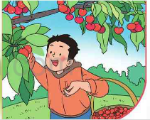

Slide 15
Match.
1
2
3
4
feed the cows
pick cherries
go to school
have science class

Slide 16
Let’s write.
Fill in the blanks
Hello, everyone! I am Guo Liang. I live in the country. I ________________________by school bus. My favourite class is science. Sometimes I have science classes________________. I have many interesting things to do________________. I often feed the cows. At the weekend, I usually go to our orchard to help my father__________________. I enjoy my life.
Word bank
in the field
pick fruit
go to school
after school

Slide 17

()
Talk and introduce yourself.
（Group work）小组合作
I am in Grade _____.
I live in the______.
(country\city)
I go to school by__________.
(bus\car\bike)
After school, I often_________.
At the weekend, I usually _______.
Thank you!
Word bank
play football
read books
watch TV
go shopping
do my homework
pick fruit

Slide 18
Read and write. is after many picking by in
many
1. How _____ ducks do you have ?
2. The potatoes are ___ the soil.
3. There ___ a bird in the sky.
4. I have many interesting things to do _____ school.
5. Look. He is _____ cherries.
6. He goes to school ____ bike .
in
is
after
picking
by

Slide 19

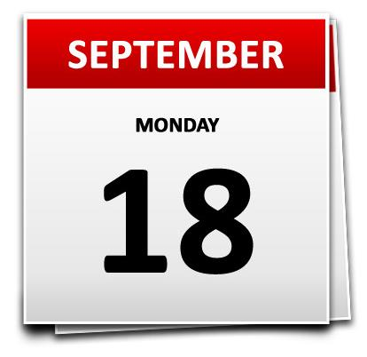
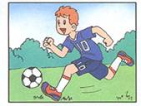
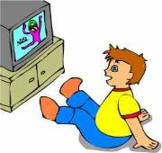
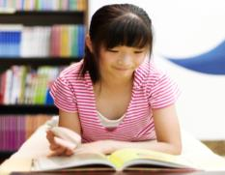
play football
watch TV
read a book

Slide 20

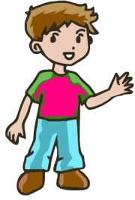
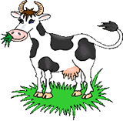
I .
feed the cow

Slide 21
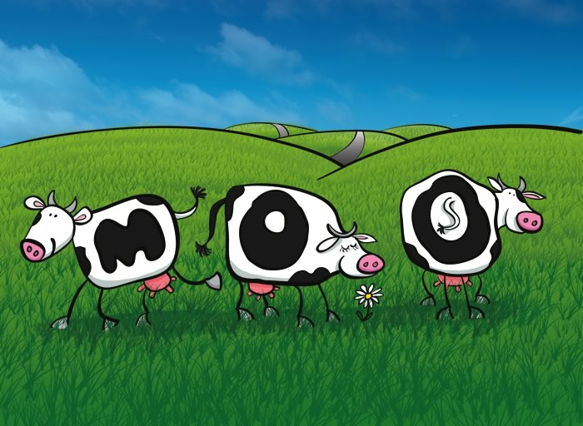
The cows are in the .
field

Slide 22
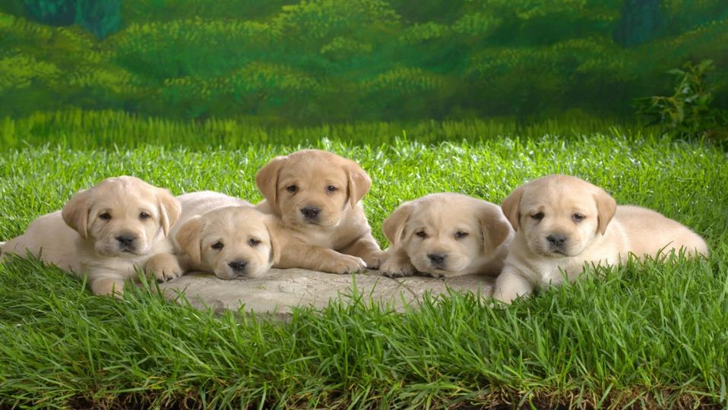
The dogs are .
in the field

Slide 23
Homework
Listen and Read the passage by yourself. (must)
听短文并朗读(必做)
Try to introduce the country or city life of yourself and your friend’s.（Optional）
试着介绍你和你朋友的城市或乡村生活(选作)

