Slide 1
Unit 2 This is my sister.
Section A (1a～1c)
WWW.PPT818.COM

Slide 2
1．parent
作名词，意为“父亲或母亲”，为单数形式，parent＝father or mother，复数形式parents＝father and mother，指的是父母两人。
2．This is sister.这是我的姐姐。
这是一个用来介绍他人的常用句型。英语中的介绍分为两种：
(1)自我介绍。在介绍前可用适当的打招呼用语或问候语，如Hello！或Hi！此时常用My name is…或I'm…句型。
(2)介绍他人。介绍在场的第三人时，常用句型为This is… That is…或That's…一般不用He is…或She is…。

Slide 3
3．Who's she？她是谁？
这是由who引导的特殊疑问句，用来询问某人是谁。
4．and these are my brothers.这些是我的兄弟们。
(1)these是指示代词，意为“这些”，它是this的复数形式。在英语中，指示代词共有四个：this，these，that，those，这些指示代词的意思和用法与汉语里的“这个”“这些”“那个”“那些”相近。this的复数是these，用来指距说话人距离近或时间上近的人或事物；而that的复数形式是those，是指在空间或时间上较远的人或事物。this，that与单数名词连用，these，those与复数名词连用。
(2)brothers是brother的复数形式。

Slide 4
一、用所给词的适当形式填空。
1．Is this _____(you) father?
2．Those _______(is) my grandparents.
3． _________(this) are my parents.
4．These are my ________(sister)．
5．This is my brother. ________(he) name is Tom.
your
are
These
sisters
His

Slide 5
二、根据句意及汉语提示写单词。
6．—Who's she?
—She is my _______(妹妹)．
7．That's my _________(家庭)．Those are my __________(父母亲)．
8. ________(这些) are my rulers.
9．This is my _________(哥哥)．
10．My _________(妈妈) is in China now.
sister
family
parents
These
brother
mother

Slide 6
三、按要求完成句子。
11．This is my brother.(用brothers改写句子)
_____________my brothers.
12．That is a key.(用keys改写句子)
_______are keys.
13．He is my_brother．(对画线部分提问)
__________ he?
14．These are my pens.(用pen改写句子)
_________ my pen.
15．Those are oranges.(用orange改写句子)
________________orange.
These are
Those
Who is
This is
That is an

Slide 7
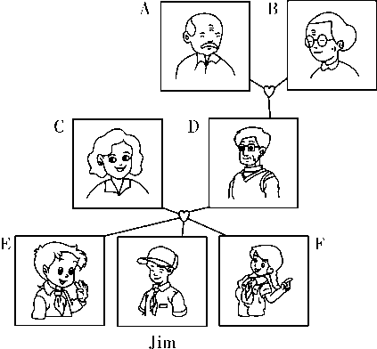
四、下面是Jim的家谱图，请根据图片内容及人物身份进行图文配对。
16．Jim's father ______
17．Jim's brother ______
18．Jim's grandfather ______
19．Jim's grandmother ______
20．Jim's parents _________
21．Jim's grandparents _________
22．Jim's mother ________
23．Jim's sister ________
D
E
A
B
CD
AB
C
F

Slide 8
五、单项选择。
24.______ is my sister，Mary.
A．This B．These C．I
25．______ my parents.
A．This is B．These are C．These is
26．His mother's ______ is his grandmother.
A．grandfather B．mother C．father
A
B
B

Slide 9
27．—______ is Bob?
—He's my brother.
A．What B．How C．Who
28．This is Mary and that is Kate.______ my ______．
A．She's，friend B．They're，friends
C．They's，friend
C
B

Slide 10
六、根据情景写单词补全对话。
Li Lan：Cindy，is this your family photo?
Cindy：Yes，29.____ is，Li Lan.
Li Lan：Are these your parents?
Cindy：30. ____，they are.This is my mother，Fenry.31._____ this is my father，Tom.
Li Lan：Oh，32.______ is she?
Cindy：She's my sister，Mary.
Li Lan：Who're they?
Cindy：They 33._____ my grandparents，Linda and Bob.
it
Yes
And
who
are

