Slide 1
Unit 2 Lesson 1
Do you like running?
WWW.PPT818.COM

Slide 2
动词变成动名词
run ---- running
skip ----- skipping
sing ----- singing
draw ----- drawing

Slide 3
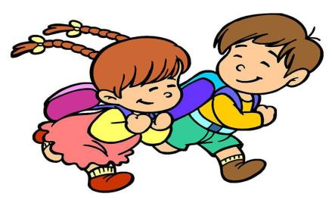
bus—fun—run
Do you like running?
Yes, I do. No, I don’t.

Slide 4
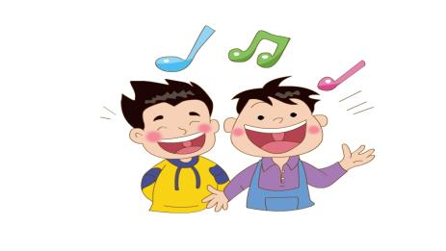
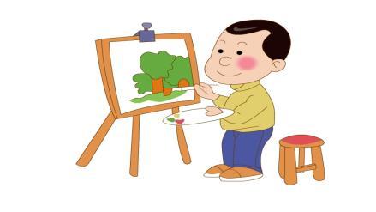
Do you like singing?
Yes, I do./No, I don’t.
Do you like drawing?
drawing
Yes, I do./No, I don’t.

Slide 5
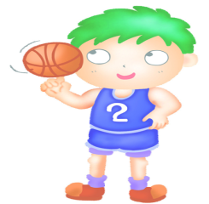
Do you like going shopping?
Yes, I do./No, I don’t.
Do you like basketball?
Yes, I do./No, I don’t.

Slide 6
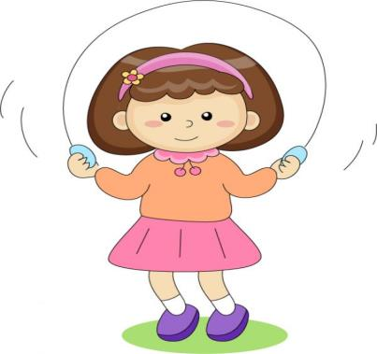
I like skipping.
Do you like skipping?
Yes, I do./No, I don’t.
Hi！Come and skip！

Slide 7
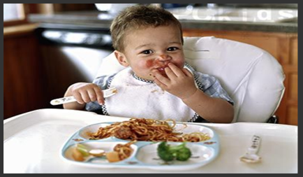
Do you like eating?
Yes, I do. / No, I don’t.
Do you like doing homework?
Yes, I do. / No, I don’t.

Slide 8
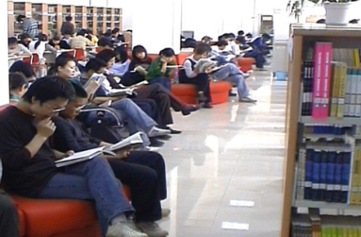
Do you like reading?
Yes, I do. / No, I don’t.

Slide 9
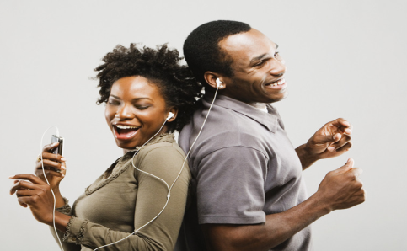
Do you like listening to music?
Yes, I do.

Slide 10
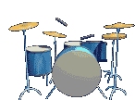
Let’s sing!
Running, running.
Do you like running?
No, no, no, I don’t.
What? What?
What do you like?
Skipping, skipping,
I like skipping.

Slide 11
Practice
1. Pater ____ singing.
A. likes B. like C. play
2. I ____ dancing.
A. likes B. like C. play
3. I like _____ basketball.
A. plays B. playing C. play

Slide 12
Practice
4.She likes playing_____ erhu.
A. the B. / C. a
5. He sings ____.
A. good B. beautiful C. well
6. My hobby is ____ the piano.
A. playing B. play C. plays

Slide 13
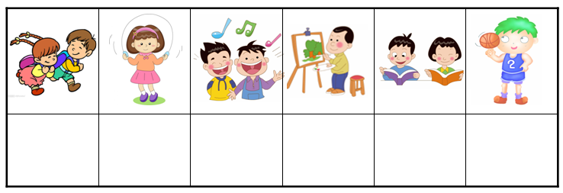
Homework
1.Read the text in roles.
2.Fill in the survey blank with your friends’ name.

Slide 14
Thank you!

