Slide 1
Unit4 How’s the weather today?
人教精通版四年级上册
WWW.PPT818.COM

Slide 2
Let’s chant
Review

Slide 3
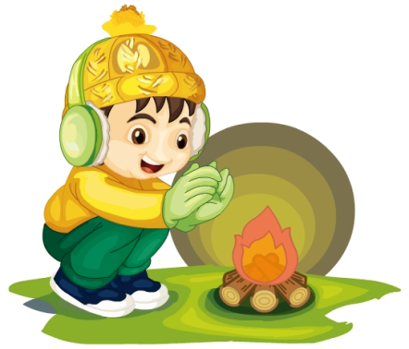
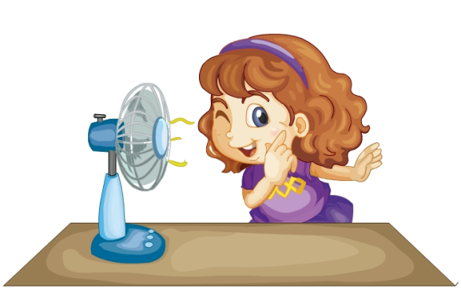
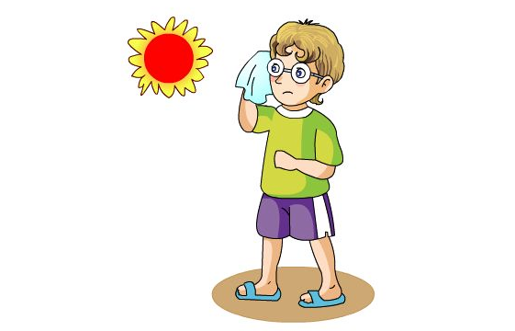
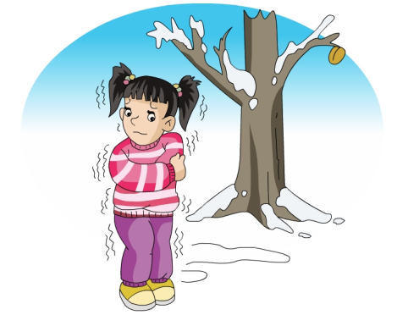
Review
Game
Quick response

Slide 4
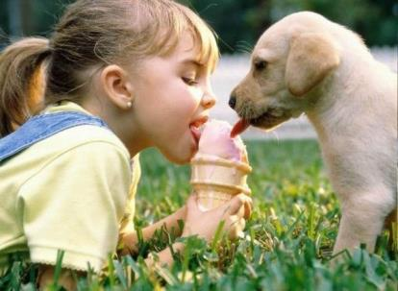
Look and say
Review
It’s … today. Can I have … ?

Slide 5
Presentation
Let’s learn
sunny
It’s sunny.

Slide 6
Presentation
Let’s learn
cloudy
It’s cloudy.

Slide 7
Presentation
Look and say
How’s the weather today?
sunny
cloudy
It’s ____ today.
It’s _____ today.

Slide 8
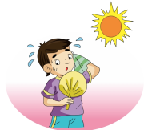
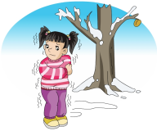
Practice
Game 1
Look and match
cloudy
hot
cold
warm
sunny
cool

Slide 9
Practice
Game 2
What’s missing?

Slide 10
Presentation
Look and say
Guess! What are they talking about?

Slide 11
Presentation
Listen and imitate
1
Mum, how’s the weather today?
2
It’s sunny. Let’s go shopping.
Great!
3
4
Oh, dear. It’s cloudy now.
5
Yes, it is.

Slide 12
Practice
Let’s read
1
2
3
Read together.
(齐读)
Read in roles.
（分角色读）
Read in groups.
(分组读）

Slide 13
Show time
两人一组，练习对话并表演，其他同学评价。
 | 模仿录音中的语音语调，有感情地朗读。
 | 可以脱离课本，适当改动其中部分，语音地道。
 | 适当添加内容，意思完整，有创新，表演生动。
Good
Great
Excellent

Slide 14
Just read and write

Slide 15
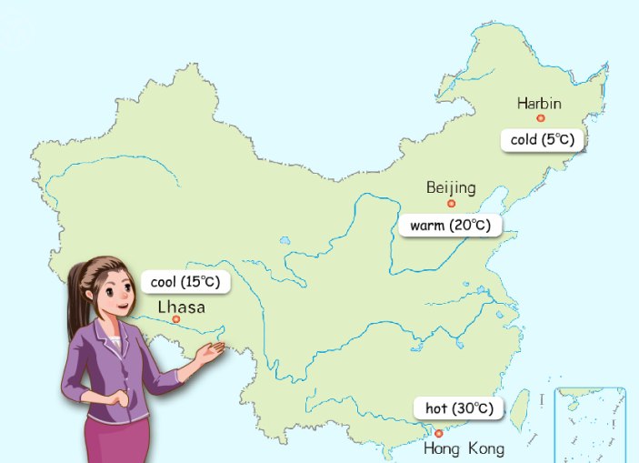
Ask and answer
—How’s the weather in Harbin today?
—It’s sunny today.

Slide 16
Let’s sing
Practice

Slide 17
Summary
本课学习的描述天气状况的单词有:
sunny
cloudy

Slide 18
Summary
如何询问天气状况，并做相应回答呢？
—How’s the weather today?
—It’s … today.

Slide 19
Homework
1. 跟读Just talk部分的课文录音，并注意语音、语调。
2.观看天气预报节目，搜集各种天气图标，并在图标下面
写出正确的英文单词。
3. 预习Lesson 23。
Close

