Slide 1
Unit 6 I'm tall
WWW.PPT818.COM

Slide 2
Happy new year!
新年快乐！

Slide 3
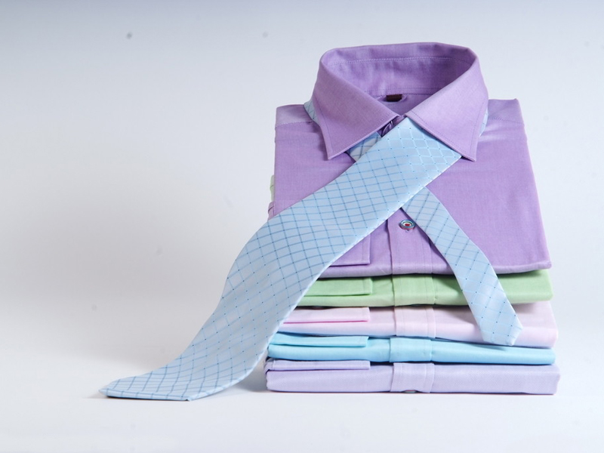
new

Slide 4
happy

Slide 5
Look at my new sweater.
Wow, it's pretty.
看我的新毛衣
哇，真漂亮！

Slide 6
My sweater is old, but I like it.

Slide 7
转折词
But
与and 词义相对。

Slide 8
练一练1.S 2.D 3.S 4.S 5.S
判断画线部分读音是否相同。
(相同的写“S”，不同的写“D”。)
1．year ears( )
2．go come( )
3．happy bag( )
4．miss big( )
5．let bed( )

Slide 9
小练习
连词成句。
1．New，Happy，Year(！)
________________________________________________________________________
2．go，school，to，Let's(.)
________________________________________________________________________
3．us，go，Let，shopping(.)
________________________________________________________________________

Slide 10
答案
1.Happy New Year!
2．Let's go to school.
3．Let us go shopping.

Slide 11
see you

