Slide 1
Unit 7 Seasons
第6课时
WWW.PPT818.COM

Slide 2
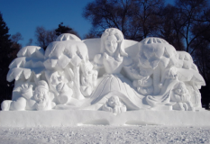
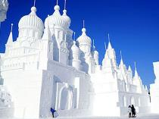
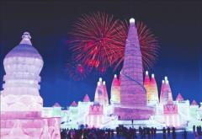
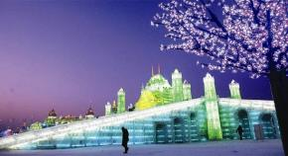
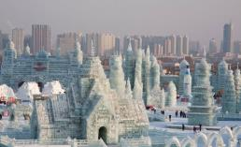
Harbin International Ice and Snow Festival

Slide 3
Task
A)Simon is reading an article about the winter in Harbin on the Internet.
I love winter
Winter is my favourite season. It is very cold and everyone has to wear thick warm clothes, but I always enjoy the winter here in Harbin.
The temperature is usually below zero and it is often snowy. Everything is covered in deep white snow, and the lakes and rivers are frozen. During this season, you cannot see beautiful

Slide 4
flowers or green trees, but the land is quiet and beautiful.
My friends and I love playing outside in winter. It is exciting to have big snowball fights. We throw snowballs at each other, screaming and laughing. We also make snowmen and use carrots for their noses. They look funny. Moreover, I enjoy the Ice Festival each year. There are beautiful ice lanterns everywhere. It is really wonderful.
Winter is great!

Slide 5
Useful expressions
... is my favourite season.
I always enjoy....
I love spring/summer/autumn/winter because....
The temperature is usually....
It is often sunny/windy/rainy....
During this season, you can/cannot....
My friends and I often....

Slide 6
知识点
deep /diːp/ adj. 深的
1
eg: The water is very deep. 水很深。
deep还可指“(颜色)深的；(声音)深沉的”。 eg：The sea is deep blue.大海是深蓝色的。
Men usually have deep voices.
男人通常有着低沉的嗓音。
考向一

Slide 7
考向二
deep还可作副词，意为“深深地；至深处”。
eg: He often works deep into the night.
他常常工作到深夜。
考向三
当deep和数词搭配表示“有……深的”时，deep要放在数词和度量单位之后。
eg: The lake is three meters deep. 这个湖有3米深。

Slide 8
知识点
land /lænd/ n．陆地
2
eg: The biggest animal on land is the elephant.
陆地上最大的动物是大象。
考向
land还可作动词，意为“降落；着陆”。
eg: The pilot landed the plane safely in the heavy snow.
飞行员在大雪中安全地将飞机降落。

Slide 9
知识点
3
throw /θrəʊ/ vt.扔，投，掷
eg: He spent hours throwing a tennis ball against a wall.
他好几个小时都对着一堵墙掷网球。
考向
throw的过去式为threw，过去分词为thrown。
搭配：throw away 扔掉

Slide 10
throw sb. sth.
＝throw sth. to sb. 扔某物给某人
throw sth. at sb. 向某人扔/掷某物 (有目的或目标，带有感情色彩)

Slide 11
知识点
4
everywhere /'evriweə(r)/ adv.到处
eg: I've looked everywhere.
我各处都看过了。
拓展
somewhere 在某处；anywhere 在任何地方(用于否定句和疑问句中时，代替somewhere); nowhere无处；哪里都不

Slide 12
eg: I looked everywhere for my lost key.
我到处寻找我丢失的钥匙。
Let's go somewhere for supper.
让我们去某个地方吃晚饭吧。

Slide 13
B)Answer the questions below about your favourite season.
1.Which is your favourite season?
_____________________________________________
2.What is the weather like then?
_____________________________________________
3.What does your city look like then?
_____________________________________________

Slide 14
4.Why do you like this season?
_____________________________________________
5.What activities do people enjoy doing in this season?
__________________________________________

Slide 15
根据首字母提示完成短文
There are four s________ in a year—spring, summer, autumn and winter. The weather in spring is nice. A windy day is p________ for flying a kite. You can see bees and butterflies play a_______ flowers. They h______ themselves away when the April showers come. People often have sweet m________ of summer days. They can go swimming and eat ice cream. They can also play by quiet s________ or under
easons
erfect
mong
ide
emories
treams

Slide 16
the s________ of trees. When autumn comes, the l________ turn brown and f______ in to piles upon the ground. Farmers are busy h________ crops. Winter is the coldest season of the year. White snow c________ the whole earth. And the temperature can d________ below zero.
hade
eaves
all
arvesting
overs
rop

Slide 17
本节课主要学习了以下知识点，请同学们及时巩固练习：
deep, land, throw, everywhere

