Slide 1
Unit 5 Good manners
Reading 1
WWW.PPT818.COM

Slide 2
Free- talk
How do we greet others?
How do we start a conversation?
Do we greet others with a kiss?
Do we always queue in public?
Do we shout or laugh in public?
Do we push past when someone is in our way?
Do we say “sorry” when we bump into someone?
Do we say “please” or “thank you” at home?

Slide 3
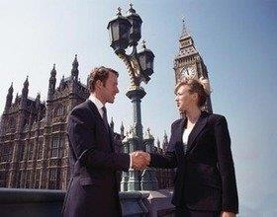
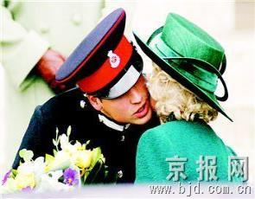
Talk about manners in the UK
meet for the first time
say “hello” or “nice to meet you”
Shake others’ hand
greet relatives or close friends with a kiss

Slide 4
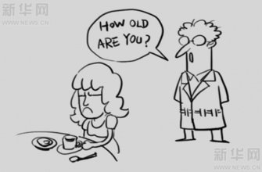
Talk about manners in the UK
Start a conversation
talk about the weather, holidays, music, books…
avoid asking age, weight or money

Slide 5
Talk about manners in the UK
be in public
queue for their turn
never push in others
cut in
never shout or laugh loudly

Slide 6
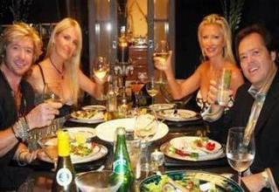
Talk about manners in the UK
be at home
be polite as well
say “please” or “thank you” all the time

Slide 7
When in Rome
Skimming
How can we be polite in other countries?
When in Rome, do as the Romans do.

Slide 8
When in Rome
Scanning
How do people greet others for the first time?
How do people start a conversation?
How do people behave politely in public?
How do people be polite at home?
They say “hello” or “nice to meet you” and shake hands.
They talk about the weather, holidays, music, books or something else.
They queue, keep their voice down, say “sorry” or “excuse me”…
They say “please” or “thank you” all the time.

Slide 9
When in Rome
Fill in the table
 | do | don’t
Greeting | say | greet others with
 | shake
 | talk about | talk about
In public | always | before others
 | say if bumping into someone
 | say if someone is in their way. | or past.
 | keep | or loudly
At home | say all the time
“hello” or “nice to meet you”
with a kiss
the hand
the weather, holiday
Music, books…
age, weight or money
queue
push in
sorry
“excuse me”
touch
push
the voice down
shout
laugh
“please” or “thank you”

Slide 10
When in Rome
Choose T or F
1. People say “hello” or “nice to meet you” when meeting for the
first time.
2. They usually greet others with a kiss.
3. They start a conversation with talking about age, weight .
4. They hardly queue for something.
5. They say “sorry” if they bump into others.
6.They never shout or laugh loudly in public.
7. They sometimes say “please” or “thank you” at home.
T
F
F
F
T
T
F

Slide 11
When in Rome
Finish B2, B3 on Page 68, 69.

Slide 12
Discussion
Talk about the differences in manners
between the UK and China.

Slide 13
Homework
Read the text frequently after class.
2. Try to find out more differences about good manners between the UK and China.

