Slide 1
Unit2 Lesson3
What's your hobby?
WWW.PPT818.COM

Slide 2
Let ‘s chant
Singing ,singing,I like singing.
Dancing,dancing.I like dancing.
Reading,reading,I like reading.
Skipping,skipping,I like skipping.

Slide 3
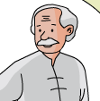
Question 1:
Who are they visiting?
（他们在拜访谁？）
grandpa
grandma
uncle
aunt

Slide 4
Question 2:
Match the family members and their hobbies.
（家庭成员与爱好连线）
My hobby is paper cutting.
My hobby is doing taijiquan.
uncle
I like cooking.
aunt
My hobby is reading.

Slide 5
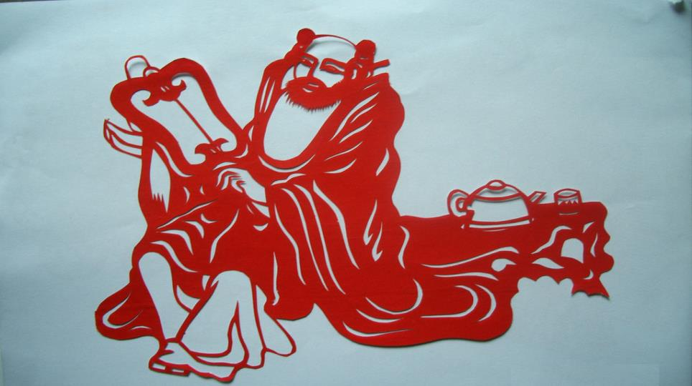
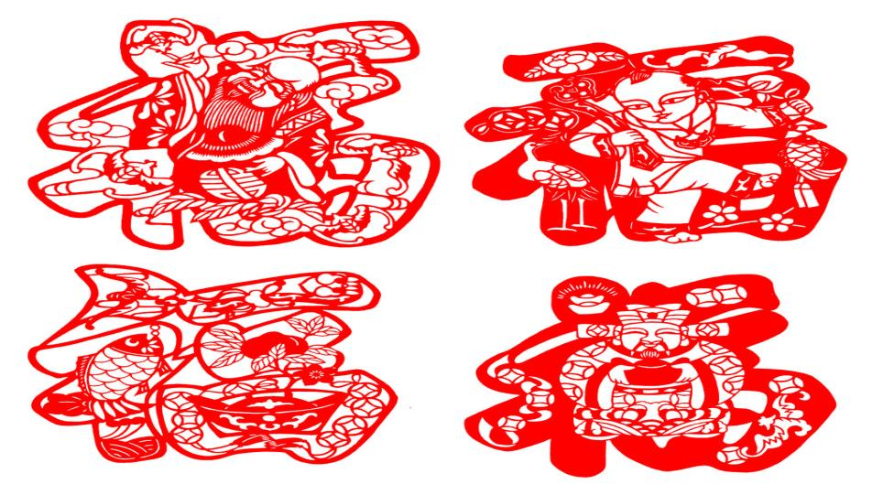
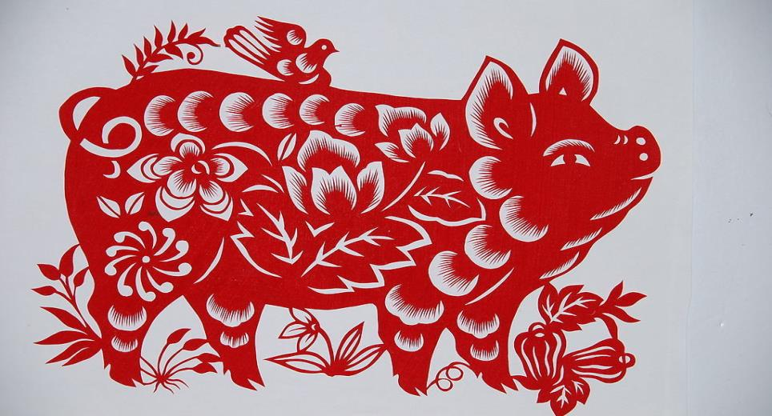
How beautiful!

Slide 6
Can you find the similarities(共同点)?
Grandpa：
doing taijiquan
My hobby is ___________.
paper cutting
Grandma：
My hobby is __________.
Uncle：
My hobby is ______.
reading
Aunt：
cooking
I like ______.

Slide 7
Read by yourselves.

Slide 8
Show time .

Slide 9
Let’s talk

Slide 10
小记者采访
It’s time for
little reporter！

Slide 11
Summary
What have you learned today?
(今天你学到了什么知识？)
What’s your hobby?
My hobby is……
I like ……

