Slide 1
Unit 6 At one with nature
Section Ⅱ Language Points(Starting out & Understanding ideas)
WWW.PPT818.COM

Slide 2
语
言
基
础
自
测
Notes:
2

Slide 3
Flashes
admire
attracted
tradition
Notes:
3

Slide 4
sheet
generation
prevent
design
shallow
Therefore
Notes:
4

Slide 5
completion
significant
design
Notes:
5

Slide 6
tradition
attract
admire
Notes:
6

Slide 7
Notes:
7

Slide 8
wrapped
covered
to
hundreds
to
Notes:
8

Slide 9
far
of
again
Notes:
9

Slide 10
once again
went to so much trouble to
plenty of
As far as the eye can see
Notes:
10

Slide 11
is home to
hundreds of years
was wrapped in
were covered in
Notes:
11

Slide 12
Notes:
12

Slide 13
pulled down
Notes:
13

Slide 14
with whom
Notes:
14

Slide 15
Hearing the news of the
team being defeated
Notes:
15

Slide 16
What they really need
Notes:
16

Slide 17
It is from the sun that
Notes:
17

Slide 18
核
心
要
点
探
究
Notes:
18

Slide 19
Notes:
19

Slide 20
n.封面
v.报道
v.行走(路程)
Notes:
20

Slide 21
v.足以支付
v.覆盖
Notes:
21

Slide 22
Notes:
22

Slide 23
Notes:
23

Slide 24
Notes:
24

Slide 25
Notes:
25

Slide 26
Notes:
26

Slide 27
to keep
sleeping
Notes:
27

Slide 28
Notes:
28

Slide 29
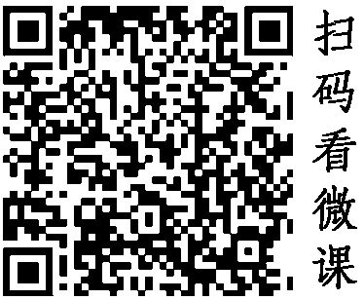
Notes:
29

Slide 30
being carried
is prevented
from
Notes:
30

Slide 31
Notes:
31

Slide 32
Notes:
32

Slide 33
Notes:
33

Slide 34
Notes:
34

Slide 35
harmonious
in
Notes:
35

Slide 36
Notes:
36

Slide 37
Notes:
37

Slide 38
Notes:
38

Slide 39
designed
by
Notes:
39

Slide 40
Notes:
40

Slide 41
Notes:
41

Slide 42
seeing
While
Notes:
42

Slide 43
Notes:
43

Slide 44
Notes:
44

Slide 45
far
is concerned
Notes:
45

Slide 46
Notes:
46

Slide 47
Notes:
47

