Slide 1
精通版·六年级下册
.
Unit 1
I went to Sanya for my holidays.
WWW.PPT818.COM

Slide 2
句型详解
重点句型
1、— What did you do during your holidays ?
假期你做了什么？
— I went to Sanya with my parents.
我和我的父母一起去了三亚。

Slide 3
句型详解
重点句型
2、— How did you get there ？
你们怎么去的那里？
— We went there by plane.
我们乘飞机去那里的。

Slide 4
句型详解
重点句型
3、— Did you have a good time?
你们玩得愉快吗？
Sure !
当然！

Slide 5
句型详解
详细解析
1、— What did you do during your holidays ?
假期你做了什么？
— I went to Sanya with my parents.
我和我的父母去了三亚。
这是一般过去时的特殊疑问句。

Slide 6
句型详解
Where did you do during your holidays?
你们假期去了哪里?
I went to Beijing .
我去了北京。
句型结构：特殊疑问词+did +主语+动词原形+其他？
回 答：主语+动词的过去式+其他

Slide 7
句型详解
详解解析
2、— How did you get there ？
你们怎么去的那里？
— We went there by plane.
我们乘飞机去那里的。
how的意思是“怎样”。

Slide 8
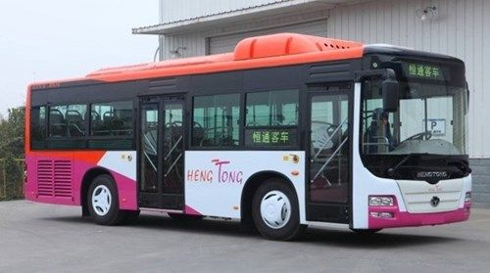
句型详解
2、— How do you go to school ？
你们怎么去上学？
— By bus.
乘公共汽车。
how 的意思是“怎样”，可以对交通方式进行提问。
回答：by+交通工具名称,或者是on foot 表示步行。

Slide 9
句型详解
zh
详细解析
3、— Did you have a good time?
你们玩得愉快吗？
— Sure !
当然！
这是一般过去时一般疑问句形式。

Slide 10
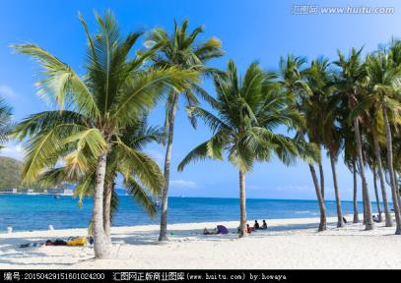
句型详解
— Did you go to Sanya last year ？
去年你去三亚了吗？
— Yes,I did . — No,I didn't .
是的,我去了。/不，我没有去。
句型结构：Did +主语+动词原形+其他
肯定回答：Yes + 主语 +did ./Sure !
否定回答：No + 主语 +didn't .

Slide 11
句型详解
xuxuanze
选择题：
1. What did you
____
A
yesterday ？
A. do B. did C.does

Slide 12
句型详解
xuxuanze
选择题：
A
2. did you go to work last Sunday?
I went to work by car .
A. How B. What C.Where

Slide 13
句型详解
选择题：
xuxuanze
3. Where did you go last summer holiday？
A
I ____ at home .
A. stayed B. stays C.staying

Slide 14
句型详解
how对交通方式进行提问。
小 结
1.— What did you do during you holidays ？
一般过去式
一般过去时特殊疑问句及其回答。
— I went to Sanya with my parents.
2、— How did you get there ？
how对交通方式进行提问。
— We went there by plane.
3、— Did you have a good time?
一般过去时的一般疑问句及其肯定回答。
— Sure !

Slide 15
Thank you !
解析

