Slide 1
Unit 7 Sports and Good Health
Move Your Body
WWW.PPT818.COM

Slide 2
Learning Targets
Key words & phrases:
outdoors, weight, couch, air, lucky, side, worry about, used to, not...any more, put on weight, couch potato, in the sun, get out, on one's side
Key sentences:
1.They used to be very active together.
2.They played games outdoors.
3.But now Ben worries about Tim.
4.Tim is not active any more.
5.And he is putting on weight.
6.But I feel really lucky.
7.With a true friend on my side, ...

Slide 3
Lead in
Look at the following pictures and discuss the two questions with your partner:
1. Do you like staying home or going out?
2. Which do you think is good for you?

Slide 4
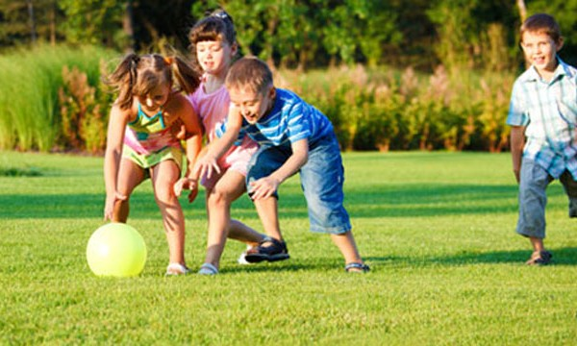
play games outdoors

Slide 5
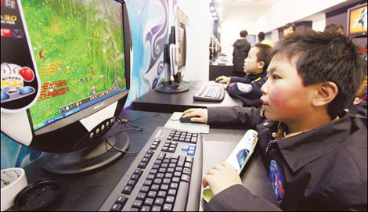
play computer games

Slide 6
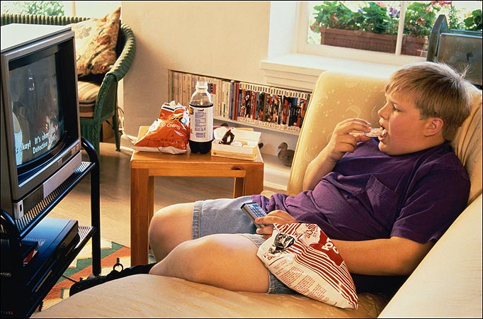
couch potato

Slide 7
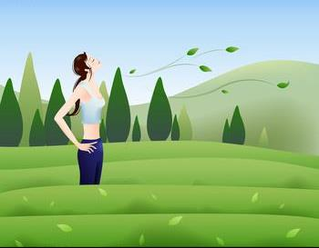
fresh air

Slide 8
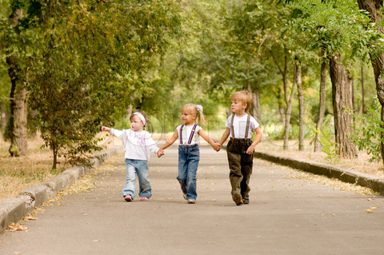
go for a good walk

Slide 9
Words and expressions
outdoors
weight
couch
air
lucky
side
adv. 在户外
n. 重量
n. 睡椅；长沙发椅
n. 空气；天空
adj. 幸运的；侥幸的
n. 边；侧边

Slide 10
used to
过去常常
做游戏
担心……
整天
不再……
体重增加；长胖
出去
沙发土豆
在阳光下
站在某人一边；支持某人
play games
worry about
all day
not…any more
put on weight
couch potato
in the sun
get out
on one’s side

Slide 11
Presentation
1
Listen to the statements and number the pictures.
1
3
2
5
4

Slide 12
2
Read the lesson and write true (T) or false (F).
T
1. Tim used to be very active. ( )
2. Ben watches too much TV and plays too much computer games. ( )
3. Ben and Tim are both putting on weight. ( )
4. Tim finds a letter at his desk. ( )
5. Ben and Tim will meet and go for a good walk. ( )
F
F
F
T

Slide 13
3
Fill in the blanks with the correct forms of the phrases in the box.
worry about go for a walk put on weight
used to any more
1. A: How do you go to school, Mike?
B: I __________ walk to school, but now I ride a bike.
2. A: Be careful and don’t stay out too late.
B: Don’t ______________ me, Mum! I will be OK!
3. A: How is Tom these days?
B: He doesn’t get any exercise and he is not eating healthy food. He is ______________ .
used to
worry about
putting on weight

Slide 14
4. A: You and Jason are neighbours, right?
B: No. He moved to a new house. He is not my neighbour ______________.
5. A: What do you like to do after supper?
B: I like to ______________.
any more
go for a walk

Slide 15
Work in groups. Good friends are important. They help each other. Did a friend ever help you? Did you ever help a friend? What happened? Talk about it .
4

Slide 16
Language points
1. They used to be very active together.
used to是一个固定结构，意为“过去经常，以前常常”，其后用动词原形。它表示过去存在某种状态或者过去的某种经常性、习惯性的行为或者动作，并意味着这种动作目前已经不存在，所以它只表示过去，不表示现在。含used to的句式结构如下：

Slide 17
①肯定句：主语＋used to＋动词原形＋其他。如：I used to play with my friends after school.过去放学后我常常和朋友们一起玩。
②否定句：主语＋didn't＋use/usedn't to＋动词原形＋其他。如：You didn't use to like pop songs.你过去不喜欢流行歌曲。
③一般疑问句：Did＋主语＋use to＋动词原形＋其他？如：Did your sister use to be quiet？你的妹妹过去很安静吗？

Slide 18
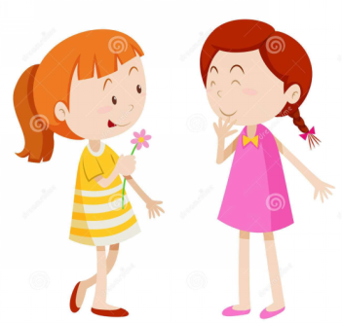
【温馨提示】
used to可以和副词always、often、sometimes等连用，但是仍然是指过去的习惯。如：He always used to be late for class.他过去总是上课迟到。

Slide 19
【用法辨析】
与used to不同搭配的用法
be used to doing sth. | 意为“习惯于做某事”,其中的to是介词, 后接动词要用动名词 | He is used to living in the country. 他已习惯于住在乡下。
be used to do sth. | 表示“……被用来做某事”,是动词use的被动语态结构(此时意为“被用来”,其中的to为不定式符号,其后要接动词原形) | This kind of machine is used to make books. 这种机器是用来制造书的。

Slide 20
2.They played games outdoors.
outdoors作副词，意为“在户外”。其反义词为indoors(在室内)。如：It was warm enough to be outdoors all afternoon.天气很暖和，整个下午都可以待在户外。
【拓展】
outdoor作形容词，意为“户外的，在户外的”，其反义词为indoor(室内的)。

Slide 21
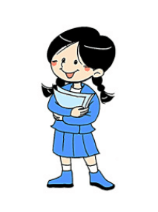
3.Tim is not active any more.
not...any more是固定短语，意为“不再……”，相当于no more。
如：I don't like this pair of shoes any more.我不再喜欢这双鞋了。

Slide 22
4.He watches too much TV and plays too many computer games.
【辨析】too much、too many与much too
①too much 意为“太多”，其后跟不可数名词；它还可以作副词短语用来修饰动词。如：This bottle was filled with too much water.这个瓶子里装了太多的水。

Slide 23
② too many 意为“太多”，其后跟可数名词复数。如：There are too many people in the hall.大厅里有太多的人。
③ much too 意为“太，非常”，常用来修饰形容词或副词，但不能用来修饰动词。如：It rains much too heavily.雨下得太大了。

Slide 24
5.And he is putting on weight.
weight作名词，意为“重量”，其动词形式为weigh(重达……)。常用短语：put on weight 增加体重；lose weight减肥；by weight以重量计算；the weight of... ……的重量；in weight在重量方面；over weight超重。如：She is on the way to lose weight.她正在减肥当中。

Slide 25
6. But I feel really lucky.
lucky作形容词，意为“幸运的”。它既可作表语，也可作定语。其名词形式为luck(运气)；副词形式为luckily(幸运地)。固定搭配：lucky dog 幸运儿。
如：She is really a lucky dog.
她的确是个幸运儿。

Slide 26
7.With a true friend on my side, ...
side作名词，意为“边，旁边，侧边”。常用短语：on one's side站在……这边，支持某人；on the left/right side在左/右边；on one's left/right side在某人的左/右边；on both sides of...在……的两边；on each side of...在……的每一边。如：There are lots of trees on both sides of the river. 河的两边有许多树。

Slide 27
Exercises
一、用所给词的适当形式填空。
1. My grandfather used to_________ (live) in the country, but now he lives with us.
2. Dick decided to lose________(weigh) by eating less and doing more exercise.
3. The boy is _________ (luck) to have a chance to speak to foreigners.
live
weight
lucky

Slide 28
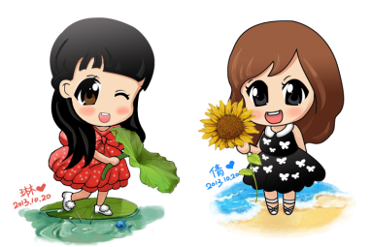
4. I’m on _________ (you) side in this question.
5. Let’s _________ (visit) the Great Wall tomorrow.
your
visit

Slide 29
二、单项填空。
1. Don’t spend _________ time playing _________ computer games. It’s bad for you.
A. too much; too much B. too many; too many
C. too much; too many D. too many; too much
2. Mary used to ________in the countryside, but now she is used to________in the city.
A．live；live B．live；living
C．living；live D．living；living

Slide 30
3. Don’t worry _________ your baby. He is very well.
A. at B. with C. about D. on
4. Don’t read books _________ the sun. It’s bad for your eyes.
A. under B. in C. below D. on
5. Don’t smoke _________. It’s bad for your health.
A. any much B. any more
C. no more D. many

Slide 31
三、翻译下列句子。
1. 李亮体重正在增加。
Li Liang is ____________________.
2. 别担心我的安全。我会小心的。
__________________ my safety. I will be
careful.
3. 你喜欢在户外玩吗？
Do you like to _______________?
putting on weight
Don't worry about
play outdoors

Slide 32
4.银行在超市的对面，路的另外一边。
The bank is opposite the supermarket,
________________of the road.
5.我吃了太多冰激凌，所以我去年夏天重
了五千克。
I ate________ ice cream, so I was five kilos
heavier last summer.
on the other side
too much

Slide 33
Summary
1. Learn some new words and phrases: outdoors, weight, couch, air, lucky, side, worry about, used to, not...any more, put on weight, couch potato, in the sun, get out, on one's side
2. Learn to talk about how you helped your friends
or how your friends helped you.

Slide 34
Homework
1. Review and recite the imporant
points of Lesson 40.
2. It’s very important for friends to help each
other. Did any of your friends help you?
Write something to express your thanks to
him/her.
3. Preview Lesson 41.

