Slide 1
What can we do at home to protect the environment?
Unit 2 Topic 3
Section D
WWW.PPT818.COM

Slide 2
Grammar
Compound Sentence
Recycling can protect the environment, _______ it can save money, too.
Some things we have done are good for the earth _________ some are bad.
We should do everything to protect it, ________ we’ll be punished and lose our home.
…people produce power from coal, _______ it is very dirty and causes acid rain .
and
while
or
but

Slide 3
( ) 1. Help others whenever you can _____ you’ll make the world
a nicer place to live in.
A. or B. and C. but D. while
( )2. Cross the road carefully, ________ you’ll keep yourself safe .
A. so B. or C. but D. and
( ) 3. Hurry up, ________ you’ll be late for the concert .
A. or B. so C. but D. and
( ) 4. ---Tell us something about Canada, OK?
--- I’m sorry. ________ Jack _______ I have ever been there.
A. Either, or B. Not only, but also
C. Both, and D. Neither, nor
( ) 5. I always enjoy visiting London, ______ I wouldn’t like to live
there.
A. because B. so C. but D. and
B
D
A
D
Choose the best answer.
C

Slide 4
Functions
Would you like to be a __________ person?
First, you ought to _________ the electricity when you leave a room.
__________ said than done.
Action speak _________ than words.
The train can _________ a top speed of 431 km per hour.
greener
shut off
Easier
louder
reach

Slide 5
Can you answer them?
What are the three R’s?
Which means “make something less or smaller”?
What should we reduce?
Which means “use it again”?
What should we reuse?
What should we do about recycling?
Reduce, reuse and recycle.
Reduce.
We should reduce the things which people can use only once.
Reuse.
We should reuse plastic bags.
We should collect waste paper or soft drink cans, and sort them so that they can be recycled.

Slide 6
Which one is right?
Throw the rubbish here and there.
Don’t spit in a public place.
Draw a beautiful picture on the public walls.
Don’t throw things away if they can be reused.
Go to school by bike instead of by bus.
Collect the rubbish and try to sort it.
Pour dirty water into rivers directly.
Turn off the lights when you go out.

Slide 7
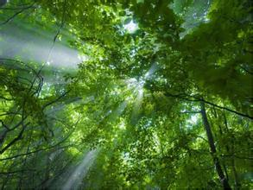
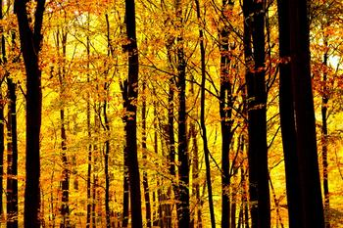
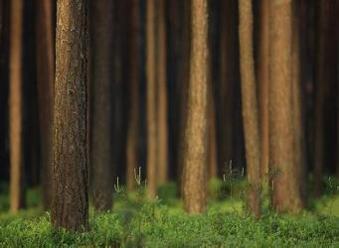
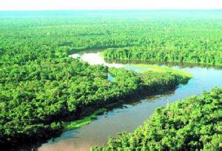
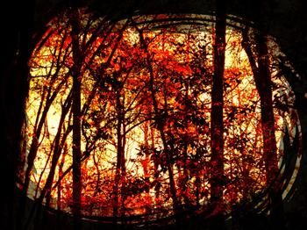
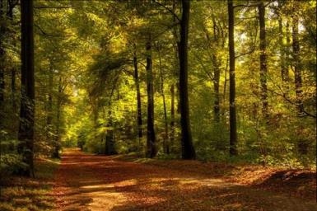
How important is the forest?

Slide 8
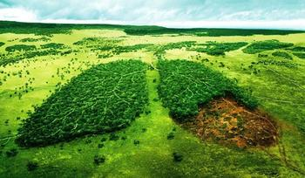
Forests are the lungs of the earth.

Slide 9
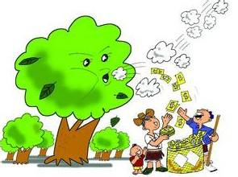
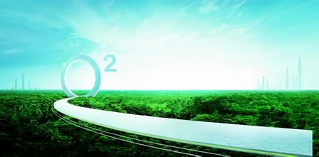
Remove carbon dioxide from the air
Make oxygen

Slide 10
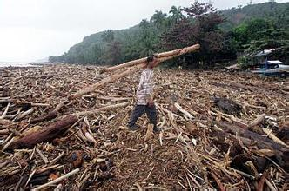
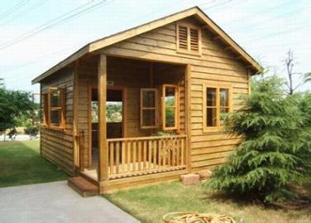
Cut down
Build houses

Slide 11
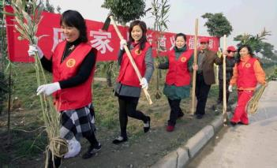
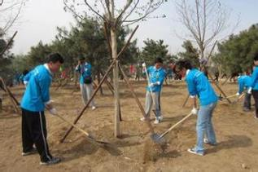
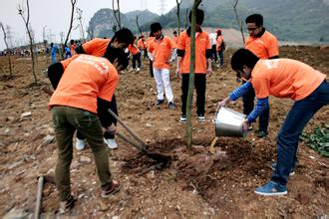
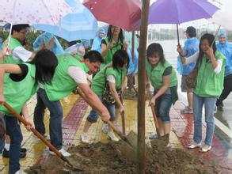
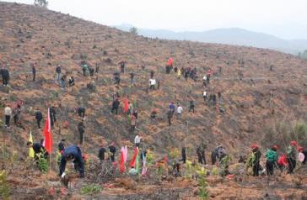
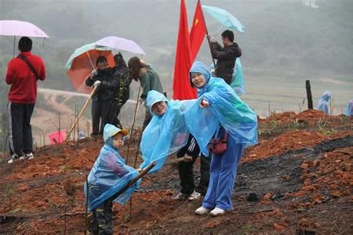
Plant trees

Slide 12
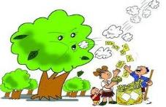
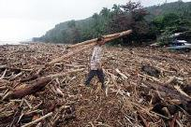
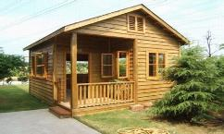
How do you understand “Forests are the lungs of the earth”?
Forests can remove carbon dioxide from the
air and make oxygen.
Retell it

Slide 13
Paragraph 2
What difficulties do tree planters face
when they plant trees ?
(1)The weather may be very hot and dry or it may be very cold and wet.
(2)There are often many insects that bite these planters on their legs, arms, and faces while they work.
(3)They carry heavy bags of small trees, and working in the mountains can be dangerous.
adj.干燥的，雨少的，干性的
v. 使……干，弄干，擦干

Slide 14
Paragraph 3
Why do they plant different kinds of trees ?
They plant different types of trees so that
birds and animals can live in the forests.

Slide 15
Have a try
What will happen if we do not plant new forests ?
The forests will become less and less.
We cannot breathe without them.
Would you like to be a tree planter when you are older ? Why or why not ?
…

Slide 16
Project
=3
=2
=1
=0
Finding the Greenest Person
1. Answer the following questions to see how green you are.
Score:
0—4 You have not started turning green yet!
5—9 You are pale green.
10—13 You are medium green. Try harder.
14—18 You are bright green, but do
not stop trying.

Slide 17
Project
1、Do you usually recycle
newspaper or cans?
Often. Seldom. Never.
2. What do you usually take ?
A bath. A shower.
3. When you have a short journey,how do you
usually go there ?
Walk or ride a bike. Go by car. Go by bus.
4. What do you usually do when you see others
littering?
Stop them.
Pick the litter up.
Do nothing.

Slide 18
Project
5. How often do you use paper towels?
Often. Seldom. Never.
6. How often do you eat fast food?
Often. Seldom. Never.
7. What type of bags do you use for shopping?
Baskets or cloth bags.
Reused plastic bags.
New plastic bags.
8. How often do you turn off the lights when you leave a room?
Nearly always. Seldom. Never.

Slide 19
Summary
We learn: 1. Some words: dry
2. Some phrases: provide sth. to do
sth.; face difficulties; even though
3. Some sentences:
(1)Without them, it cannot breathe.
(2)They plant different types of trees so that birds and animals can live in the forests.
We can: 1. Use the compound sentence correctly.
2. Realize the importance of the forest.

