Slide 1
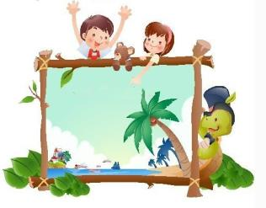
Unit6 My Holiday
陕旅版
五年级下册
第四课时
WWW.PPT818.COM

Slide 2
>>Review
travel enjoy the visit
Magic fingers
place of interest the Palace Museum
the Great Wall the West Lake

Slide 3
>>Review
Game 1
Simon says
enjoy the visit

Slide 4
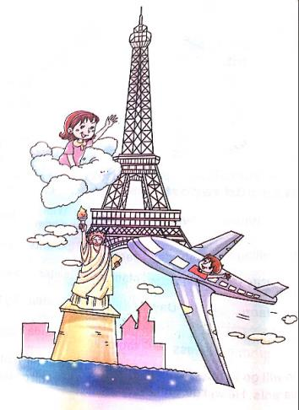
>>Presentation
Q1: What can you see in the picture?
The Eiffel Tower, two children and
the Statue of Liberty.
Q2: Where will the boy go?
He will go to the USA.
Q3: Where will the girl go?
She will go to the France.
Q4: How will they go?
By air.
答案

Slide 5
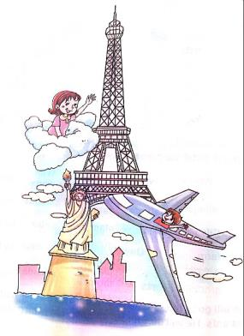
>>Presentation
Su Will Go
Su Will go to France today,
France today,
France today.
She will go by air.
Swoosh, swoosh,
She will go today.
She will go today.
Leo will go to the USA today,
The USA today,
The USA today.
He will go by air.
Up and down,
He will go today.
He will go today.

Slide 6
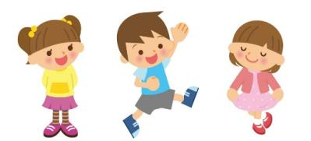
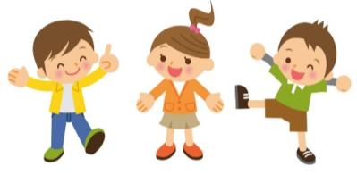
>>Practice
我是小小演唱家
Su Will Go

Slide 7
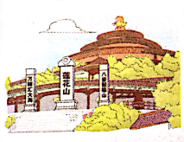
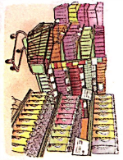
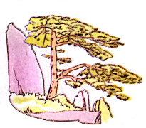
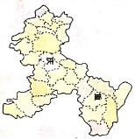
>>Presentation
Look and say
Where are they?
Guangzhou
supermarket
Chongqing
Anhui

Slide 8
>>Presentation
Listen and write
①
②
③
④
by plane
by taxi
by ship
by train

Slide 9
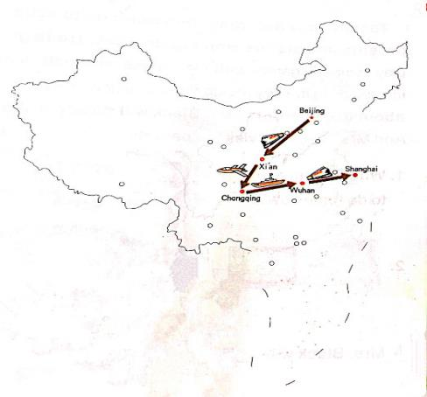
>>Practice
Look and say
Where will Kitty go?
How will she go?

Slide 10
>>Practice
Read and tick
Tomorrow is Saturday. Tom won’t go to school. His parents and sisters won’t go to work. He is going to play computer games with his friends. His sister are not interested in it. They are going to dance in the park. What about their parents? Mr. Black will do some shopping. And Mrs. Black will visit her parents.

Slide 11
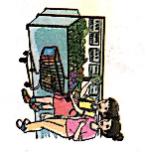
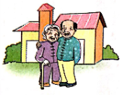
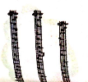
>>Practice
Read and tick
What is Tom going
to do tomorrow?
√
2.
What will the girls do?
√
Mrs. Black will ______
3.
√
答案

Slide 12
>>Summary
会唱歌曲Let’s sing：
Su Will Go
Su Will go to France today,
France today,
France today.
She will go by air.
Swoosh, swoosh,
She will go today.
She will go today.
Leo will go to the USA today,
The USA today,
The USA today.
He will go by air.
Up and down,
He will go today.
He will go today.

Slide 13
>>Homework
1.听课文录音并跟读，按照正确的语音、语调朗读并表演课文对话。 2.将本节课所学的歌曲，给家长演唱。
3.预习Unit7 A Let’s learn。
close

