Slide 1
陕旅版英语五年级上册
Unit3
My Favorite Food Is Hamburgers
第3课时
WWW.PPT818.COM

Slide 2
教学目标：
1. 拓展功能结构：
Mom is drinking coffee. That’s her favorite.
My brother loves chocolate. That’s his favorite.
继续就他人的喜好进行表达，并在教师的带领下完成Let’s learn more部分的问题。
2. 能听懂、会唱Let’s sing部分的歌曲。
3. 能在教师的正确引导下，完成Ask and answer部分的问答，通过小组合作的方式对本单元所学的内容进行归纳和总结，并能在日常生活中灵活运用。

Slide 3
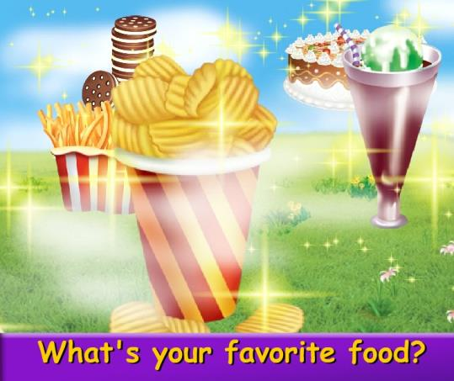
Let’s sing-What’s your favorite food?

Slide 4
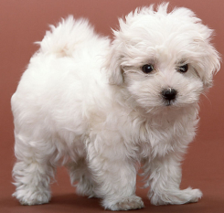
I like dogs very much. Dogs are my favorite animals. How about you? What’s your favorite animal?

Slide 5
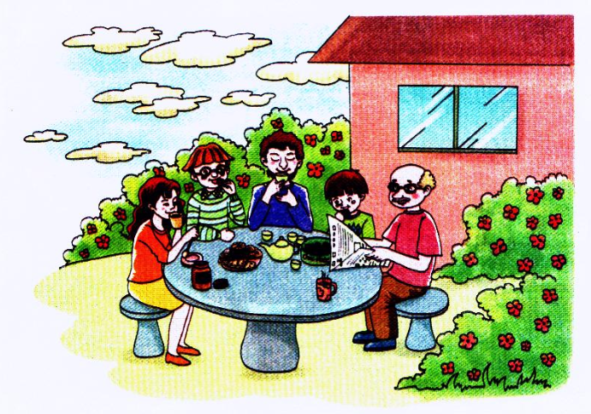
New class!
Look, this is a photo of my family. It’s our afternoon tea time（下午茶时光）.

Slide 6
This is my dad. He is drinking tea.
His favorite drink is tea.

Slide 7
This is my mom. She is drinking coffee.
Coffee is her favorite drink.

Slide 8
This is my grandpa. He is reading. He reads every day.

Slide 9
This is my brother. He loves chocolate.
Chocolate is his favorite.

Slide 10
Can you guess what do I like?
I like cookies best!

Slide 11
Let’s learn more
带着问题看图听短文
(1) What day is it today?
(2) What’s the time now?
(3) What are Kevin’s family doing?
(4) What’s his mother’s favorite drink?
(5) What’s his father’s favorite thing?
(6) What about his grandpa and his brother?
(7) What’s Kevin’s favorite thing?

Slide 12
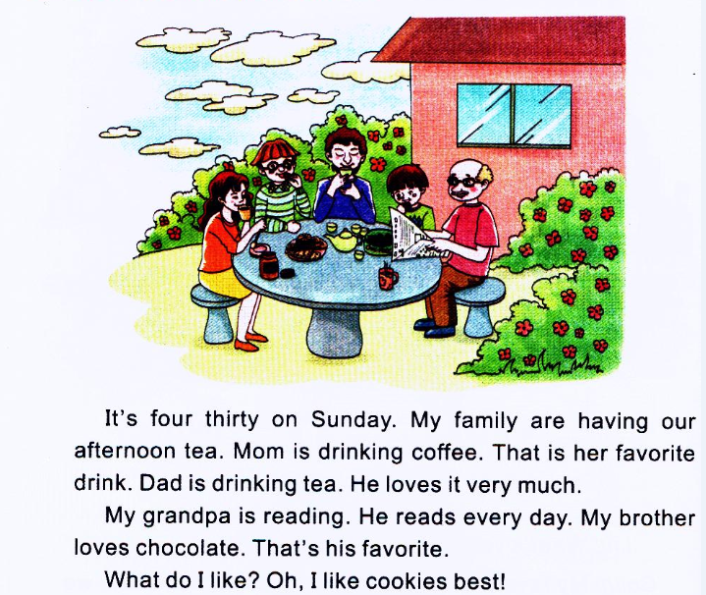
Let’s learn more

Slide 13
The answer
(1) What day is it today?
(2) What’s the time now?
(3) What are Kevin’s family doing?
It’s Sunday.
It’s four thirty.
They are having their afternoon tea.

Slide 14
Review
关于时间的表达法
1. 直接表达法
eleven o’clock 十一点钟，five o’clock 五点钟
ten five 十点五分，seven twenty-five 七点二十五
2. 间接表达法
twenty past six 六点二十 nine past three 三点九分
当分钟数是30时，可用名词half （ 一半）表示。
如：9:30 half past nine，3:30 half past three。

Slide 15
Review
星期的表达

Slide 16
观看动画并大声跟读

Slide 17
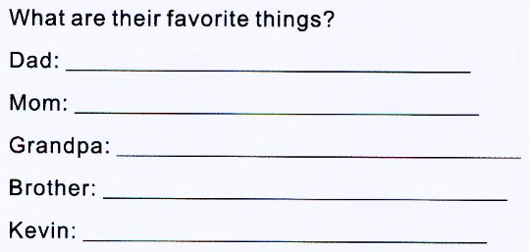
Read again and answer the question
His favorite drink is tea.
Her favorite drink is coffee.
His favorite thing is reading.
His favorite food is chocolate.
His favorite thing is cookies.

Slide 18
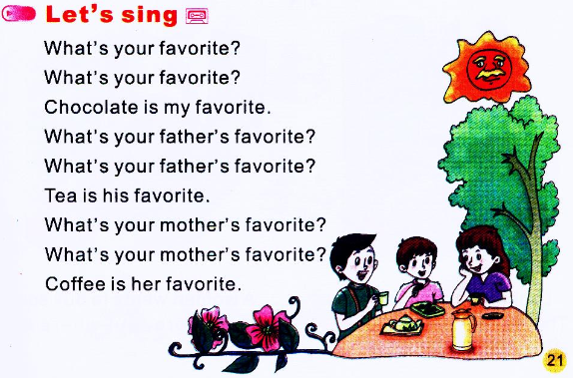
读一读

Slide 19
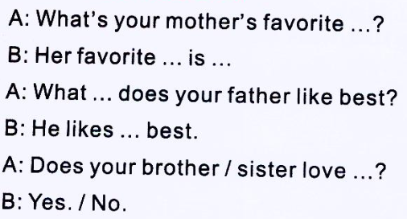
Part C Ask and answer

