Slide 1
Unit4 There are seven days in a week.
人教精通版四年级下册
WWW.PPT818.COM

Slide 2
Review
Let’s chant

Slide 3
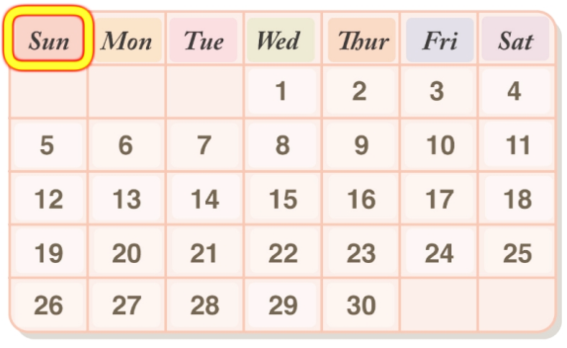
Review
Look and say
Sunday
day
week
What’s the first day of the week?
How many days are there in a week?

Slide 4
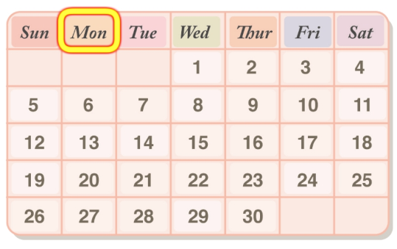
Presentation
Let’s learn
Monday
Monday is the second day of a week in
Western countries.

Slide 5
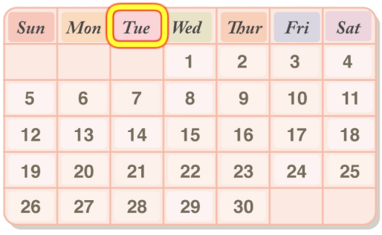
Presentation
Let’s learn
Tuesday
Tuesday is the second day of a week in China.

Slide 6
Presentation
Let’s learn
When do you have art lessons?
Monday
Tuesday
8:30
Chinese
Maths
9:20
Maths
Chinese
10:30
English
art
11:20
art
PE
We have art lessons on Monday and Tuesday.

Slide 7
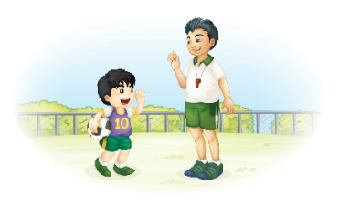
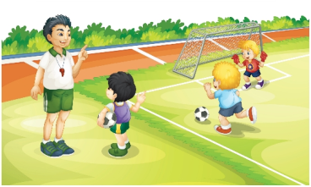
Presentation
Listen and say
1. Does Gao Wei like sports?
Yes, he does.
2. When do they have PE
lessons?
They have PE lessons on
Monday and Tuesday.

Slide 8
Presentation
Let’s learn
Glad to meet you, Gao Wei. Do you like sports?
Welcome to our school! My name is Gao Wei.
Yes, I do. I like PE very much.

Slide 9
Presentation
Let’s learn
When do you have PE lessons?
We have PE lessons on Monday and Tuesday.

Slide 10
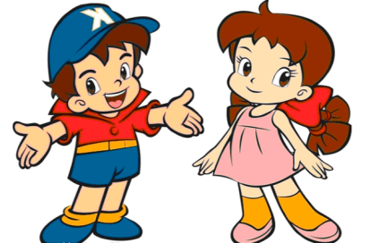
Practice
Role play
两人一组练习Just talk部分对话，随后表演出来吧！

Slide 11
Practice
Let’s do a survey

Slide 12
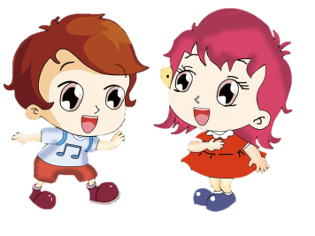
Practice
活动
Write and say
Mon.
Tues.
Wed.
Thur.
Fri.
Chinese
上
午
Maths
English
art
A:Do you like …?
B: Yes/No, ….
A:When do you have … lessons?
B: We have … lessons on …

Slide 13
Summary
本课学到的重点单词：
Monday Tuesday
本课学到的重点句型：
—When do you have … lessons?
—We have … lessons on ...

Slide 14
Homework
1. 跟读课文Just talk部分的录音，注意语音、语调。
2. 了解学校其他年级各学科的日课时或周课时量，将统计结果制成表格，并用英语进行描述。
3. 预习Lesson 21。
Close

