Slide 1
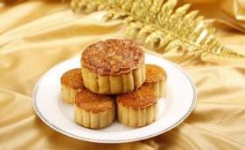
Unit 2
I think that mooncakes are delicious!
Section B (第1课时)
WWW.PPT818.COM

Slide 2
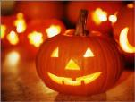
Warming up
Do you know something about Halloween?

Slide 3
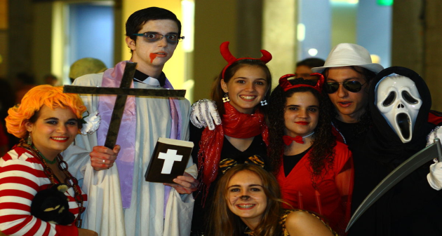

Slide 5
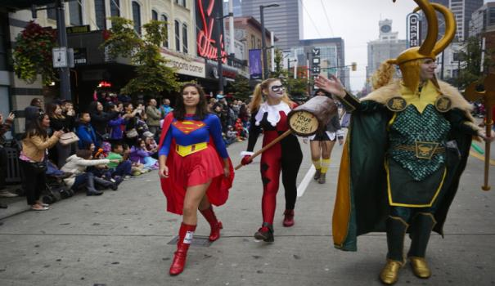

Slide 6
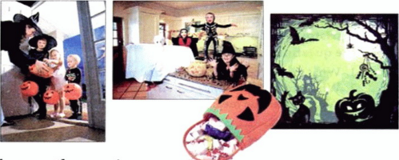
Look at the pictures and words related to Halloween.
What do you think this festival is about?
1a
scary dress up haunted house black cat candy
ghost trick or treat October spider

Slide 7
Listen and answer the questions.
1b
1.Where is Halloween popular?
2.When do people celebrate Halloween?
3.What does Wu Yu think of this festival?
It's popular in North America.
They celebrate Halloween on October 31st.
Wu Yu thinks it is quite a scary but really fun festival.

Slide 8
Listen again and fill in the blanks.
1c
houses
1.Many people make their___________look scary. They
may ____________the lights and light candles.They
sometime also put things like spiders and ghosts
around the doors and____________.
2.Little kids and even parents___________as ghosts or
black cats. They can also dress up as fun things
like___________characters.
3.Parents take their children around the neighborhood to ask for___________and treats.
4."Trick or treat" means kids will___________a trick on you if you don't___________them a treat.
turn off
windows
dress up
cartoon
candies
play
give

Slide 9
Think about the Halloween activities that interest you most. Discuss what you have learned with a partner.
1d
A:What have you learned about Halloween?
B:Oh,I know it's a popular festival in the North America and it's on October 31st.
A:What do you like most about this festival?
B:I think it's fun to dress up as cartoon characters!

Slide 10
What do you know about Christmas? Discuss in grounps and create a mind map.
2a
Date
Activities
Christmas
Symbols
Stories

Slide 11
Read the passage about Christmas and answer the questions.
2b
1.What are the common things that people think of
for Christmas?
2.Who wrote A Christmas Carol?
3.What is the true meaning or spirit of Christmas?

Slide 12
The Spirit of Christmas
Many would agree that when we think of Christmas,we probably think of gifts,Christmas trees and Santa Claus.But behind all these things lies the true meaning of Christmas: the importance of sharing and giving love and joy to people around us.The story in A Christmas Carol is perhaps the best example of this.
A Christmas Carol is a famous short novel written by Charles Dickens. It is about an old man named Scrooge who never laughs or smiles. He is mean and only thinks about himself.He doesn’t treat others nicely. He just cares about whether he can make more money and he hates Christmas. One Christmas Eve,Scrooge sees the ghost of Jacob Marley,his dead business partner.

Slide 13
Marley used to be just like Scrooge,so he was punished after he died.He warns Scrooge to change his ways if he doesn’t want to end up like him.He also tells Scrooge to expect three spirits to visit him.
That night,three ghosts visit Scrooge.First,the Ghost of Christmas Past takes him back to his childhood and reminds Scrooge of his happier days as a child.Then the second spirit,the Ghost of Christmas Present,takes him to see how others are spending Christmas this year.Everyone is happy,even poor people.The last one,the Ghost of Christmas Yet to Come,takes him to the future. Scrooge sees that he is dead,but nobody cares.

Slide 14
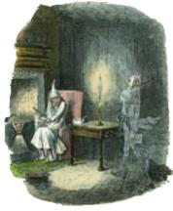
He is so scared that he wakes up in his bed and finds out it is only the next morning—Christmas Day!
He decides to change his life and promises to be a
better person.He happily celebrates Christmas with his relatives. He also gives gifts to people in need.He now treats everyone with kindness and warmth,spreading love and joy everywhere he goes. And that is the true spirit of Christmas!

Slide 15
1.What are the common things that people think of
for Christmas?
2.Who wrote A Christmas Carol?
3.What is the true meaning or spirit of Christmas?
Gifts,Christmas trees and Santa Claus.
Charles Dickens.
The importance of sharing and giving love and joy to people around us.

Slide 16
Read the passage again and complete the chart.
2c
What does Scrooge see when he's with...
the Ghost of Christmas Past?
the Ghost of Christmas Present?
the Ghost of Christmas Yet to Come?
His childhood.
How others are spending
Christmas this year.
He is dead,but nnobody
cares.

Slide 17
Answer the questions. Some answers need to be inferred.
2d
1.Why does Scrooge hate Christmas?
2.Does Scrooge have a lot of friends? Why or why
not?
3.Why was Jacob Marley punished after he died?
4.Does Jacob Marley want to help Scrooge? How do
you know?
5.How does Scrooge feel when he wakes up on
Christmas Day?
6.What does Scrooge do after seeing the three spirits?

Slide 18
Answers:
1.Because is mean and only thinks about himself.
2.No,he doesn't.Because he doesn't treat others nicely.
3.Because he used to be just like Scrooge.
4.Yes,he does.Because he warns Scrooge to change his
ways if he doesn't want to end up like him.
5.He feels scared.
6.He happily celebrates Christmas with his relatives.He
also gives gifts to people in need.

Slide 19
2e
What do you think the three ghosts say to Scrooge when they visit him? In groups of four, make a conversation between the three ghosts and Scrooge. Role-play the conversation in front of the class.

Slide 20
Language Points
1.What does Wu Yu think of this festival?吴雨认为这个节目怎
么样？（教材第13页）
(1)What ...think of...?意为“……认为……怎么样？”相当于
How...like...?这是询问人对某事(物)或某人看法的常用句型。
e.g.:What do you think of soap operas?=How do you like soap
operas?
(2)think of意为“想起；认为；思考”。of作为介词，其后可接名词、代词或动词-ing形式作宾语。
e.g.:I can't think of his name.
They're thinking of buying a new car.

Slide 21
2.Many people make their____look scary.很多人让他们的____ 看起来很吓人。（教材第13页）
(1)make此处用作使役动词，意为“使，叫，让”。常见的使役动词还有have,let等。make的常见用法是：
①make+人(宾语)+动词原形(宾语补足语)，即make sb.do sth.,意为“让某人做某事”。
e.g.:Don't make her work at night.
②make+宾语+形容词(宾语补足语)，意为“使某人(物)……”。
e.g.:He often makes me bored.
Please make the door open.

Slide 22
(2) look scary意为“看起来很吓人”。此处look用作连系动词，后接形容词作表语。
e.g.:The flower looks beautiful.
3.Parents take their children around the neighborhood to ask for____and treats.父母带着他们的孩子到附近街坊去要_______和要求请客。（教材第13页）
(1)ask for意为“要；寻求；请求”，其宾语是物；ask sb. for sth.表示“向某人要某物”。
e.g.:You can ask for help from the adults.
He asked his mother for some money.

Slide 23
(2)treat 此处用作可数名词，意为“请客；款待”。
e.g.:This is my treat.
【拓展】treat用作及物动词，其意义和用法为：
①意为“款待；请客”。常构成短语treat sb. to sth.,意为“请某人吃……”。
e.g.:She treated us to some delicious chicken.
②意为“看待；当作”，与as连用构成treat...as...短语，意为“把……当作……”。
e.g.:Don't treat me as a child.

Slide 24
③意为“治疗”
e.g.: Which doctors are treating him for his illness?
4.I think it's fun to dress up as cartoon characters!我认为装扮成卡通人物很好玩！（教材第13页）
dress up意为“装扮，穿上盛装”，dress up as...意为“装扮
成……；打扮成……”，as后面接表示角色、职业等的名词。
e.g.:Children like dressing up.
He often dresses up as a farmer.

Slide 25
Exercise
一、根据汉语提示填空。
1.The teacher will____________(处罚)you if you don't say
sorry to me.
2.The illness has___________(传播)to the country from the city.
3.Europeans like celebrating____________(圣诞节).
4.English is used in____________(商业).
punish
spread
Christmas
business

Slide 26
二、选择方框中的单词并用其正确形式填空。
1.The dog is________.You should save it.
2.Red Sorghum(《红高粱》) was________by Mo Yan.
3.Mother gives me love and________.
4.The teacher warns me not ________late.
5.He_______to be late all the time.The teacher was angry.
warm be write die use
dying
written
warmth
to be
used

Slide 27
Homework
1.Finish 2e on Page 15.
2.Remember the new words and expressions.

Slide 28
Thank you!

