Slide 1
Unit 6 Topic 3
I will remember our friendship forever.
Section B
WWW.PPT818.COM

Slide 2
What they do for the ceremony?
Name | What they do for the ceremony
Maria | _________ the classroom
Michael | write ____________ with ________ chalks
Jane | get dozens of ______
Kangkang | prepare a large package of _________
decorate
some words
colored
cards
presents

Slide 3
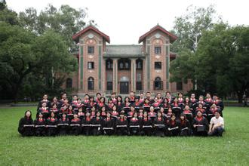
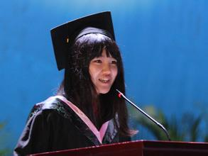
take graduation photos
give a graduation speech

Slide 4
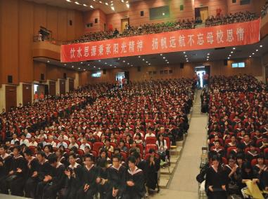
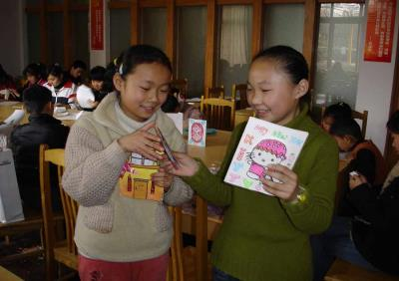
have a graduation ceremony
exchange gifts

Slide 5
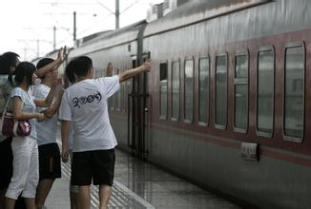
send gifts to teachers
see good friends off

Slide 6
Let's talk!
What will you want to say in your graduation ceremony speech?

Slide 7
What are they saying?

Slide 8
1b Listen to 1a and tick the information you’ve heard.
1. the happy experiences in the school
2. the friendship among the classmates
3. the mistakes they’ve made and corrected
4. the progress they’ve made
5. the dreams for the future
6. the thanks to the teachers
★
★
★
★
★

Slide 9
1c Listen to 1a again and mark T (True) or F (False).
Maria
She recalled the three years when all the classmates lived together like a family and had a lot of fun. ( )
2. She is sure their friendship will last forever and become more and more valuable as time goes by. ( )
3. Maria gave a speech on the English competition. ( )
T
T
F

Slide 10
Kangkang
1. He has many memories of the past three years which will not be forgotten. ( )
2. He won the Excellent Student Award in the school.
( )
3. He expresses thanks to his teachers and classmates.
( )
4. He thinks he has made much progress in the past three years. ( )
T
F
F
T

Slide 11
Key points
1. as is known to all 众所周知
2. bottom n. 底，底部
3. unforgettable adj. 难以忘怀的，令人难忘的
4. joy n. 高兴，愉快

Slide 12
Key points
5. To my great joy, I won the Excellent Student
Award in my class.
to one’s joy/surprise 使某人高兴/惊讶的是
eg：To my surprise, I got a ticket to the
concert.

Slide 13
Key points
6. Everything comes to him who waits.
功夫不负有心人。
7. There is no royal road to learning.
书山有路勤为径，学海无涯苦作舟。

Slide 14
2a Work in groups and find out what should be
included in a graduation ceremony speech
and note down the key words.
Graduation Ceremony Speech
the unforgettable memories the friendship among the classmates the things you’ve learned the best wishes for your classmates …

Slide 15
Written work
Write a speech for the graduation ceremony.
要求: (1) 先列出提纲，再写正文。
(2) 文章中尽量运用已学或自己收集的谚语或俗语。如:
① Where there is a will, there is a way.
② It’s the thought that counts.
③ No pains, no gains.
(3) 词数： 60-80。

Slide 16
Tip
Before giving a speech or taking an exam, you can take a deep breath, enjoy a piece of pleasant music or give a smile to help yourself lower anxiety.

Slide 17
You can write like this:
Hello, everyone! First, I want to express my thanks to my teachers and classmates … Second, I will tell you about the fruits of my past three years’ hard work … Third, I want to talk about my dreams … Fourth, … Finally, …

Slide 18
Hello, everyone! First, I want to express my thanks to my teachers and classmates. We have had three fantastic years in Beijing International School. We’ve had a lot of fun together. I also learned a lot from you. Second, I’ll tell you about the fruits of my past three years’ hard work. I have made great progress in my study in the past three years. And I won the Excellent Student Award in my class. Third, I want to talk about my dreams. I hope I can be a great scientist in aerospace like Qian Xuesen. I know there is no royal road to learning. So I will keep on working hard to realize my dream. My dear friends and teachers, I love you all. I will miss you all! Thanks a lot!

Slide 19
Summary
1. as is known to all 众所周知
2. bottom n. 底，底部
3. unforgettable adj. 难以忘怀的，令人难忘的
4. joy n. 高兴，愉快
5. to one’s joy/surprise 使某人高兴/惊讶的
6. Everything comes to him who waits.
功夫不负有心人。
7. There is no royal road to learning.
书山有路勤为径，学海无涯苦作舟。

Slide 20
Homework
Search for more information about a graduation ceremony.

