Slide 1
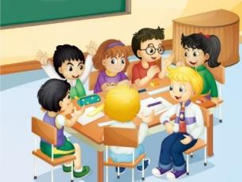
Unit 3 We should obey the rules.
人教精通版英语五年级下册
WWW.PPT818.COM

Slide 2
>>Warm-up
Let’s chant

Slide 3
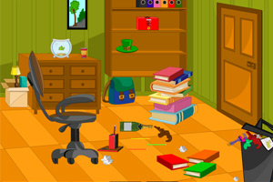
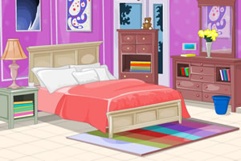
>>Lead-in
Which room do you like better? Why?
How to be a good boy/girl at home?

Slide 4
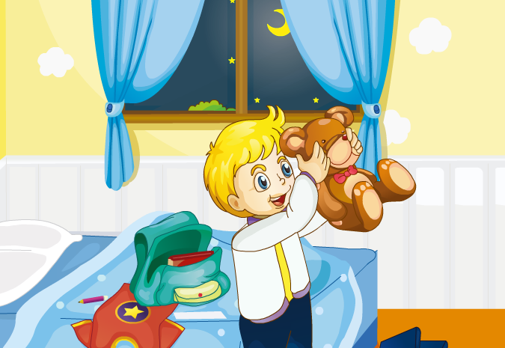
>>Presentation
Just talk

Slide 5
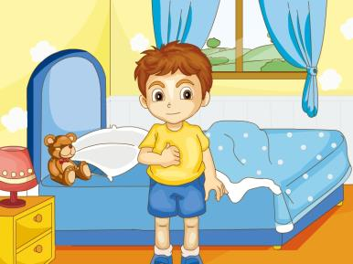
>>Presentation
Let’s learn
get up
We should get up early.

Slide 6
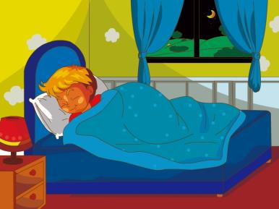
>>Presentation
Let’s learn
go to bed
We shouldn’t go to bed late.

Slide 7
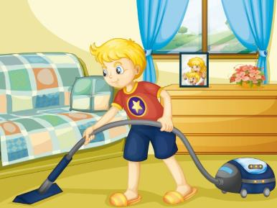
>>Presentation
Let’s learn
do housework
We should help to do housework.

Slide 8
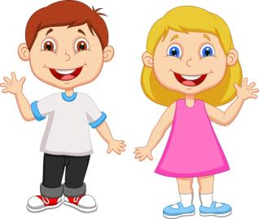
>>Practice
Pair Work
Does Peter like to do housework?
No, he doesn’t.

Slide 9
>>Presentation
should
V.原形
shouldn’t
should not

Slide 10
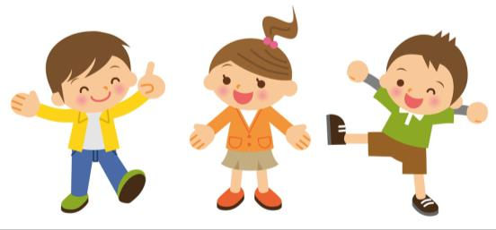
>>Practice
句子接龙
You should…
You shouldn’t...
You should…

Slide 11
>>Practice
should
shouldn’t
1. You ________ keep your room clean.
should
2. You ________ get up late.
shouldn’t
3. You ________ read in bed.
shouldn’t
shouldn’t
4. You ________ watch TV too often.
5. You ________ go to bed early.
should
should
6. You ________ help to do housework.

Slide 12
>>Practice
go home
watch TV
do housework
read in bed
get up
home rules
go to bed

Slide 13
>>Summary
重点短语：
do housework
go home
get up
go to bed
read in bed
keep your room clean
如何表达应该和不应该做某事？
You should…
You shouldn’t…

Slide 14
>>Homework
1. 观看课文动画，按照正确的语音、语调朗读课文。
2 . 为自己制定一些家庭规则，贴在家里的墙上。
3 . 预习Lesson16。
close

