Slide 1
Unit 4
Grandparents
WWW.PPT818.COM

Slide 2
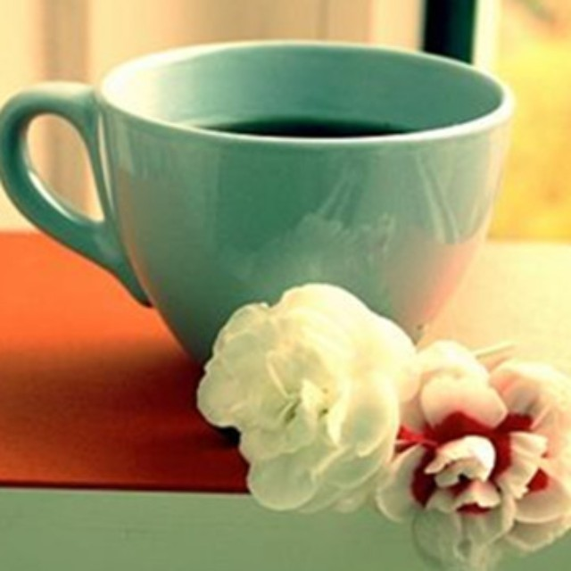
mother
father
brother
sister
uncle
aunt
grandma
grandpa
family
parents
Mr 先生
Mrs 夫人
Ms 女士
Miss 小姐
baby brother
baby sisiter
cousin
grandparents

Slide 3
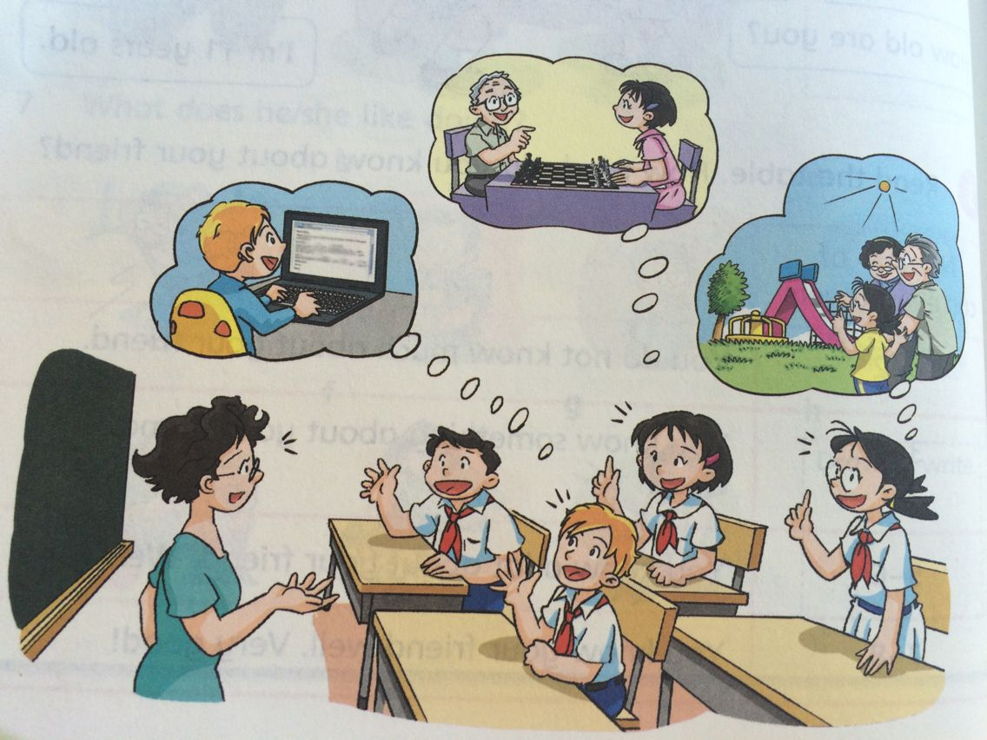

Slide 4
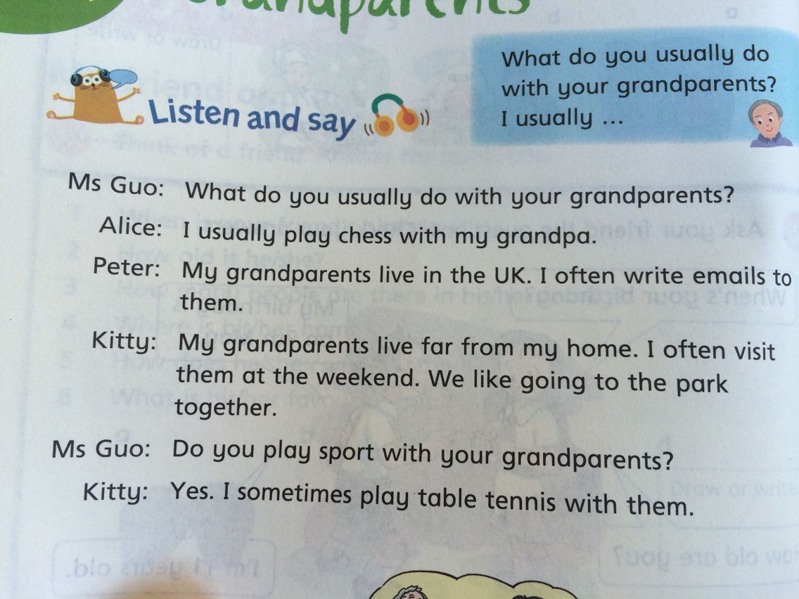
[tenɪs]

Slide 5
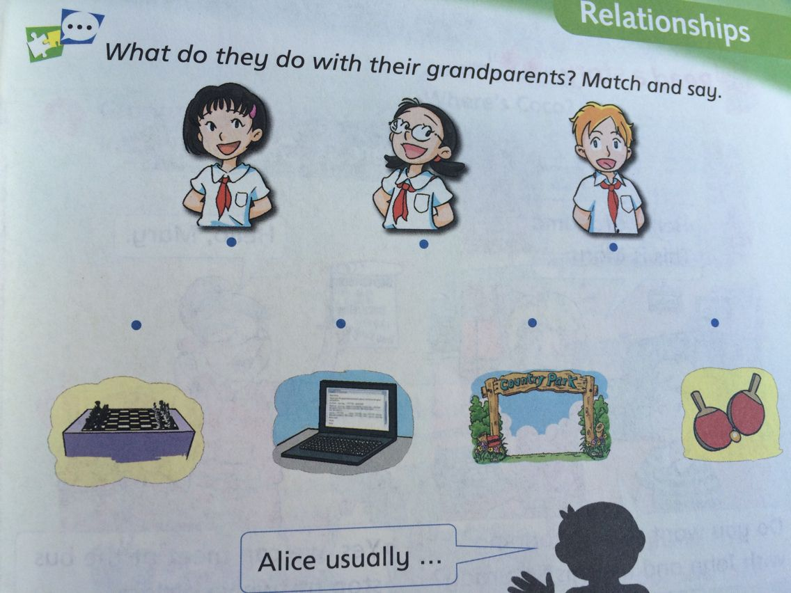

Slide 6
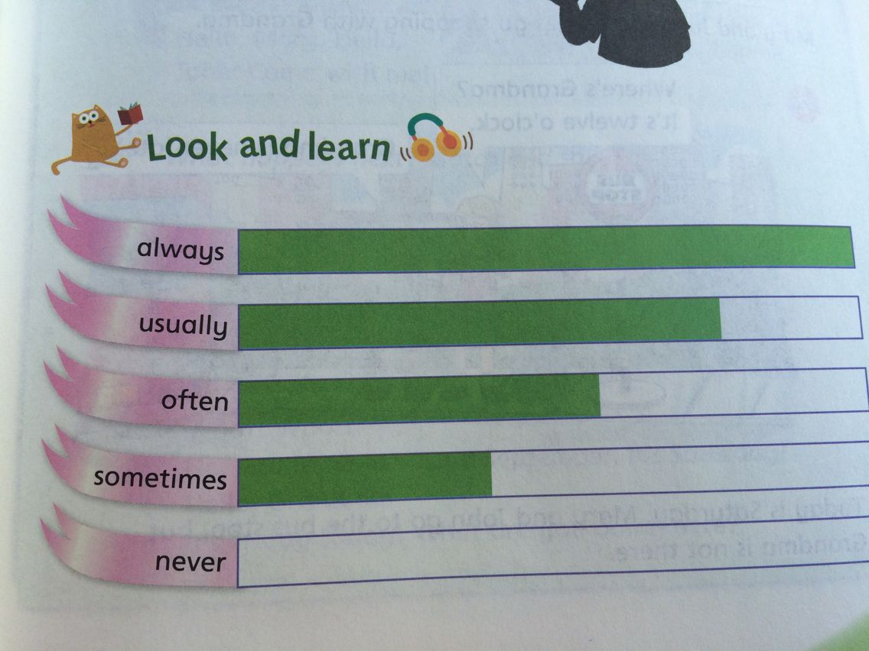
[ɔ:lweɪz]
[ ju:ʒuəli]
[ɔ:fn]
[sʌmtaɪmz]
[nevə(r)]

Slide 7
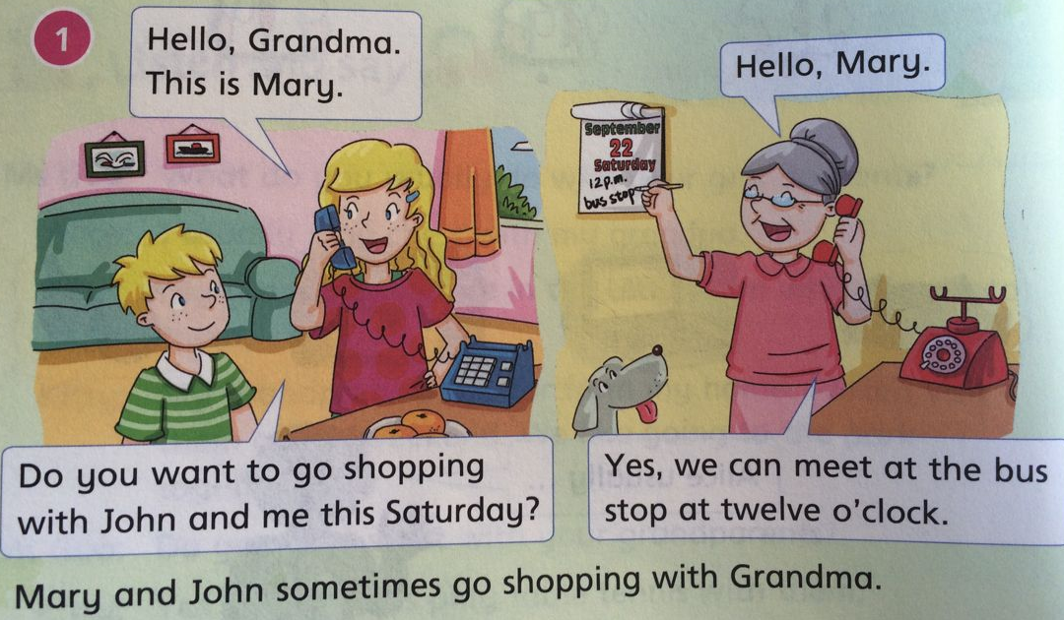
Where is Grandma?

Slide 8
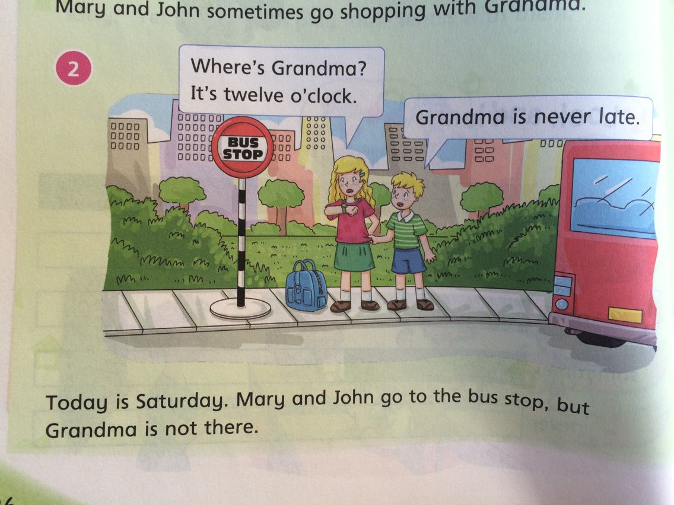
[leɪt]

Slide 10
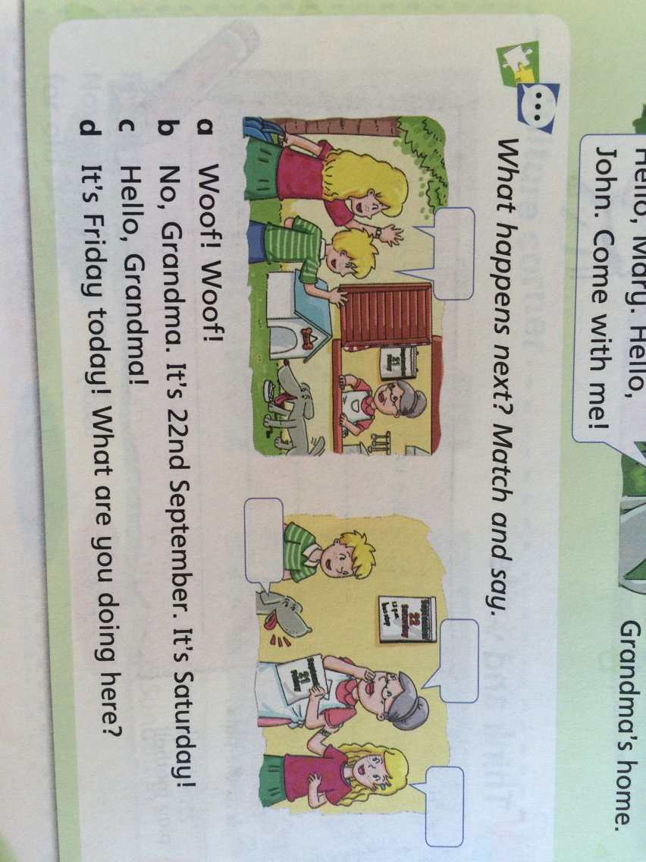
c
b
d
a

Slide 11
 | Play chess | Play sport | Go to the park
Alice | usually
Activity
Name
S1: What do you usually do with your grandparents?
S2:I usually… with…
S1: Do you …with…?
S2: Yes, I do.
No, I never…with…

Slide 12
go to the cinema go to the park
play chess go shopping play football
I (do not) live with my grandparents.
( I _________ visit them.)
I_________________ with them.
I_________________________.
__________________________
always
usually
often
sometimes
never

Slide 13
Sh----- [ʃ ]
Catch a fish. Splish ! Splish!
Wash the fish. Splash! Splash!
Cook the fish. Swish! Swish!
Where can I put the fish?
On a dish ! On a dish!
[fɪʃ ]
[splɪʃ] 水声
[splæʃ] vt. 使（液体）溅起
[swɪʃ] v. 鞭打;嗖嗖声
[dɪʃ]

Slide 14
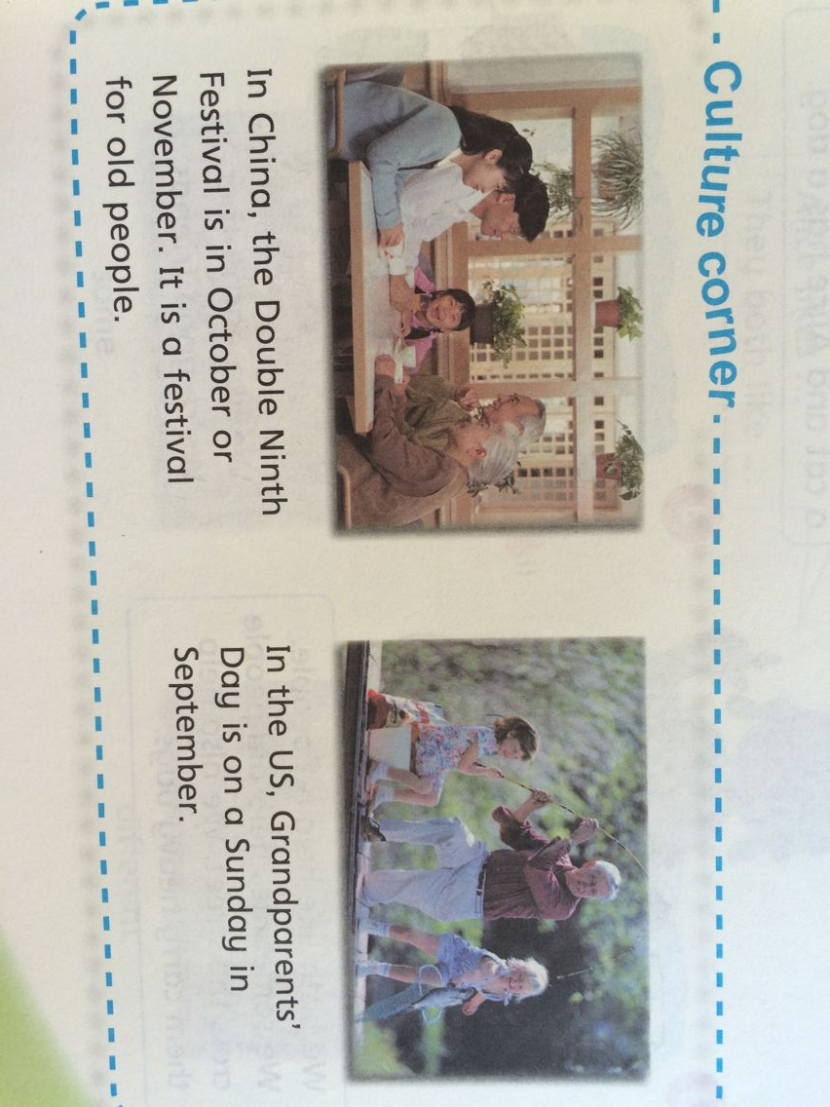
[dʌbəl] adj. 双的
[festɪv] adj. 节日的

