Slide 1
Unit 2 Housework
Can you clean the windows?
WWW.PPT818.COM

Slide 2
Can you read?

Slide 3
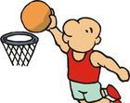
Can you play basketball?

Slide 4
Can you dance?

Slide 5
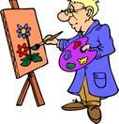
Can you draw?

Slide 6
Can you run?

Slide 7
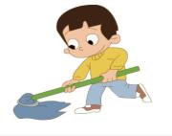
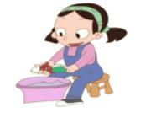
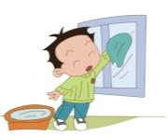
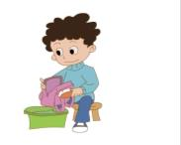
Can you do housework?

Slide 8
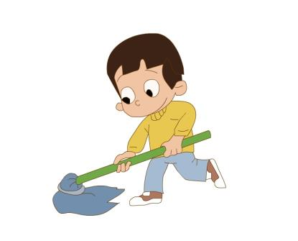
clean the floor
Can you clean the floor?

Slide 9
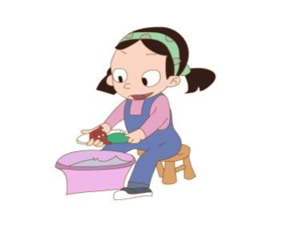
clean your shoes
Can you clean your shoes?

Slide 10
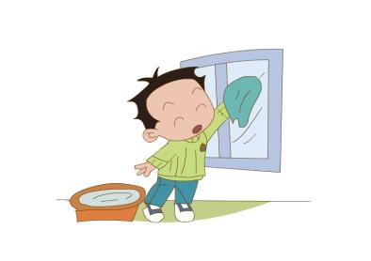
clean the windows
Can you clean the windows?

Slide 11
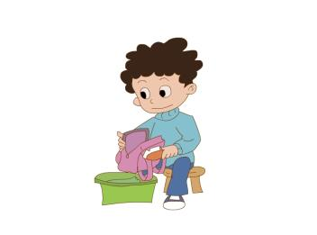
clean the schoolbag
Can you clean the schoolbag?

Slide 12
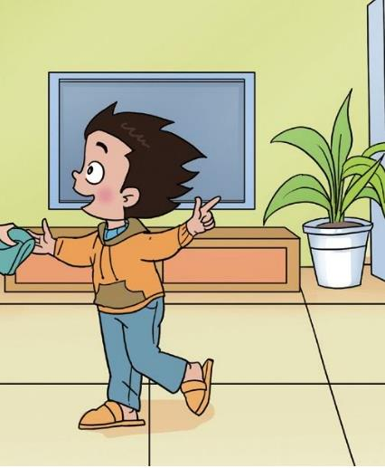
What can Li Ming do?

Slide 13
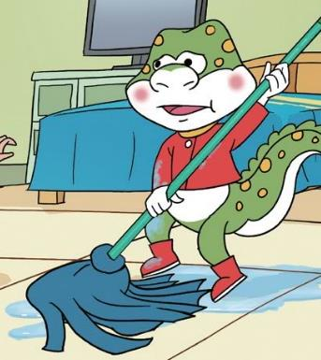
What can Danny do?

Slide 14
Thank You.

