Slide 1
Unit 5
I like those shoes.
WWW.PPT818.COM

Slide 2
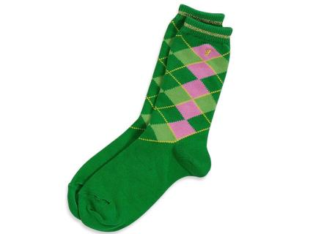
socks

Slide 3
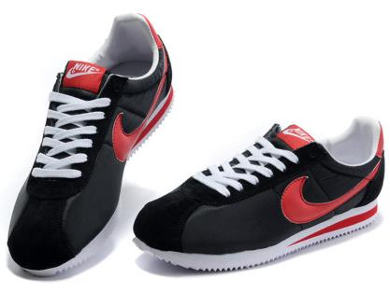
shoes

Slide 4
课本回顾
Mum,I like those shoes.
Can I look at those shoes?
May I try it on ？
Certainly!

Slide 5
知识拓展
have a look 看一眼
eg：Can I have a look at your dress?
我能看一下你的裙子吗？

Slide 6
练一练
单项选择。
( )1.________ you like those jeans?
A．Are B．Do C．Does
( )2.My socks ________ in the box.
A．/ B．is C．are
( )3.I like ________ trousers.
A．these B．this C．that
( )4.Where ________ my dress?
A．is B．are C．/

Slide 7
练一练1.B 2.C 3.A 4.A 5.A 6.B 7.A 8．A
( )5.Here are the shoes.Try ______ on.
A．them B．it C．they
( )6.These are ________ shoes.
A．he B．his C．him
( )7.—Are those your pants?—________
A．Yes，they are. B．No，they are. C．Yes，they aren't.
( )8.—Where is my skirt?—________．
A．Here it is B．It's blue C．It's red

Slide 8
练一练
根据情境选择。
( )1.“请问我可以看一下那双鞋吗？”应该怎样说？
A．Can I have a look at those shoes，please?
B．Can you give me those shoes，please?
C．Certainly.
( )2.“我喜欢这双袜子。”应该怎样说？
A．I like this sock. B．I like these socks. C．I like that socks.
( )3.“我的鞋在哪？”应该怎样说？
A．Where is my shoe? B．Where are my shoes? C．Where is my shoes？

Slide 9
巩固 大家一起说
socks

Slide 10
shoes

Slide 11
see you

