Slide 1
What colour is it?
第3课时
WWW.PPT818.COM

Slide 2
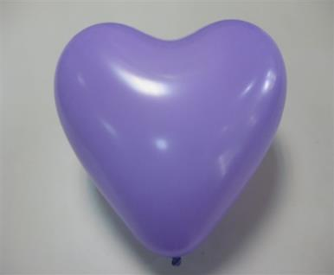
purple
What color is it?

Slide 3
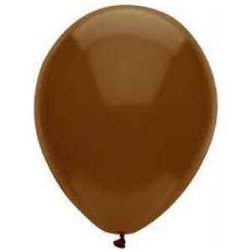
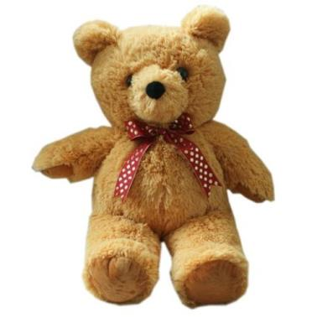
brown
What color is it?

Slide 4
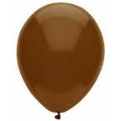
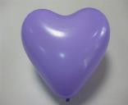
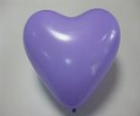
brown, brown, purple, purple, purple,
brwon
purple, purple, brown, brown, purple,
purple

Slide 5
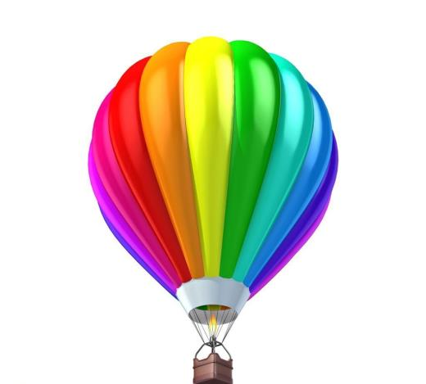
Look, I have a big balloon.

Slide 6
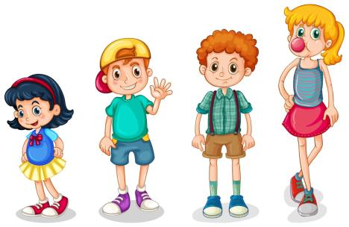
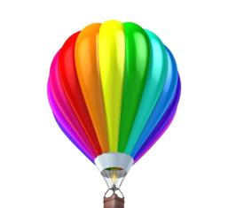
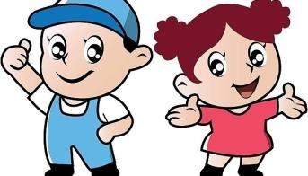
Hello! I have a
big balloon.
Wow! Cool!
Look! Red, yellow, blue...
Green, purple and brown.

Slide 7
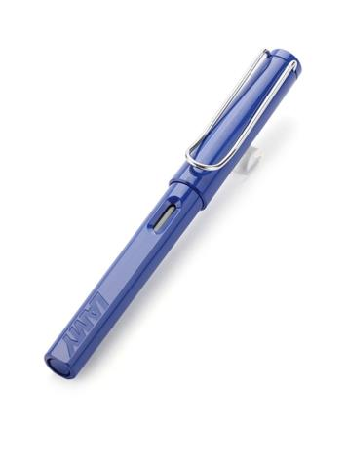
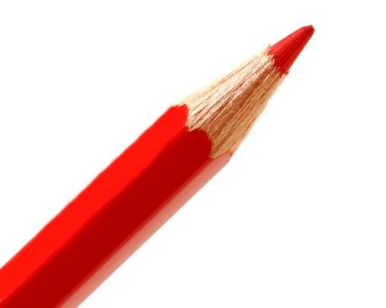
Let’s do
Show me a red pencil. Show me a blue pen.

Slide 8
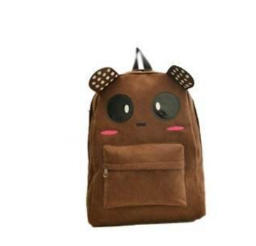
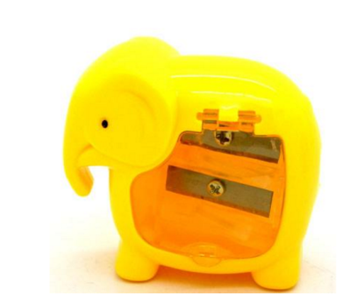
Show me a brown bag. Show me a yellow sharpener.

Slide 9
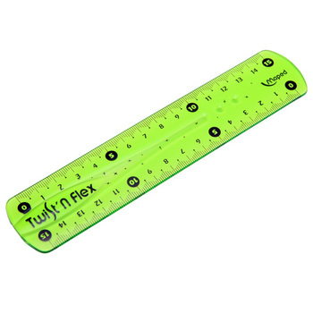
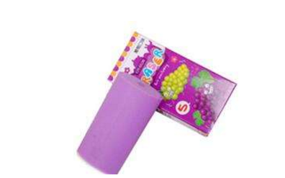
Show me a purple eraser. Show me a green ruler.

Slide 10
Homework
1.Practice the dialogue again.
2.Use “What colour is it?” to make a dialogue.

Slide 11
Thank You.

