Slide 1
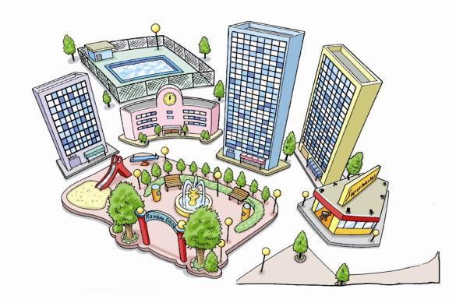
4
Our neighbours
WWW.PPT818.COM

Slide 2
Chant
am, is --- was 是
are --- were 是
go --- went 去
take --- took 拿，拍摄
do--- did 助动词
have --- had 有，吃

Slide 3
Chant
enjoy --- enjoyed享受
visit --- visited 拜访
play --- played 玩
stay --- stayed 停留
pick --- picked 摘，捡起

Slide 4
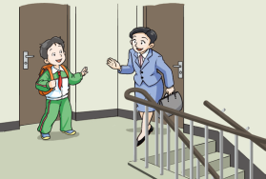
Riddle谜语
They live near you,
but they are not your family members(家庭成员).
？
Who are they
neighbour

Slide 5
eight
eigh
neigh
neigh
bour
neighbours
our neighbours
your neighbours

Slide 6
Chant
our neighbours
your neighbours
Who are your neighbours?
our neighbours
your neighbours
Do you know them?
our neighbours
your neighbours
The Wus are my neighbours.

Slide 7
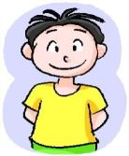
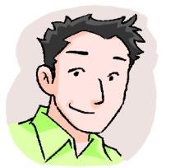
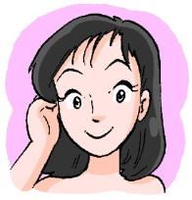
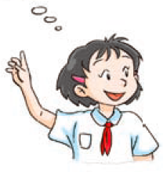
Sam
son
Mr Wu
Mrs Wu
The Wus are my neighbours.
They have a son .
His name is Sam .

Slide 8
son
sun
同音词
？
Father’s son’s son
grand
son
动脑筋

Slide 9
grand
son
对应词
grand
daughter
动脑筋

Slide 10
A. daughter
B. doctor
A. son
B. song
A. neighbour
B. night
A. our
B. your

Slide 11
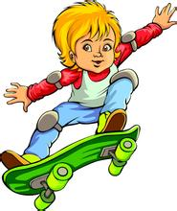
son
Mike
They have a son and a daughter .
daughter
Nancy

Slide 12
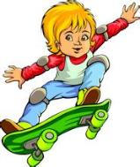
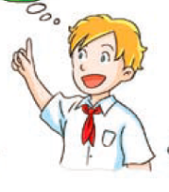
Nancy
Mr Green
Mrs Green
Mike
They’re the Greens.
They’re from the US.

Slide 13
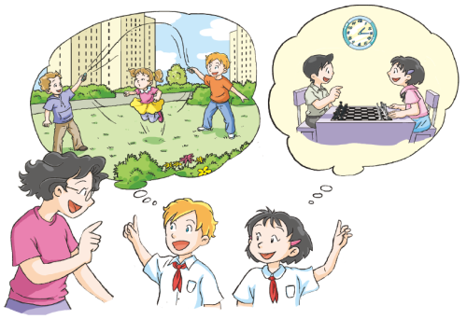
neighbours

Slide 14
Who are Peter’s neighbours?
Where are they from?
Did Peter see the Greens this morning?
Did Alice play chess with Sam?
思考一下

Slide 15
Listen and repeat.
听音模仿

Slide 16
Who are Peter’s neighbours?
The Greens.
Where are they from?
They’re from the US.
Did Peter see the Greens this morning?
No, he didn’t.
Did Alice play chess with Sam?
Yes, she did.
讨论一下

Slide 17
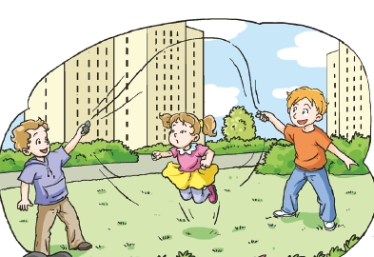
Did
did
last weekend
?
Peter
开动脑筋
Mike and Nancy
play with

Slide 18
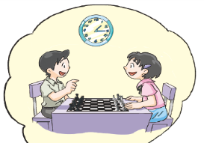
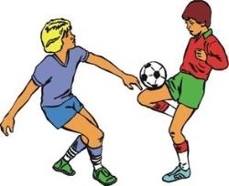
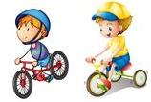
Did you …last weekend?
说一说
Yes, I _____.
didn’t
did
No, I _____.

Slide 19
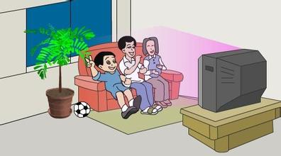
Did …?
Yes. / No.
The Lis
Did the Lis watch TV yesterday?
yesterday / this morning / last week

Slide 20
Did …?
Yes. / No.
Peter and Sam
yesterday / this morning / last week

Slide 21
Listen again.
再听一遍

Slide 22
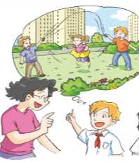

Slide 24
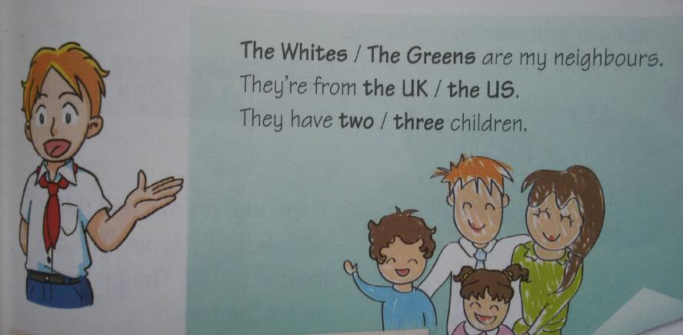
动脑筋

Slide 25
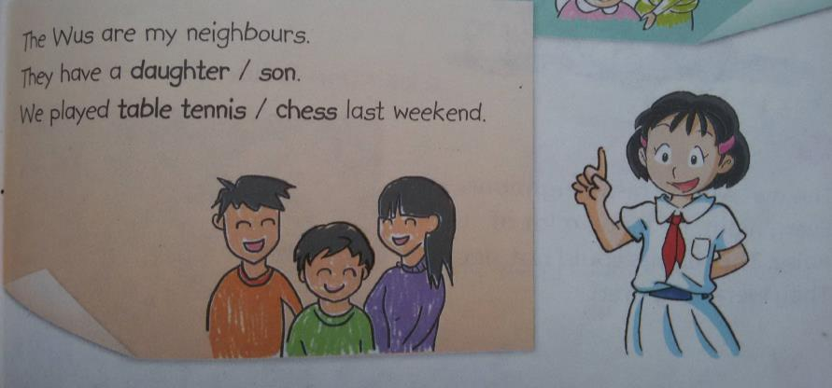
动脑筋

Slide 26
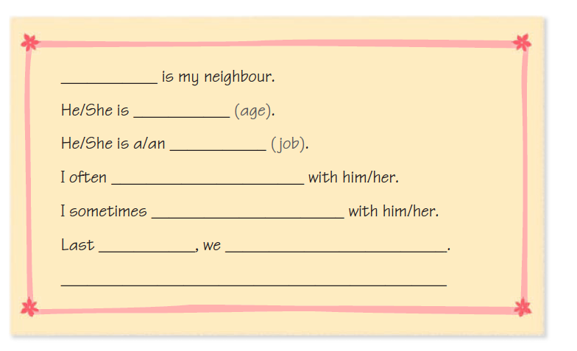
My neighbour
Fangfang
保护眼睛哦！
twenty
worker
sing songs
swim and run
weekend
played chess
She’s my good neighbour.

Slide 27
My neighbour

Slide 28
Report

Slide 29
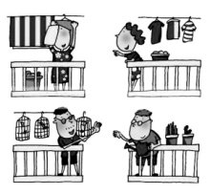
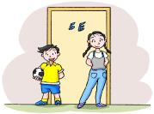
Be friendly， be kind to your neighbour.
友爱，和善地对待邻居。
A close neighbour is better than a brother far off.
远亲不如近邻。

Slide 30
Homework
1. Review and remember the key words.
2. Read and recite the dialogue.
3. Introduce your neighbours.
认真完成哦！

