Slide 1
Unit 4 Topic 1
What can I do for you?
Section A
WWW.PPT818.COM

Slide 2
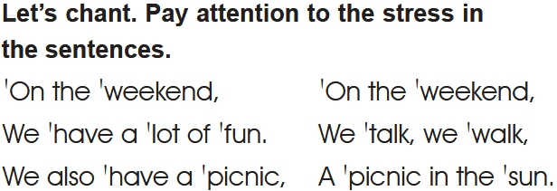
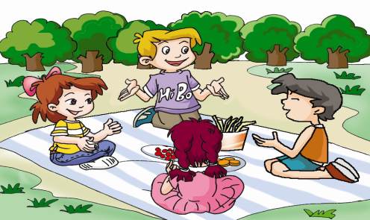

Slide 4
Read the numbers you have learned.
one
two
three
four
five
six
seven
eight
nine
ten

Slide 5
one
two
three
four
five
six
seven
eight
nine
ten
eleven
twelve
thirteen
+ teen =
fourteen
fifteen
+ teen =
sixteen
+ teen =
seventeen
+ teen =
eighteen
nineteen
twenty

Slide 6
Learn the numbers 21-29.
20
twenty
21
twenty-one

Slide 7
twenty-two
twenty-three

Slide 8
twenty-four
twenty-five

Slide 9
twenty-six
twenty-seven

Slide 10
twenty-eight
twenty-nine

Slide 11
Look and learn
20
twenty
sixty
ty
60
ty
30
ty
thirty
seventy
70
ty
eighty
40
forty
80
ty
ty
ninety
50
fifty
90
ty
ty

Slide 12
100
one hundred
101
one hundred and one

Slide 13
151 one hundred (and) fifty-one
365 three hundred (and) sixty-five

Slide 14
Listen and learn.
21
22
23
24
25
26
27
28
29
twenty-one
——————
twenty-three
twenty-four
——————
twenty-six
——————
twenty-eight
——————
30
40
50
60
70
80
90
thirty
——-
——-
sixty
seventy
——-
——-
100
101
185
315
999
one hundred/a hundred
————————————
————————————
————————————
nine hundred (and) ninety-nine

Slide 15
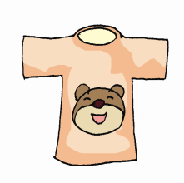
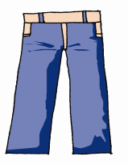
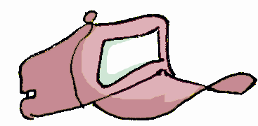
Listen and match the prices.
cap
skirt
pants
T-shirt
1. ￥18.00
￥80.00
2.￥16.00
￥60.00
4.￥15.00
￥50.00
3.￥17.00
￥70.00

Slide 16
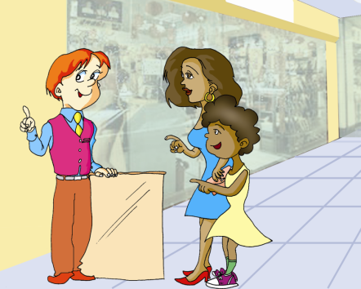
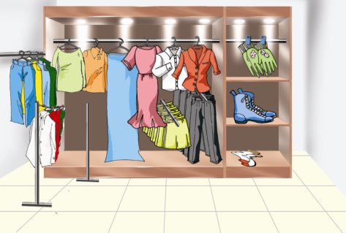
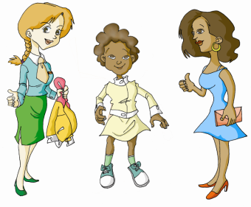
Look, listen and say.
Q: How much is the coat?

Slide 17
Key points:
1. I want to buy some clothes for my daughter.
我想为我女儿买些衣服。
buy sth. for sb.= buy sb. sth.
为某人买某物
如：She wants to buy some flowers for me.
= She wants to buy me some flowers.

Slide 18
2. Can I try it on?
我可以试穿一下吗？
try on 试穿 （如宾语是代词，放中间）
如：The shoes are nice. Please try them on.
3. How much is it?
多少钱？
how much is/are …? ……多少钱？
如：How much are the shoes?
They’re 165 yuan.

Slide 19
Listen to 1a and check.
1. Mother wants to buy _______ (shoes, clothes, gloves) for Maria.
2. Maria likes _________ (the red coat, the yellow skirt, the yellow coat).
3. It is _______ (17.00, 70.00, 700.00) yuan .
√
√
√

Slide 20
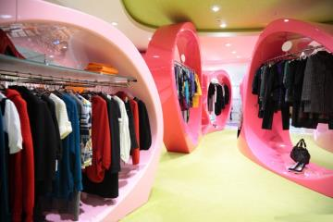
Happy shopping!
Salesman: ________________
Mother: Yes, please. I want a T-shirt for my son.
Salesman: ______________________
Mother: White.
Salesman: What about this one?
Mother: All right. ______________
Salesman: Twenty yuan.
Mother: OK. ___________
Can/May I help you?
What color do you want? /
What’s his favorite color?
How much is it?
I’ll take it.

Slide 21
Summary
Numbers:
1-999
Useful expressions:
What can I do for you? / May I help you?
I want … / I’d like …
Can I try it / them on? Sure.
It looks very nice on you.
We’ll take it.

Slide 22
Homework
Review the numbers 21—999.
Recite 1a.
Preview Section B.

