Slide 1
Unit 6 Do you like bananas?
Section B (1a～1e)
WWW.PPT818.COM

Slide 2
1．egg
意为“鸡蛋”，为可数名词，因为它是以元音音素开头，所以一个鸡蛋应说an egg。
2．chicken
名词，作不可数名词时，意为“鸡肉”，作可数名词时，意为“鸡，小鸡”。
eg：I have chicken for lunch.午餐我吃鸡肉。
three chickens三只小鸡
3．breakfast
名词，意为“早餐”。
lunch
名词，意为“午餐”。

Slide 3
dinner
名词，意为“晚餐，正餐”。
常用短语：
(1)at breakfast/lunch/dinner在吃早(午、晚)餐
(2)have breakfast/lunch/dinner吃早(午、晚)餐
在此短语中breakfast/lunch/dinner前面不能加冠词the或a，但可以说have a big breakfast，have a quick breakfast。
(3)have sth. for breakfast/lunch/dinner早(午、晚)餐吃……eg：
I have chicken for lunch.午餐我吃鸡肉。
She has vegetables and rice for dinner.她晚餐吃蔬菜和米饭。

Slide 4
一、汉译英。
1．一些蔬菜 ______________
2．五个胡萝卜 _____________
3．所有水果 ____________
4．吃早饭 ________________
5．吃中饭 ____________
some vegetables
five carrots
all fruits
have breakfast
have lunch

Slide 5
二、根据句意及汉语提示写单词完成句子。
6．Tom likes ______(胡萝卜)，but he doesn't like _____(鸡蛋)．
7．It's 12：00.Let's have _____(午餐)．
8．What do you have for __________(早餐)?
9．I like ________(鸡肉)，but my sister likes _________(汉堡包)．
10．Do you like ______(米饭)?
carrots
eggs
lunch
breakfast
chicken
hamburgers
rice

Slide 6
三、单项选择。
11.There is a ______ shop.It sells(卖) bananas，apples，pears and oranges.
A．fruit B．vegetable
C．food D．drink
12．—What kind of fruit do you like?
—Well，I like ______．
A．the strawberries B．strawberry
C．strawberries D．the strawberrys

Slide 7
13．______ like French fries.
A．He and I B．I and he
C．He and me D．I and him
14．Do they like ______？
A．pear B．an pear
C．pears D．tomatos
15．—Mom，can I go and play tennis with Jim now?
—______，dear.It's good for health.
A．No B．Sorry
C．Sure D．Excuse me

Slide 8
四、按要求完成句子。
16．Jim likes ice­cream.(改为否定句)
Jim ___________ice­cream.
17．Betty doesn't have carrots for lunch.(改为肯定句)
Betty ____ carrots __________．
18．She eats fruit every day.(改为一般疑问句)
_____ she ____fruit every day?
19．My sister likes eggs_and_apples for breakfast.(对画线部分提问)
What ____ your sister ____for breakfast?
20．—Does your father like chicken for lunch？(作否定回答)
—_____________
doesn't like
has
for lunch
Does
eat
does
like
No，he doesn't．

Slide 9
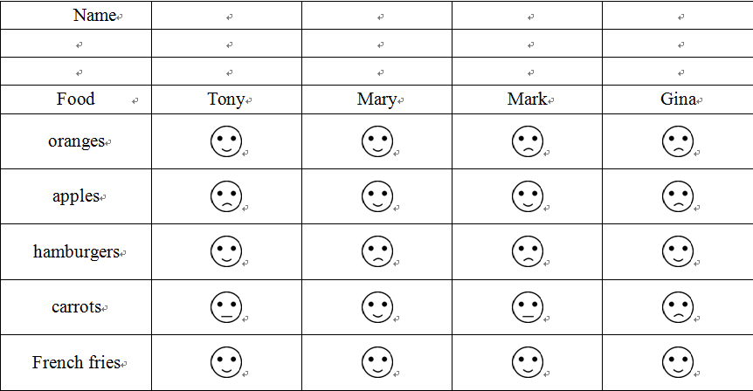
五、阅读理解。

Slide 11
21．Does Mary like hamburgers？____
A．Yes，she does. B．No，she doesn't.
C．We don't know.
22．What do they all like？____
A．Apples. B．French fries.
C．Hamburgers.
23．How many kinds(多少种) of vegetables can you see？____
A．Only one. B．Two. C．Three.
24．Who doesn't eat any healthy food every day？____
A．Gina. B．Mary. C．Mark.
B
B
B
A

