Slide 1
Unit 5
What day is it today?
WWW.PPT818.COM

Slide 2
nay kay
say may
pay hay
day bay
way ray
jay lay
词缀:-ay

Slide 3
星期天
S
u
n
d
ay

Slide 4
星期一
M
o
n
d
ay

Slide 5
星期二
ue
s
d
ay
T

Slide 6
星期三
W
e
dn
es
d
ay

Slide 7
星期四
Th
ur
s
d
ay

Slide 8
星期五
F
r
i
d
ay

Slide 9
星期六
S
a
t
ur
d
ay

Slide 10
星期天
星期六
星期二
Saturday
Tuesday
Sunday
星期四
星期三
星期五
Wednesday
Thursday
Friday
星期一
What day is it today?
Monday
It’s .......

Slide 11
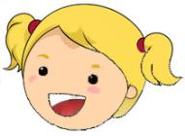
What day is it today?
Thursday
It’s .......

Slide 12
What day is it today?
Wednesday
It’s .......

Slide 13
What day is it today?
Friday
It’s .......

Slide 14
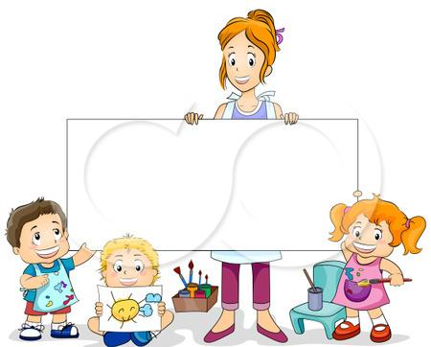
Sunday
Monday
Now you try.
Tuesday
Wednesday
Thursday
What day is it today?
Friday
Saturday
It’s .......

Slide 15
What’s your favourite day?
Tuesday
My favourite day is.......

Slide 16
What’s your favourite day?
Friday
My favourite day is.......

Slide 17
Sunday
Monday
Now you try.
Tuesday
Wednesday
Thursday
What’s your favourite day?
Friday
Saturday
My favourite day is.......

Slide 18
Chinese
Math
English
PE
Art
Music
Science
Computer
learn to speak English
sing songs
draw pictures
use numbers
play computer games
play sports
read and write stories
understand the world

Slide 19
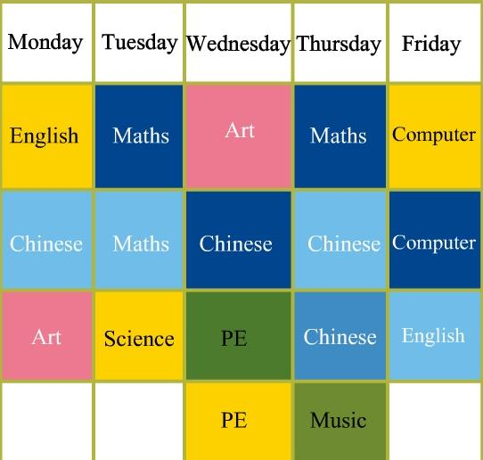
School timetable
(课程表)
What’s your favourite day?
My favourite day is.......
Why?
I have a ...lesson on ..., I like/love....

