Slide 1
Unit 3
How do you get to school?
R 七年级下册
第1课时
WWW.PPT818.COM

Slide 2
Lead-in

Slide 4
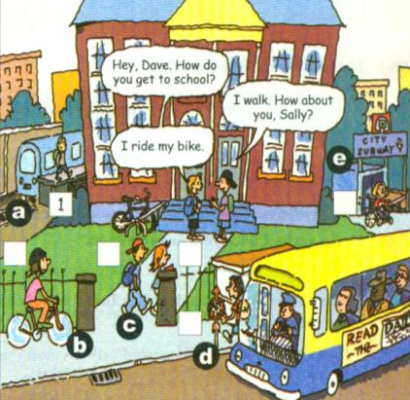
1a
Match the words with the pictures.
a
1. take the train ______
d
2. take the bus______
e
3. take the subway______
b
4. ride a bike______
c
5. walk _____

Slide 5
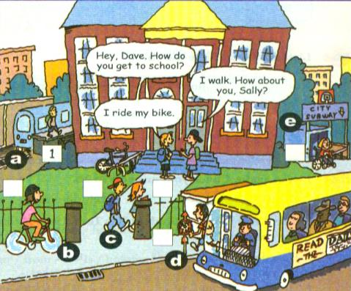
Listen and write the numbers next to the
correct students in the picture.
1b
1. Bob
2. Mary
3.John
4.Paul
2
5.Yang Lan
6
4
5
6.Jim
3

Slide 6
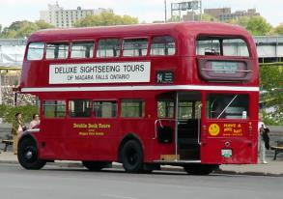
Look at the picture in 1a. How do the students get to school? make conversation with your partner.
1c
He takes the bus.
How does John get to school??

Slide 7
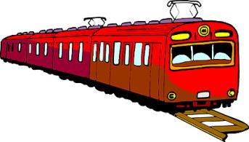
How does Bob get to school??
He takes the train.

Slide 8
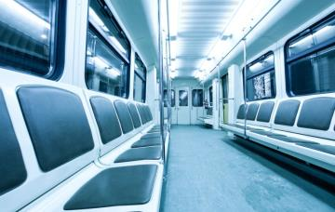
How does Mary get to school??
She takes the subway.

Slide 9
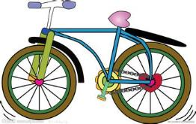
How does Jim get to school??
He rides a bike.

Slide 10
Listen and repeat. Then write the correct number next to the word.
2a
84
105
99
200
72
61
sixty-one ______ seventy-two _______
eighty-four ______ ninety-nine _______
one hundred and five _______
two hundred _______
61
72
84
99
105
200

Slide 11
Can you read these numbers? Have a try.
45
32
120 198
88
220
forty-five
thirty-two
one hundred and twenty
one hundred and ninety-four
eighty-eight
two hundred and twenty

Slide 12
2b
Listen and complete the chart.
How long?
(minutes)
How far?
(kilometers)
How?
Tom
walks
20 minutes
2 kilometers
Jane
one hour
and 30 minutes
60 kilometers
takes the bus

Slide 13
2c
Listen again. Check your answers in 2b.
Tom
school
home
About 20 minutes.
How long?
How far?
About 2 kilometers.
walk
How?

Slide 14
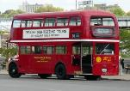
Jane
school
home
About one hour
and 30 minutes.
How long?
How far?
About 60 kilometers.
bus
How?
Notes:
14

Slide 15
Student A is Jane and Student B is Tom. Use the information in 2b to make conversations.
2d
A:How do you get to school? B:I…
A:How long does it take… B:It takes…
A:How far is it from…to… B:It’s about…

Slide 16
How do you get to school?
I take the subway.
How long does it take?
It takes about 15 minutes.
How far is it from your home to school?
It’s about 45 kilometers.

Slide 17
How do you get to school?
I ride my bike.
How long does it take?
It takes about 15 minutes.
How far is it from your home to school?
It’s about 3 kilometers.

Slide 18
2e
Role-play the conversation.
Listen and fill in the blanks.
 | How | How long | How far
Lisa
Jane
take the bus
20 minutes
10 kilometers
ride the bike
15 minutes
Notes:
18

Slide 19
Lisa: Hey, Jane. Is this your new bike?
Jane: Yes. I ride it to school every day. How do you get
to school?
Lisa: I usually take the bus.
Jane: How far is it from your home to school?
Lisa: I’m not sure … about 10 kilometers? The bus
ride takes about 20 minutes. How long does it
take you to get to school?

Slide 20
Jane: About 15 minutes by bike. It’s good exercise.
Lisa: Yeah. Well, have a good day at school.
Jane: You, too.

Slide 21
Language points
1. take the train 乘火车
take(动词):乘；坐；搭(飞机、车、船等)
乘坐某种交通工具: take + the/a + 交通工具
例：我们每天乘公共汽车去上学。
We take the bus to school every day.

Slide 22
take 的其他用法：
1. I will take the book. How much is it?
买下
2. I want to take some books to school.
拿走；带走（它强调将某人或某物从说话地点带到其他地方去。）
3. How long does it take to do your homework?
花费。常用搭配：It takes (sb.) time to do sth.“花费（某人）多长时间做某事”。

Slide 23
2. How do you get to school? 你怎样到学校?
(1) get to : 到达; 抵达 (= arrive in / at)
例：你将什么时候到伦敦？
When will you get to London?
= When will you arrive in London?
get 后接 home, here, there, downstairs 等地点副
词时，要去掉to。

Slide 24
(2)how疑问副词，意为“如何；怎样；以何种方式；用什么手段”。
本句为how引导的特殊疑问句，用以询问交通方式。
take + a/the+表示交通工具的名词
(在句中作谓语)
回答方式
by+表示交通工具的单数名词
作方式状语， 乘（交通工具）
on/in+限定词+表示交通工具的名词

Slide 25
on foot, by bike, by bus, by subway, by train, by car等词组的名词前不能加任何冠词或其他修饰词。
例：我骑自行车到学校。
I ride my bike to school.
I get to school by bike.
I get to school on my bike.

Slide 26
3. I ride it to school every day. 我每天骑它去上学。
(1)ride此处作及物动词，意为“骑”，后面可接bike, horse, motorbike等。
例：他骑自行车去学校。
He rides a bike to school.
= He goes to school by bike.

Slide 27
(2)every形容词，意为“每一；每个”，其后接单数可数名词。
every day意为“每天”，是一般现在时的时间状语。
辨析： every day 与 everyday
every day表示某事发生的频率，意为“每天；天天”，在句中作状语。
everyday是形容词，意为“日常的，普通的”，在句中作定语。

Slide 28
4. How far is it from your home to school?
从你家到学校有多远？
how far: 多远，用来询问距离或路程的远近。
常用句型：
How far is it from A to B? / How far is B from A?
答语：It’s +数词+表示距离的名词。

Slide 29
在回答how far 的提问时，通常有两种情形：
(1)有具体的数字时，应与away from连用，表示具体距离的计量，口语中away可省略。
(2)没有具体数字时，应用far或near作答。
例：你家离学校有多远？ 我家离学校有20千米。/很远。
— How far is your home from your school? 
— It’s twenty kilometers away from my school.
/It’s very far.

Slide 30
5. I’m not sure … about 10 kilometers?
我不很肯定……大约10千米？
sure在此句中意为“确信的，确定的，肯定的，有把握的”。
sure 相关句型：
(1)be sure to do sth. 意为“一定要，务必（做某事)”。
例: 务必代我向你的家人问好。
Be sure to give your family my regards.

Slide 31
(2)be sure of 意为“有把握……；确信……”。
例: 我确信能赢得这场比赛。
I’m sure of winning the game.
(3)make/be sure + that从句，意为“确信……”，
当从句主语与主句主语一致时，可与“be sure to do sth.” 替换。
例：我肯定帮你。
I’m sure I’ll help you.
=I’m sure to help you.
Notes:
31

Slide 32
Exercise
一. 单项选择。
1. — How does your sister get to school?
— ______.
A. Once a day B. Two miles
C. Take a bus D. Twenty minutes
2. My sister _____ the bus to school every day.
A. on B. by C. takes D. ride
C
C

Slide 33
3. My brother _____ to school every morning.
A. takes B. takes a bus C. on foot
4. —When does the train _______ Beijing?
—At 5:30.
A. get B. go C. get to D. arrive
5. We aren’t free. We are busy _______. 
A. every day B. everyday
C. every day’s D. everyday’s
B
C
A

Slide 34
6. ______ is it from Zunyi to Guiyang? Hope we can
arrive in 2 hours.
—About 150 kilometers.
A. How soon B. How long C. How far
7. More and more people in Shanghai choose to go to
work ______ subway.
A.in B. with C. by D. for
C
C

Slide 35
二.用所给词的适当形式填空。
— How ______ Bob _______(get) to school?
— He takes the bus.
2. The early bus _______(take) _______(he) to school
at 8:00.
3. Tom usually __________(ride) his bike to school.
— How did she_______ (get) to that city?
— She_______ (take) the train to the city.
does
get
takes
him
rides
get
takes

