Slide 1
Unit 3 Days of the Week
I can dance on Friday
WWW.PPT818.COM

Slide 2
Days of the week
星期一
星期二
星期三
星期四
星期五
Monday
Tuesday
Wednesday
Thursday
Friday
Mon.
Tue.
Wed.
Thu.
Fri.

Slide 3
Sharp eyes

Slide 4
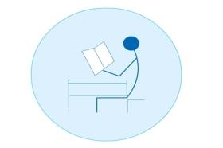
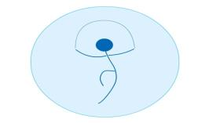
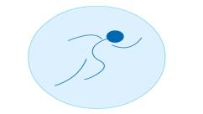
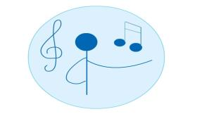
Look and say.
play basketball
read
skip
run
sing

Slide 5
What day is today?今天星期几？
It’s_________.
What do we have today?今天上什么课？
We have_______

Slide 6
fill
What day is today?
今天星期几？
打开30页，画出表示星期几
的单词，并翻译。

Slide 7
fill
What day is today?
今天星期几？ 请看课文动画
Thursday
It’s _________.
Danny and Li Ming can
____________this afternoon.
play football

Slide 8
basket
foot
ball

Slide 9
a small football
a big ________

Slide 10
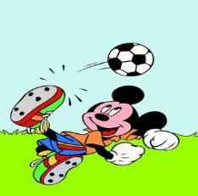
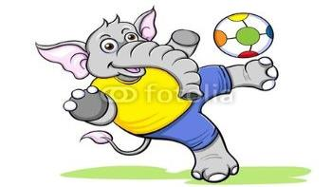
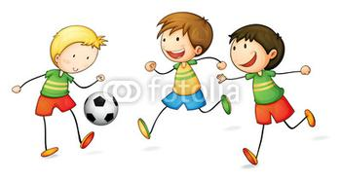
The elephant can play_________.
play football
Mickey can play_________.
They can
________________.

Slide 11
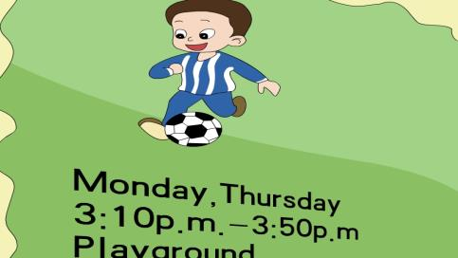
play football
He can play_________.
He can __________on
_______and________.

Slide 12
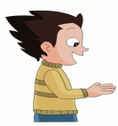
match.
再听一遍课文，回答问题。
I can play the piano on Wednesday.
I can dance on Tuesday and Friday.
I can draw pictures on Monday.

Slide 13
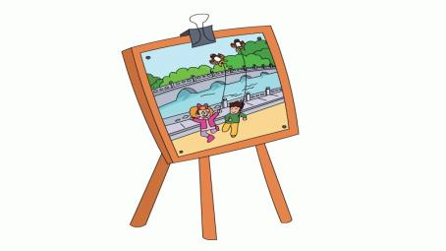
picture
pictures

Slide 14
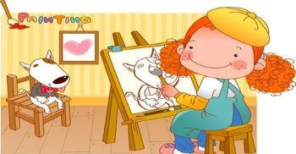
draw pictures
The boy can
draw_________.
The girl can
_____________.

Slide 15
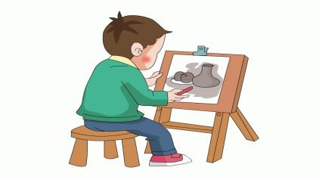
Friday
draw pictures
He can draw_________.
He can __________on
_______.

Slide 16
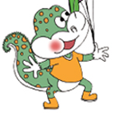
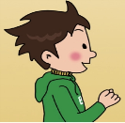
Think and say.
We can_______
on Thursday.
I can_______
on Monday.
I can_______
on Tuesday
and ________.
I can_______
on __________.

Slide 17
Tips:
谈论一周可以进行的活动：
We/I/They/…can_________
on_________.
活动
周几

Slide 18
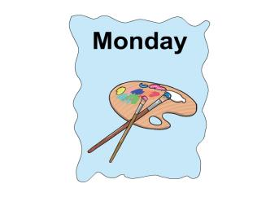
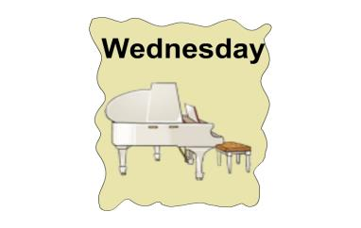
draw pictures
dance
play the piano
We can…on_______.
paper cutting
play the erhu

Slide 19
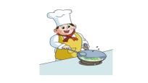
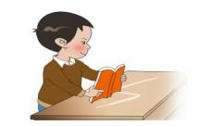
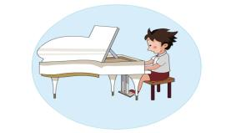
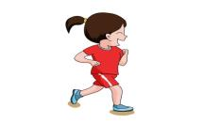
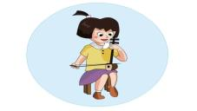
他们在干什么？
dance
cook
play the drums
read
draw pictures
play the piano
play the erhu
run

Slide 20
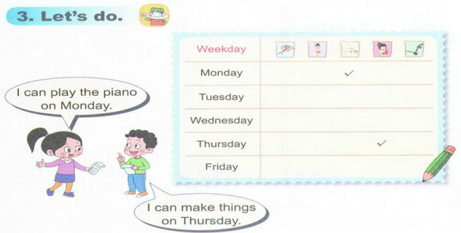

Slide 21
Homework
熟读课文。

