Slide 1

Animals in danger
WWW.PPT818.COM

Slide 2
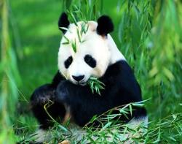
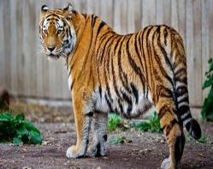
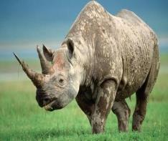
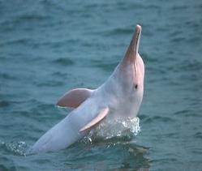
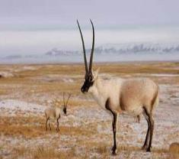
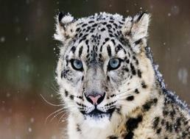
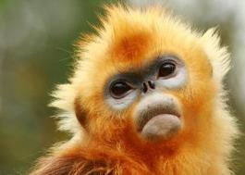
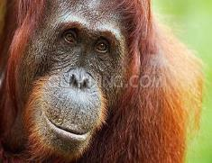
panda
black rhino
tiger
white-flag dolphin
Tibetan antelope
Animals
in danger
snow leopard
golden
monkey
gorilla

Slide 3
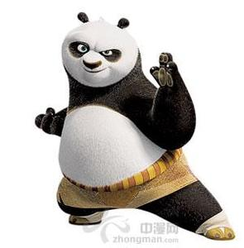
Animals

Slide 4
Listen and think
1) Where does the panda live?
2) What has it got?

Slide 5

Read and underline
(阅读划出新单词）
Tips
小贴士
快速浏览文本，在新单词下划横线。

Slide 6
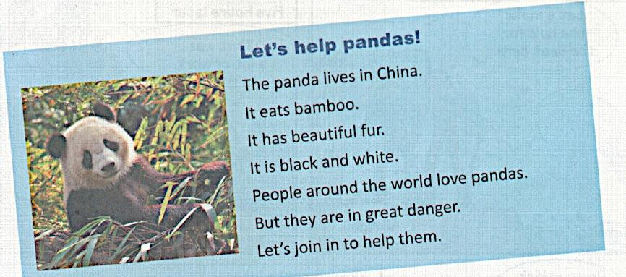

Slide 7
ham---bam
book---boo
bamboo

Slide 9







Map of the world
North America
Europe
Antarctica
Asia
South America
Africa
Australia

Slide 10



Slide 11

Task 1
Discuss in groups why the pandas are in danger
（小组讨论熊猫濒危的原因）
Tips
小贴士
You can use:
There is no...for pandas to eat/drink...
People kill /sell ... to get...

Slide 12
Task 2
Talk about the South China Tiger in groups（小组运用所给信息谈论一下华南虎的简介）
Name | Place | Colour | Food | Can
South China Tiger | China | white,yellow, black,orange | deers （鹿） antelopes （羚羊） | swim

Slide 13
Name | Place | Colour | Food | Can
South China Tiger | China | white,yellow, black,orange | deers （鹿） antelopes （羚羊） | swim
Tips
小贴士
You can use:
It lives… It is…
It eats… It can…

Slide 14
Task 3
Read the text and do True or False in groups（ 阅读有关华南虎的海报，小组内完成True or False练习）
Tips
小贴士
完成True or False练习时，应注意
在原文中找到相关信息，再进行判断。

Slide 15
True or false
1) The South China Tiger lives in many parts
of China.
2) We can see the South China Tigers in the forests
and the zoo.
3) The South China Tigers are in great danger.

Slide 16
True or false
The South China Tiger lives in many parts of China.
F

Slide 17
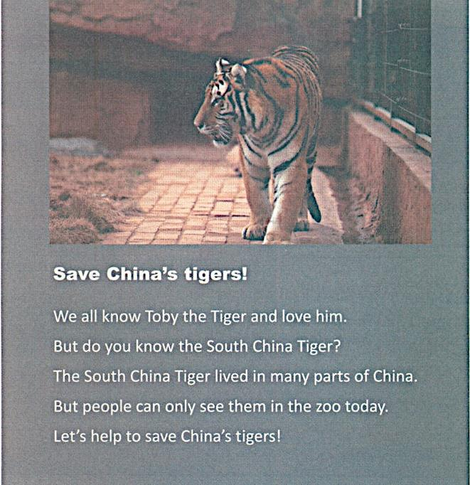

Slide 18
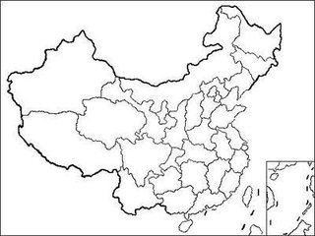











Before
Before
They lived in many parts of China.
They lived in many parts of China.

Slide 19
True or false
2）We can see the South China Tigers in
the forests and the zoo.
F

Slide 21
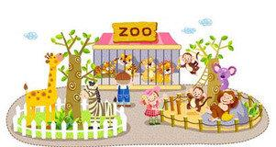
Now
But people can only see them in the zoo today.

Slide 22
True or false
3） The South China Tigers are in great danger.
T

Slide 24
Task 4
Discuss in groups how to save the animals in danger
（小组讨论如何保护濒危动物）
Tips
小贴士
You can use:
We should…
Don’t…
Let’s…

Slide 25
How to save?
Do Don’t
Plant trees
Make the air/water clear
Make friends with animals
Love animals
……
Cut trees, Hurt animals
Buy the products of animals
Make the air/water dirty
Kill animals
……

Slide 26
Task 5
Write a poster in groups（小组设计一张濒危动物海报）
Tips
小贴士
You can use:
It lives… It is… It has got…
It eats… It can…
Don’t… Let’s…

Slide 27
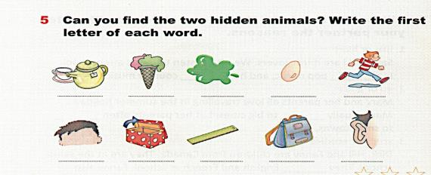
Homework
1. Do exercise: P53--5
2. Write a poster with parents
(与父母共同设计一张濒危动物的海报）

Slide 28
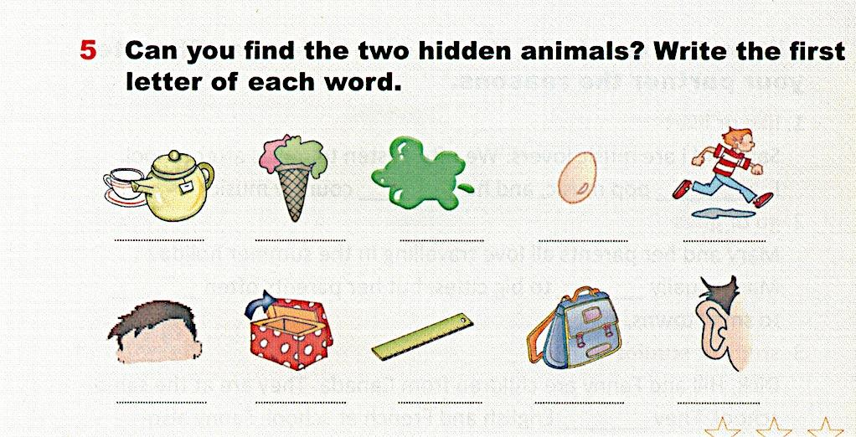
tiger
run
ice-cream
green
egg
tea
horse
hair
open
ruler
schoolbag
ear

Slide 29



Thank you！

