Slide 1
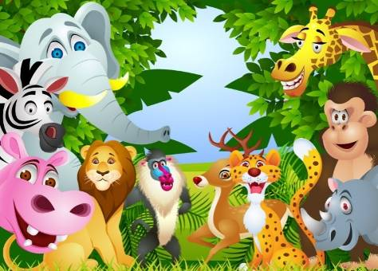
Animals in the zoo
第三课时
WWW.PPT818.COM

Slide 2
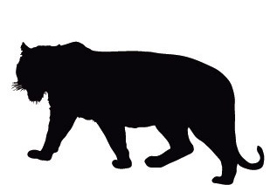
Say and spell
bear
tiger
elephant
lion
panda
monkey

Slide 3
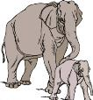
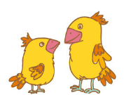
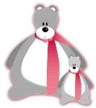
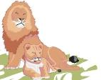
Look and tell
What animal do you like? Why?

Slide 4
Act it out
S1: Hi, … Do you like animals?
S2: ...
S1: Let’s go to ...
S2: ...
S1: Look! They are ...
S2: They are … I like …
Do you like …?
S1: …
S2: Let’s go to …
S1: Sure. Let’s go.

Slide 5
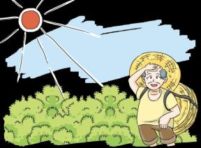
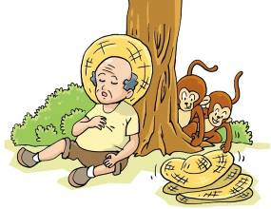
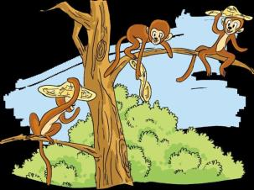
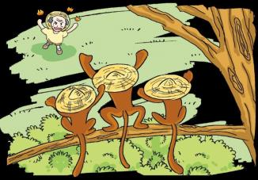
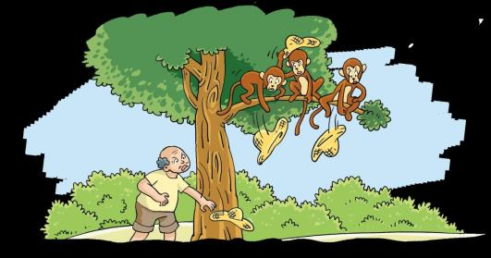

Slide 6
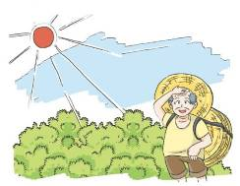
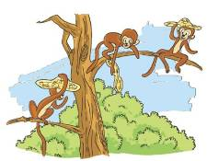
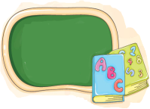
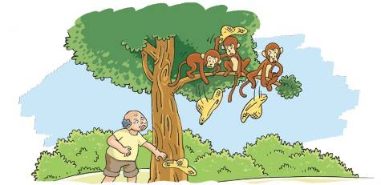
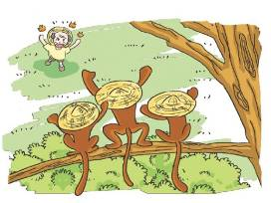
Put the pictures in the right order
1
2
3
5
4

Slide 7
Listen and answer
How many monkeys?
How are the monkeys?
How is the old man?

Slide 8
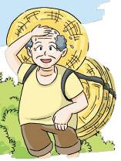
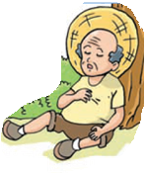
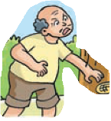
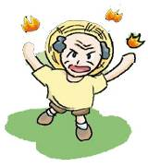
Listen and answer
How is the old man?
tired
hot
clever
angry

Slide 9
Learn the story
Oh, it’s hot.
It’s cool here.

Slide 10
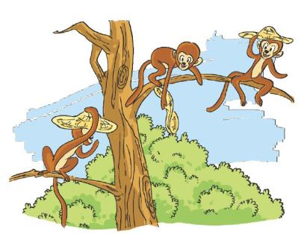
Learn the story
Look! What’s this?
It’s a hat.
They’re my hats.
I like this hat.
They’re our hats.

Slide 11
Learn the story
I don’t like this hat.
I don’t like this hat.

Slide 12
Act it out
Characters: an old man, three monkeys
Picture 2
Picture 5
Picture 3
Picture 4
Picture 1

Slide 13
By _________

Slide 14
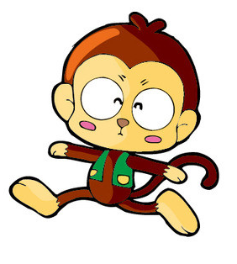
Read out loud
I like monkeys. Look at
this monkey.
Its tail is long.
Its ears are small.

Slide 15
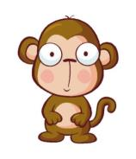
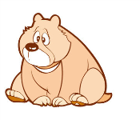
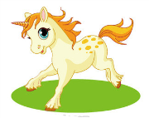
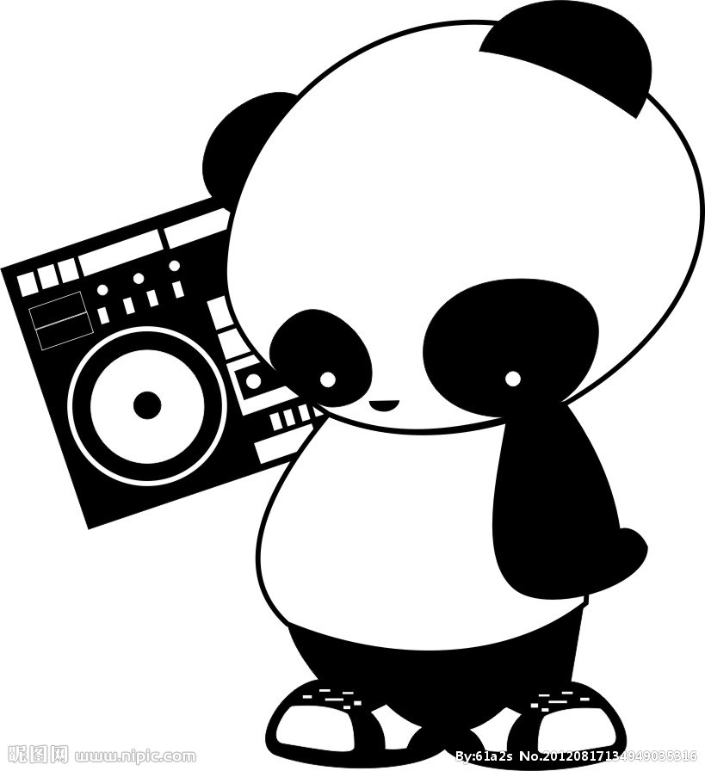
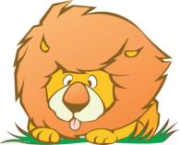
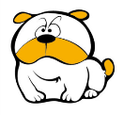
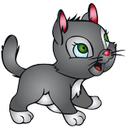
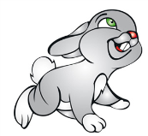
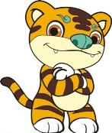
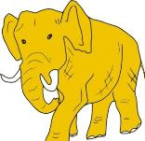
Choose and say
I like ... Look at ...
Its …

Slide 16
Make a book
Book Level 1
I like ________. Look at
this ________.
Its ____is ____.
Its ____are ____.
A picture of my favourite animal

Slide 17
Make a book
Book Level 2
I like _________. They _________.
Look at
this _________.
Its ___________.
Its ___________.
Its ___________.
I like this _____.
A picture of my favourite animal

Slide 18
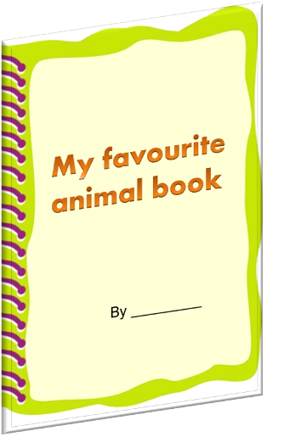
Make a book
I like ... Look at ...
Its …
Choose
Talk
Draw
Write
Read
Steps for making a book

Slide 19
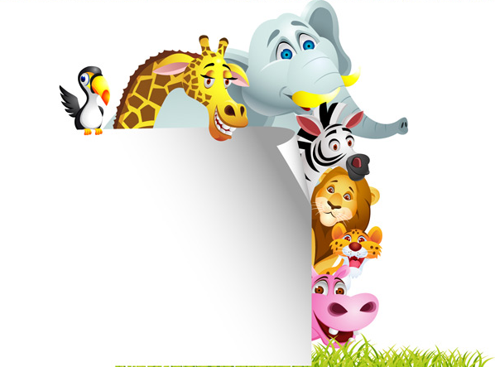
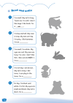
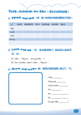
Homework
1 Talk about your favourite animal.
2 Write and draw My favourite animal book.
3 Complete Workbook pages 21, 24 and 25.

