Slide 1
Unit 9 My favorite subject is science.
Section B (1a～1d)
WWW.PPT818.COM

Slide 2
1．如何使用星期名词：
(1)表星期的词：Sunday(星期天)；Monday(星期一)；Tuesday(星期二)；Wednesday(星期三)；Thursday(星期四)；Friday(星期五)；Saturday(星期六)。
(2)书写形式：星期名词为专有名词，首字母均要大写；表示在星期几，前面一般不加冠词。在表达日期时，人们还经常用到星期名词的缩写形式：Sun.，Mon.，Tues./Tue.，Wed./Wedn.，Thur./Thurs.，Fri.，Sat.。

Slide 3
(3)询问星期
询问星期通常有两种句型：
①What day is it today？今天星期几？(回答：It's…today.)
②What's the day today？(回答：Today is…)
介词搭配：表示“在星期几，星期几的上午/下午/晚上”，介词都用on。
【注意】当星期名词前有last，this，next等修饰时，一般不再用介词。
(4)概念习惯：在中国，大家都以星期一作为每周的开始。但在英、美等西方国家，习惯上把Sunday作为第一天，把Saturday作为最后一天。
PPT模板：www.1ppt.com/moban/ PPT素材：www.1ppt.com/sucai/
PPT背景：www.1ppt.com/beijing/ PPT图表：www.1ppt.com/tubiao/
PPT下载：www.1ppt.com/xiazai/ PPT教程： www.1ppt.com/powerpoint/
资料下载：www.1ppt.com/ziliao/ 范文下载：www.1ppt.com/fanwen/
试卷下载：www.1ppt.com/shiti/ 教案下载：www.1ppt.com/jiaoan/
PPT论坛：www.1ppt.cn PPT课件：www.1ppt.com/kejian/
语文课件：www.1ppt.com/kejian/yuwen/ 数学课件：www.1ppt.com/kejian/shuxue/
英语课件：www.1ppt.com/kejian/yingyu/ 美术课件：www.1ppt.com/kejian/meishu/
科学课件：www.1ppt.com/kejian/kexue/ 物理课件：www.1ppt.com/kejian/wuli/
化学课件：www.1ppt.com/kejian/huaxue/ 生物课件：www.1ppt.com/kejian/shengwu/
地理课件：www.1ppt.com/kejian/dili/ 历史课件：www.1ppt.com/kejian/lishi/

Slide 4
2．free adj.空闲的。常用短语be free，也可说成have time。
eg：I'm free.＝I have time.我有时间。
3．cool
(1)adj.本意为“凉的，凉爽的；冷静的”。
eg：It's cool today.今天天气凉爽。
(2)还可意为“酷的，时髦的。”

Slide 5
一、用所给词的适当形式填空。
1．I don't like math very much. Because I think it's very ______(bore)．
2．This is not my schoolbag. Where's ______(I)?
3．Miss.Li teaches us English. We like ____(she) classes.
4．He thinks art is ___________(interest)．
5．I like listening to music. It's __________(relax)．
boring
mine
her
interesting
relaxing

Slide 6
二、根据句意及汉语提示写单词。
6．I'm ______(有空) on Sunday.
7．I like _______(星期日) best.
8．I think English is _____(酷)．
9．I like math because it's very ___________(有趣的)．
10．I have science on ___________(星期三)．
free
Sunday
cool
interesting
Wednesday

Slide 7
三、单项选择。
11.______ is the first day of the week.
A．Monday B．Saturday C．Sunday
12．—Why isn't he good at English?
—______ he doesn't work hard at it.
A．After B．Because C．When

Slide 8
13．Math is my favorite subject because it's ______．
A．boring B．interesting C．busy
14．—______ do you have P．E. lesson on Tuesday?
—At 9：30 a．m.
A．What subject B．When
C．What color
15．—You look really ______ in the blue hat!
—Thank you.
A．old B．big C．cool

Slide 9
四、按要求完成句子。
16．Alan likes geography.(改为一般疑问句)
_____ Alan _____ geography?
17．John has P．E. on_Monday．(对画线部分提问)
__________ John _____ P．E.?
18．Ms.Li is our math teacher.(对画线部分提问)
________ your math teacher?
19．Alice's favorite subject is English．(对画线部分提问)
________ Alice's favorite subject?
20．I like history because_it's_fun．(对画线部分提问)
_______ you like history?
Does
like
When does
have
Who is
What is
Why do

Slide 10
五、根据汉语完成句子，每空一词。
21．大卫为什么喜欢历史？
_________ David like history?
22．你的生日聚会是什么时候？
_________ your birthday party?
23．我爸爸现在有空。
My father _________ now.
24．张老师的英语课有趣。
Mr.Zhang's English class ___________．
25．她妹妹的数学老师看上去很酷。
Her sister's math teacher ________．
Why does
When is
is free
is interesting
looks cool

Slide 11
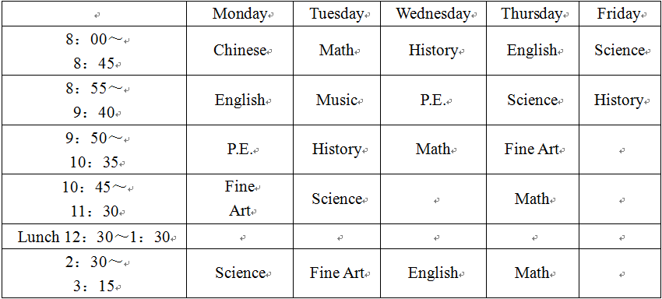
六、阅读理解。

Slide 12
26.How many English classes does Mary have in a week？____
A．Five. B．Three. C．Four.
27．What class do they have after fine art on Monday？____
A．English. B．Science. C．Chinese.
28．The second class on Thursday is ____．
A．fine art B．science C．P.E.
29．There are ____ history classes in a week.
A．three B．two C．six
30．What time do the students have lunch？____
A．At 12：00. B．At 1：35. C．At 12：30.
B
B
B
A
C

