Slide 1
Unit 2 How often do you exercise?
Section A (1a — 1c)
WWW.PPT818.COM

Slide 2
What do you do on weekdays?
What do you do on weekends?
always …
usually …
often …
sometimes …
…
I

Slide 3
What do you do on weekends?
I often/usually/...
often
go shopping
hardly ever
help with housework

Slide 4
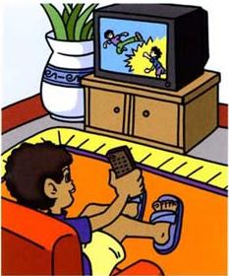
What do you do on weekends?
I often/usually/...
usually
watch TV
sometimes
read books

Slide 5
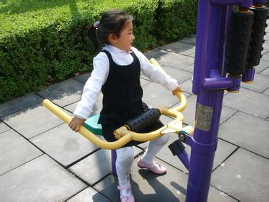
What do you do on weekends?
I often/usually/...
never
exercise

Slide 6
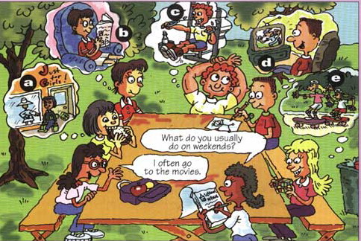
1b. Listen and write the activities next to the correct frequency.
always (100%) ______________
usually ________________
often ________________
sometimes ________________
hardly ever ________________
never (0%) ________________
exercise, read
watch TV
help with housework
go shopping
watch TV
go shopping

Slide 7
1c. Talk about the people in the picture above.
What do they do on weekends?
A: What does he do on weekends?
B: He usually watches tv.
A: Does he go shopping?
B: No, he never goes shopping.

Slide 8
小结训练
( )1. My mother _____ surfs the Internet. She likes watching TV.
A. doesn't hardly ever B. hard ever
C. isn't hardly ever D. hardly ever
( )2. My friends _____ any shopping on weekends.
A. aren't do B. isn't do
C. don't do D. doesn't do
( )3. I'm very tired. I can _____ run.
A. always B. hardly C. usually D. sometimes
( )4. My grandfather _____ every day. He looks very healthy.
A. exercise B. do exercises
C. do exercise D. does exercises
D
C
B
D

Slide 9
问题探究
1. exercise 的用法
1）我每天都锻炼。I exercise every day.
2）我爸爸总是做运动。My father always does exercise.
3）我们每天都做早操。We do morning exercises every day.
exercise 可以做动词，意为“锻炼”；也可以做名词，意为“运动、锻炼”时为不可数名词，意为“习题、体操”是为可数名词，场合动词 do 搭配使用，且做“体操”讲时多用复数形式。
常用词组：
take/do exercise 做运动；
do morning exercises 做早操；
do eye exercises 做眼保健操。

Slide 10
问题探究
2. hardly 的用法
他非常的累，几乎不能走路了。
He is very tired, he hardly walks.
hardly “几乎不”，是个否定副词，表示否定意义，通常位于实意动词之前，系动词、助动词、情态动词之后。
注意：hardly 不是 hard 添加后缀构成的副词。

Slide 11
问题探究
3. 频率副词的用法
常见的频率副词有 always, usually, often, sometimes, hardlyever, never 与疑问词 how often 对应。表示的频率由 always 向 never 递减。
在句中位于实意动词之前，情态动词（can 等）、助动词（do 等）、连系动词（be 等）之后。但 sometimes 也可在句首。

