Slide 1
Unit 8 When is your birthday?
单元同步作文导练
WWW.PPT818.COM

Slide 2
本单元围绕“When is your birthday？”来讨论每位学生及其周围人的生日及如何表达12个月份的日期。同学们只要掌握1到30的序数词及12个月份的单词，我们就可以写好自己的生日、同学的生日以及家人的生日及日程安排表。
教材中出现的相关句型：
①When is your birthday？你生日是什么时候？
②My birthday is on May 2nd.我生日是5月2号。
③I am…(year old)．我是……岁。
④Do you like…？你喜欢……？
⑤Please come to…next week.下周请到……。

Slide 3
⑥We have some interesting and fun things for you this term！本学期我们为你们准备了一些有趣而愉快的事情！
⑦This is a really busy term.这的确是一个繁忙的学期。
⑧We have a/an我们举行(举办)……
拓展常用相关句型：
①I think you will like it/them very much.我想你将非常喜欢它(们)。
②He is good at….他擅长……。
③He is a….他是一个……。

Slide 7
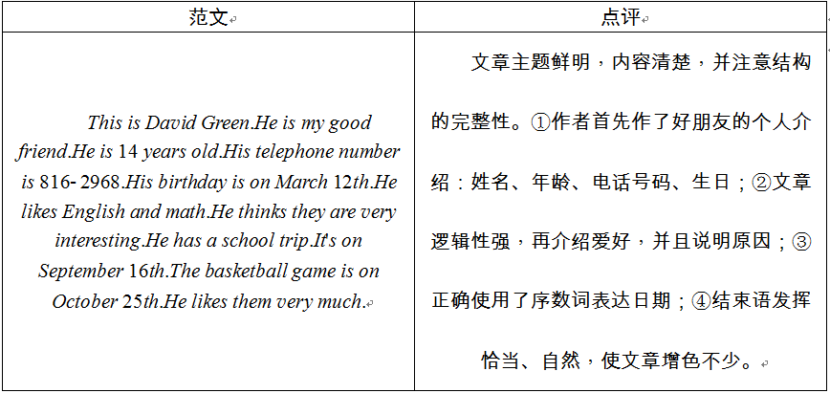

Slide 8
要求：
1．语句通顺，无语法错误。
2．词数：60左右。

Slide 9
We have tests on December 2nd and December 3rd in our school. The school trip is on December 5th.We will visit some interesting places in our city. And the art festival is on December 8th.We will sing different kinds of songs and draw some nice pictures. We have a speech contest on December 16th.We also have a volleyball game on December 21st.It's a really busy month.

