Slide 1
Unit 10
You are supposed to shake hands
Section A Period 1 1a-2d
WWW.PPT818.COM
Notes:
1
1

Slide 2
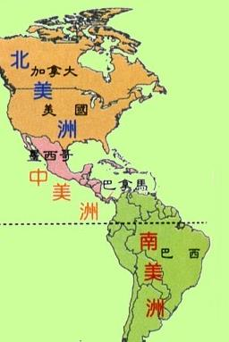
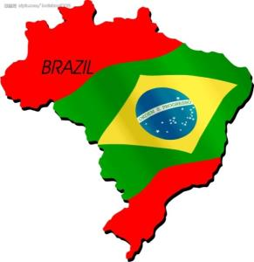
In Brazil, what do people do when they meet for the first time?

Slide 3
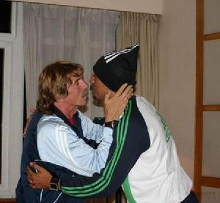
Brazil --- Brazilian(s)
kiss
They are supposed to …

Slide 4
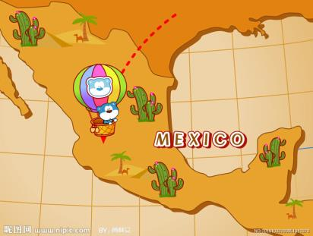
In Mexico, what do people do when
they meet for the first time?

Slide 5
Mexico—Mexican (s)
shake hands
They are supposed to …

Slide 6
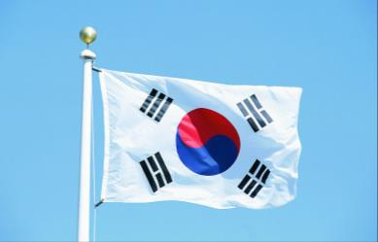
In Korea, what do people do when they meet for the first time?
Korea --- Korean (s)
bow
They are supposed to ...

Slide 7
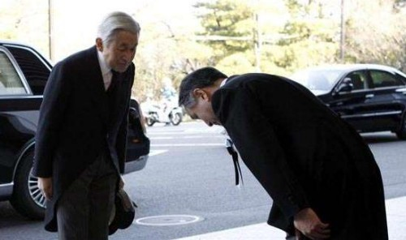
In Japan, what do people do when
they meet for the first time?
They are supposed to …

Slide 8
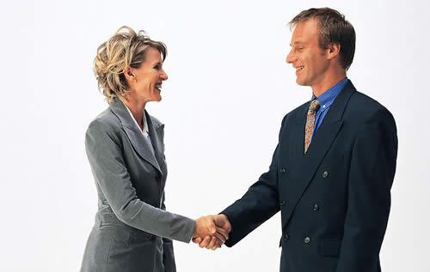
In the United States, what do people
do when they meet for the first time?
They are supposed to …

Slide 9
1b Listen and check your answers in 1a.
Countries | Customs
1.____Brazil | a. bow b. shake hands c. kiss
2.____the United States
3.____Japan
4.____Mexico
5.____Korea
c
b
a
b
a
Notes:
9

Slide 10
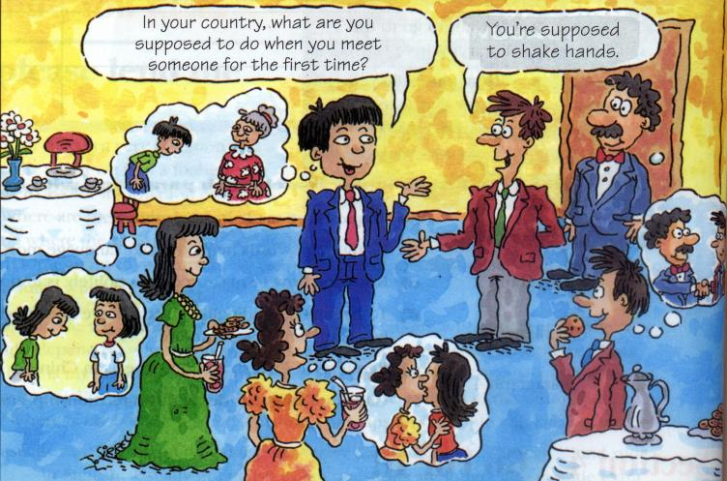
Listen and check the answer in 1a.
1b

Slide 11
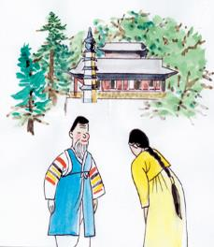
Make conversations about what people in different countries do when they meet for the first time. Talk about the countries in 1a or other countries.
1c
A: What are people in Korea
supposed to do when they meet
for the first time?
B: They’re supposed to bow.

Slide 12
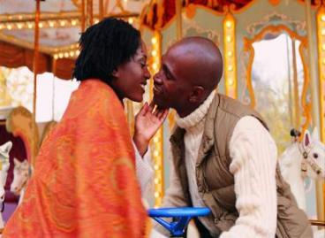
A: What are people in Brazil supposed to do when they meet for the first time?
B: They’re supposed to hug and face-to-face kiss.

Slide 13
A: What are you supposed to do when you meet a Japanese for the first time?
B: You are supposed to bow when you meet a Japanese for the first time.

Slide 14
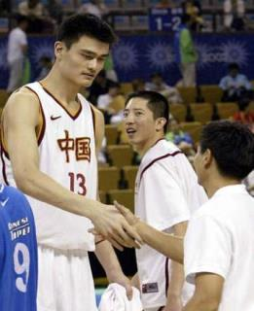
A: What are you supposed to
do when you meet him
from China for the first
time?
B: You are supposed to shake
hands when you meet him for the first time.

Slide 15
A: What are you supposed to do when you meet people from France for the first time?
B: You are supposed to kiss when you meet people from France for the first time.

Slide 16
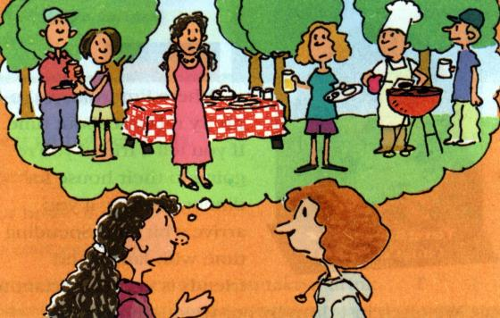
Maria’s story
2a
Maria is an exchange student. Last night she h ad
dinner at an American friend’s house. Listen and
check (√) the mistakes Maria made.

Slide 17
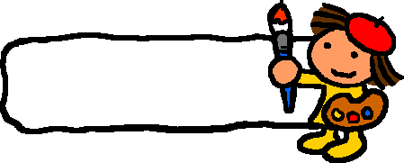
CHECK
Maria’s mistakes
√
______ arrived late
______ ate the wrong food
______ greeted Paul’s mother the wrong way
______ wore the wrong clothes
√
√

Slide 18
Listen again. Fill in the blanks.
2b
1. Maria was supposed to arrived at 7:00, but she ______________ .
In Maria’s country, when you’re invited for 7:00, you’re expected to __________.
3. When Maria met Paul’s mom, she was supposed to ____________ .
Maria should ask what she is supposed to _________ if she is invited to a party next time.
arrive at 7:00
come later
shake hands
wear

Slide 19
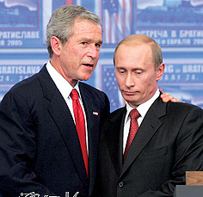
2c
Role-play a conversation between Maria and Dan. Use the information in 2a and 2b.
How was the dinner at Paul’s house last night?
Well, it was OK, but I made some mistakes. I was supposed to arrive at 7:00,but I arrived at 8:00.

Slide 20
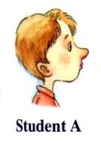
Role-play the conversation.
2d
Katie: How was the welcome party for
foreign students last night?
John: Great! I made some new friends. But a
funny thing happened.
Katie: What?
John: I met a Japanese boy called Sato, and
as soon as I held out my hand, he
bowed.

Slide 21
Katie: That’s how people in Japan are expected to greet each other. It’s impolite if you don’t bow.
John: I didn’t know that. So I just stood there
with my hand out. Finally, I returned the bow.

Slide 22
Language points
1) be expected to 意为“被期望；被要求”。
she is expected to be a good doctor.
有人期望她成为一名好医生。
The visitors are expected to arrive in half
an hour.
参观者要在半小时后到达。

Slide 23
3. smooth music
smooth adj. 平滑的；悦耳的
Her skin is as smooth as silk.
她的皮肤像丝绸一样光滑。
Our path in life will not always be smooth.
我们人生的道路不会总是平坦的。
She has the most beautiful blue eyes and a voice as smooth as silk.
她有着美丽的蓝色眼睛和十分悦耳的嗓音。

Slide 24
4. Well, if you have spare time, …
spare adj. 空闲的；不用的
What do you like doing in your spare time?
你在闲暇时喜欢做什么？
Please stay with us. We have a spare room for you.
请住下吧，我们有一个空房间给你住。
I have no spare money.
我没有余钱。

Slide 25
HOMEWORK
1. Recite the new words.
2. Write a passage about different customs in different countries.
Notes:
25
25

Slide 26
Thank you

