Slide 1
Unit 5 Shopping
Can I help you?
WWW.PPT818.COM

Slide 2
Wheels on the bus

Slide 3
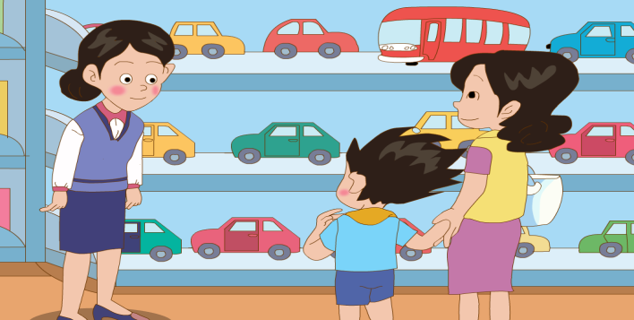
a shop

Slide 4
Watch and answer:
What does Li Ming want?
a toy car
B.a toy bus

Slide 5
toy

Slide 6
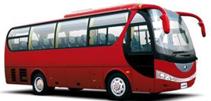
a toy bus

Slide 7
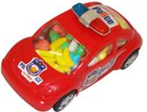
a toy car

Slide 8
A: Can I help you?
B: I’d like ______.

Slide 9
This toy car goes______
fast

Slide 10
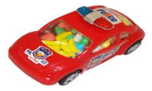
cheap
It’s very ________.
5 yuan
2 yuan

Slide 11
Practice in pairs
A: Can I help you?
B: I’d like ______.
A: How about this one?
It’s ____ and _____.
(nice, cheap, beautiful, lovely)
B: Ok! I’ll take it.

