Slide 1
Unit 3 Teenage problems
Grammar (1)
WWW.PPT818.COM

Slide 2
找出下列复合句中的宾语从句，并分析其构成：
Millie knows that it’s important to finish homework on time.
Millie often doubts whether/if it is worth spending so much time on homework.
3. Millie doesn’t know how she should deal with her problem.
4. Simon doesn’t understand why his parents are so strict with him.
5. I wonder how I can achieve a balance between my schoolwork and my hobbies.

Slide 3
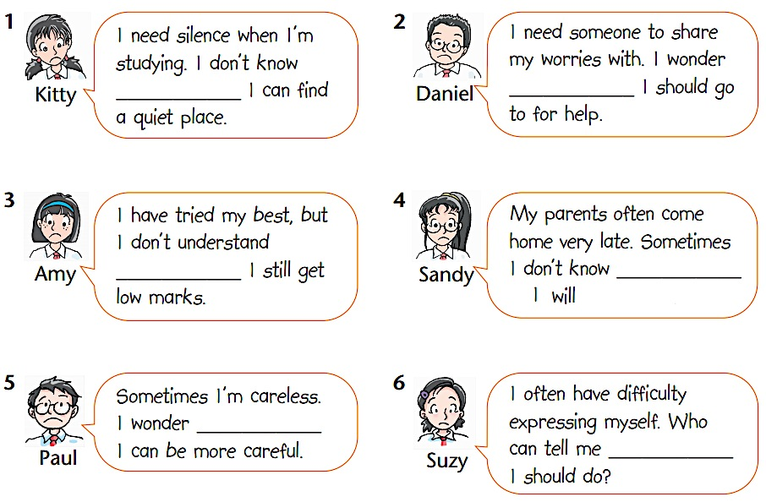
What’s… problem? A1 P.40 疑问词填空
where
who
why
when
how
what

Slide 4
Practice
A2 P.41
Daniel has some questions. Rewrite his questions by using object clauses introduced by question words.
how much sleep we need every day
2. I wonder _________________________.
3. I am not sure _____________________
________________________________.
4. Can you tell me ____________________
_________________________?
which method I should use to solve the problem
where we can buy a good dictionary

Slide 5
how I can improve my English quickly
5. I want to know __________________
______________________________.
6. I do not know ___________________
______________________________.
7. I cannot imagine ________________
_____________________________.
whom we should ask for help
what life would be like without hobbies

Slide 6
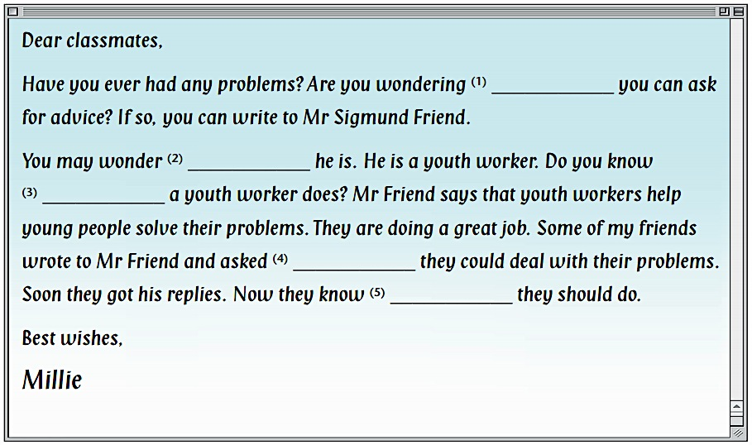
Help Millie complete her email with the correct question words.
whom/who
what/who
what
how
what

Slide 7
Rewrite the sentences
I’d like to know … Where is your school?
2. I wonder … How far is the park from here?
3. I can’t imagine … How did he find his lost dog?
4. Can you explain … Why does the sun rise in the east?
5. We haven’t found out … What’s wrong with Ann?
I’d like to know where your school is.
I wonder how far the park is from here .
I can’t imagine how he found his lost dog.
Can you explain why the sun rises in the east.
We haven’t found out what is wrong with Ann.

Slide 8
Exercises
Choose the right answers.
We don’t know ___ we will go there tomorrow.
A. where B. why
C. when D. whether
2. Do you know ____?
A. what time will the plane take off
B. what time would the plane take off
C. what time the plane will take off
D. the plane will take off at what time
√
√

Slide 9
3. The manager came up to see ____.
A. who did the job
B. who did the job do
C. who does the job
D. who does the job do
4. Can you tell me how soon ____ back?
A. will he be B. does he come
C. he will be D. did he come
5. Nobody knows ____.
A. who is he B. who he is
C. what is he D. what does he do
√
√
√

Slide 10
Homework
Remember how to use object clauses introduced by question words.
Finish the relevant exercises.

