Slide 1
Unit 1 This is me
Reading 1
WWW.PPT818.COM

Slide 2
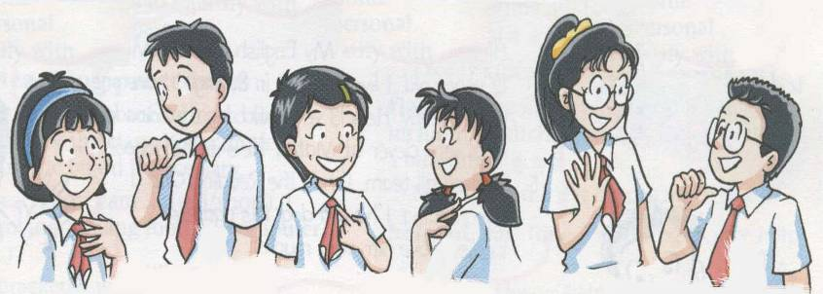
They are all in Grade Seven
Simon
Sandy
Amy
Millie
Daniel
Kitty

Slide 3
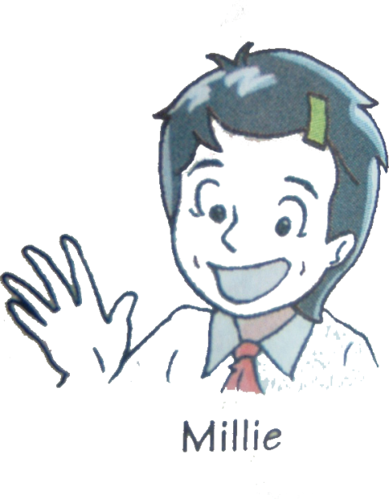
Hi, I’m Millie, a new student at Sunshine Middle School. I’m 12 years old. I have short hair. I love reading. Now let’s meet my new classmates.

Slide 4
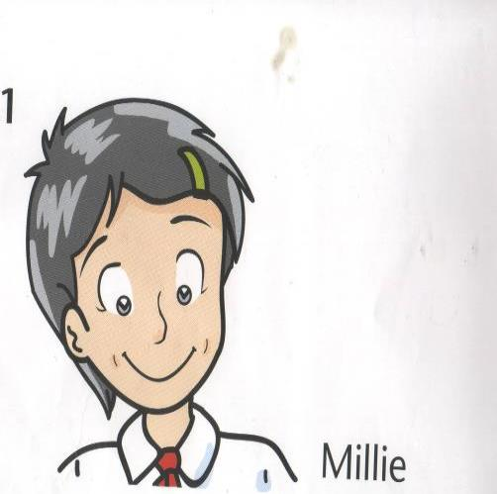
12
Age:
Hobby:
Reading
Appearance:
short hair

Slide 5
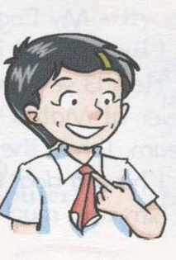
Read and fill in the blanks
12
Millie is _____ years old.
She has .
She loves __________.
short hair
reading

Slide 6
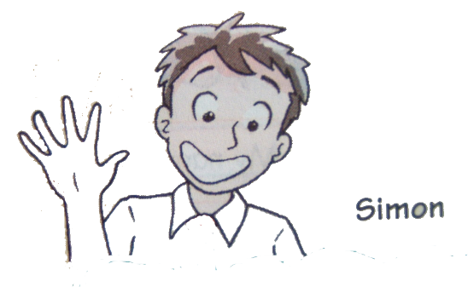
Hello! My name is Simon. I am tall I like sports. I often play football after school.

Slide 7
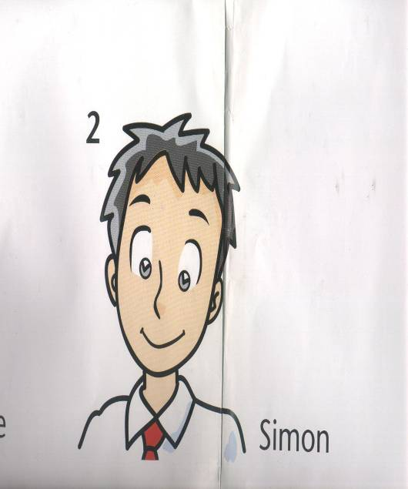
Appearance:
tall
Hobby:
football

Slide 8
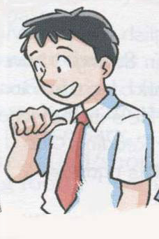
What does Simon like?
Simon is _________.
What does he love doing?
He loves ______ ______ after school.
tall
playing
football

Slide 9
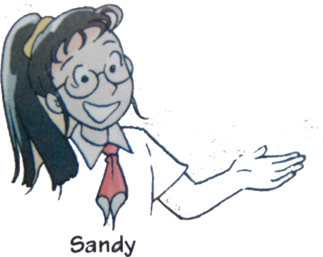
This is Sandy. She is tall and slim. Her hair is long. She likes music.

Slide 10
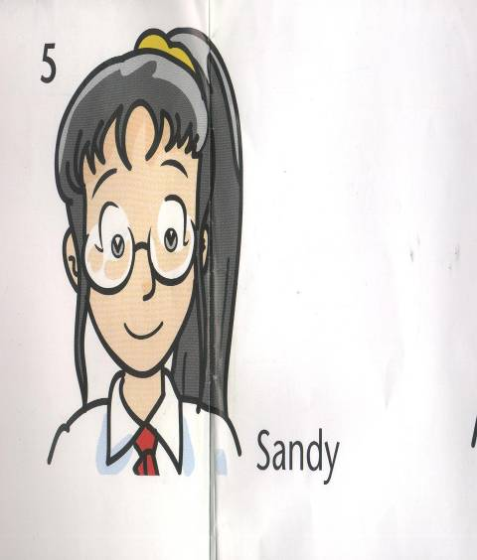
Appearance:
tall and slim
Hair:
long black
Hobby:
music

Slide 11
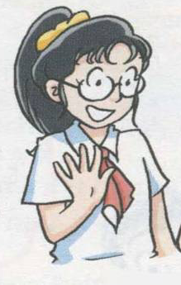
Sandy is ______________.
She has _________ hair.
She likes __________________.
tall and slim
long black
listening to music

Slide 12
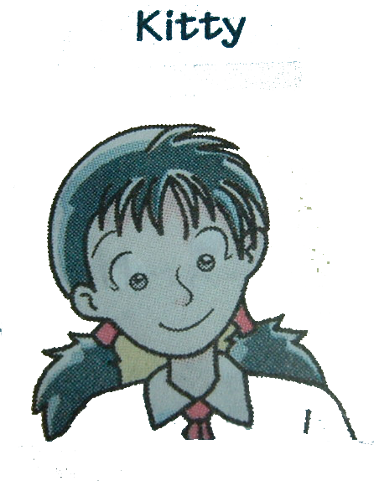
This is Kitty.
She is 11 years old.
She is small.
She loves dancing.
She works hard.

Slide 13
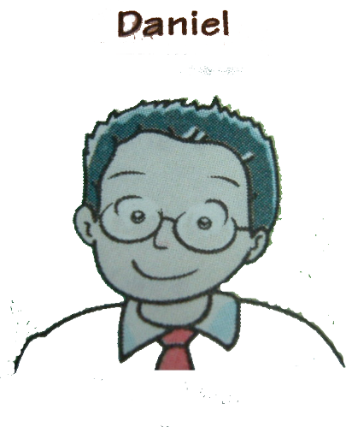
This is Daniel.He is from Nanjing.
He is short. He is good at Maths.

Slide 14
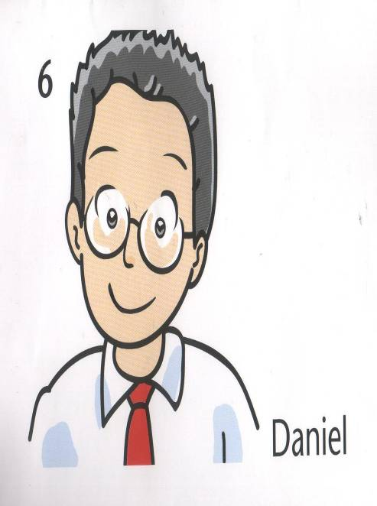
a pair of
glasses
enjoy playing computer games

Slide 15
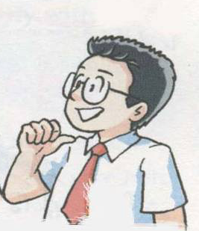
Daniel wears _________.
He enjoys ________________.
He is _____ and good at ______.
glasses
playing computer games
short
Maths

Slide 16
True or False
F
1. Millie is 11 years old.
2. Millie has short hair.
3. Simon is not tall.
4. Simon likes sports.
5. Sandy is short .
6. Sandy does not have long hair.
7. Daniel is tall.
8. Daniel is from Nanjing.
T
F
T
F
F
F
T

Slide 17
profiles
Task 2 Read and complete
English name | Millie | Simon | Sandy | Daniel
age
appearance
hair
hobbies
12
tall and slim
tall
short
short hair
long hair
music
reading
sports

Slide 18
New classmates
Simon is very tall. He loves playing ________ after school.
Sandy is tall and ________. She has ____hair. She likes listening to ________. Millie is years old. She has ________. She loves ________. Daniel is from . He is ______. He is good at ________.
football
slim
long
music
12
short hair
reading
Nanjing
short
Maths

Slide 19
Try to say sth. about yourself.
(试着说说你自己 ,不少于5句话)
Hi, I am ____. I am in _____ Seven. I am from ____. I am ____ years old. I was born in _____.Now, I live in _____. I have _____ hair and ____ eyes. I love_____ and_____. I am good at ______. I wear______ (I don’t wear ...).

Slide 20
Homework
Read the text a lot after class .
Finish off the workbook exercises .

