Slide 1
Unit 7 Days and Months
Writing
WWW.PPT818.COM

Slide 2
单元写作目标
本单元话题为“季节与天气”，要求能够介绍一年中的季节及节假日，主要包括每个季节的天气情况，能够从事的活动以及节假日中的庆祝活动。
写作时主要采用第三人称，时态以一般现在时为主。

Slide 3
单元写作素材
(一)单元话题短语积累
1．在夏天
2． 玩得高兴
3．放风筝
4. 许多的
5．大优惠；大减价
6．新年快乐
7．节礼日
8．倒计时；倒读数
in summer
have a good time
fly a kite
lots of
big sales
Happy New Year
Boxing Day
count down

Slide 4
单元写作素材
(一)单元话题短语积累
9．在……之后到来
10. 运动会
11. 闰年
12. 谈论
13. 和……玩
14. 聚会
15. 国际劳动节
16. 教师节
come after
Sports Day
leap year
talk about
play with
get together
International Workers' Day
Teachers' Day

Slide 5
单元写作素材
(一)单元话题短语积累
17. 国庆节
18. 春节
19. 元旦
20. 看电影
21. 去爬山
22. 来自
23. 去游泳／滑冰／购物
National Day
the Spring Festival
New Year's Day
watch a movie
go mountain climbing
be from
go swimming/skating/ shopping

Slide 6
单元范文剖析
范文赏析
B
My favourite season is autumn.It is the(1)_____ season in a year.
September, October and November are in this season in China. (2)______ is windy and cool.Usually, we fly kites outside after school.Flying kites is exciting.We can (3)_____．
We (4)_____ Teachers' Day on September 10th and National Day on October 1st.Mid­Autumn Day is also in this season.Our family usually (5)_____ and have a big dinner.We eat moon cakes and a lot of other good food.We are excited.
I like autumn very much.It is my favourite season.
D
A
C
D

Slide 7
单元范文剖析
请给短文的空白处选择最佳选项。
1．A.second B．third C．two D．three
2．A.Its B．She C．He D．It
3．A.have a good time B．be sad
C．do homework D．have a meal
4．A.are B．want C．have D．buy
5．A.have a lesson B．have a big sale
C. count down D．get together

Slide 8
单元范文剖析
小组探究
这是一篇有关季节介绍的文章，请在阅读短文的基础上，完成下列两项任务。
任务一：请思考：
1．你最早是如何知道本文的中心话题的？
_________________________________________
2．文章的2—3段分别介绍了这个季节的哪些方面？
Paragraph 2:___________________________________
Paragraph 3：__________________________________
3．文章最后一段表达了怎样的情感？
__________________________________________

Slide 9
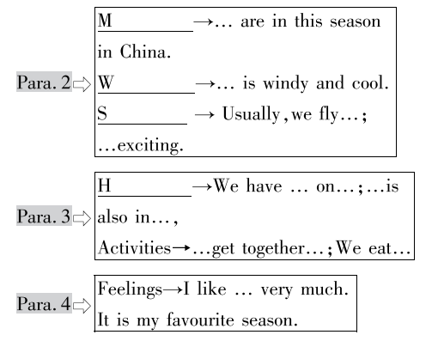
单元范文剖析
任务二：根据首字母提示完成图表中空缺的单词。
utumn
onths
eather
ports
olidays

Slide 10
单元写作练笔
你在即将到来的寒假中受邀参加一个冬令营，在冬令营中，营员要进行My favourite season的演讲。请根据思维导图完成不少于80词的演讲稿，可适当发挥。

Slide 11
单元写作练笔
思路点拨
思路点拨
1.开篇点题:
My favourite season is…
3.对这个季节的情感表达
I like… very much. It is…
2.季节介绍：所在月份，天气状况，适宜的运动项目，本季节的节假日与相关活动

Slide 12
单元写作练笔
参考范文
My favourite season
My favourite season is winter.It is the last season in a year.
December, January and February are in this season.The weather is cold and snowy.Usually, we go skating and skiing outside after school.Playing with snow is exciting.We have a lot of fun.We have Christmas Day on December 25.And New Year's Day is on January 1.The Spring Festival is also in this season.It is usually in January or February.During the Spring Festival, we get together and have a big dinner.We are very happy and excited.
I like winter very much.It is my favourite season.

Slide 13
再见

