Slide 1
Unit 6 Topic 3
Bicycle riding is good exercise.
Section A
WWW.PPT818.COM

Slide 2
Traffic signs
What does it mean?

Slide 3
Survey
How do you usually come to school?
Way | Bike | Bus | Subway | Car | On foot | Others
Number
Reason
Most of the students in our class come to school ______ ________. Why?

Slide 4
1d
Work in groups and discuss the advantages and disadvantages of riding bikes. The following expressions may help you.
Cycling can … It’s easy to…. I agree / disagree with you. I think…

Slide 5
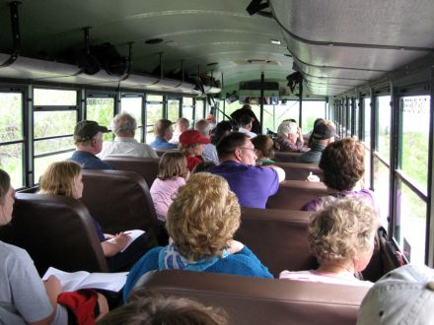
New words
anywhere adv. 任何地方
crazy adj. 疯狂的
passenger n.
- John wants to ride his bike to travel around China.
- Oh, that’s a crazy idea.
There are many passengers on the bus.

Slide 6
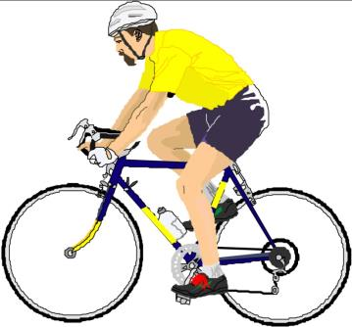
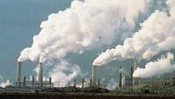
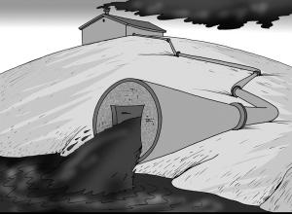
New words
pollution n. 污染
pollute v.
dis +
agree →
disagree
air pollution
water pollution
ride +
r →
rider
a bicycle rider

Slide 7
Listen to 1a and mark T( True ) or F ( False )
1b
Many passengers were hurt in the traffic accident yesterday. ( )
Traffic in Beijing is very good. ( )
Michael rides his bike less than before. ( )
Cycling does not cause air pollution. ( )
It is not easy to park bikes. ( )
T
F
F
T
F

Slide 8
1c
Read 1a and write down three advantages
of cycling. Then add your idea.
Cycling can help us save energy.
Advantage 1: _________________________
Advantage 2: _________________________
Advantage 3:_________________________
Your idea: ___________________________
It doesn’t cause air pollution.
It’s easy to park bikes.

Slide 9
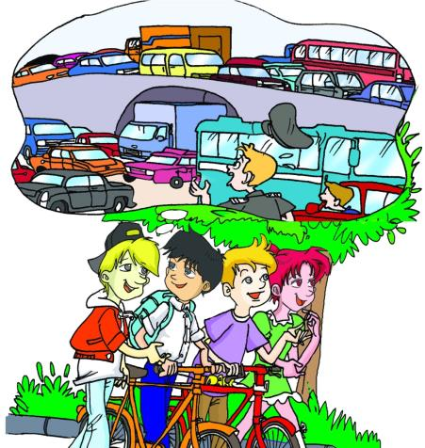
Act out 1a according to the key words.
K: accident, passenger,
D: terrible, crazy
M: get used to, afraid of, anywhere, confident
K: obey, fewer
J: ride… around
D: save energy, pollution
K: agree, easy

Slide 10
2
Listen to the passage and fill in the blanks.
1. Many people around the world use bicycles for _______ and _______.
work
pleasure
cost
bicycles ______very little.
bicycles need _______ space than cars.
cycling doesn’t cause _______ __________.
cycling is a _____________
cycling is_______________
less
2. More people in China use bicycles because
air pollution
useful sport
good for our health

Slide 11
Answer the following questions according to 2.
What do many people around the world use bicycles for?
____________________________________________
2. In China, how many people have cars while how many people have bicycles?
____________________________________________
They use bicycles for work and pleasure.
Millions of people have cars while hundreds of millions of people use bicycles

Slide 12
Listening text.
2
Many people around the world use bicycles for work and pleasure. In China, millions of people have cars while hundreds of millions of people use bicycles. Why? Because bicycles cost very little. Cars cost much more than bicycles. Bicycles need less space than cars. Cycling does not cause air pollution. What’s more, cycling is a useful sport and it is good for our health.

Slide 13
Translate the phrases.
一起交通事故
受伤
遵守交通规则
节约能源
造成空气污染
a traffic accident
be/get hurt
obey the traffic rules
save energy
cause air pollution

Slide 14
Complete the following sentences.
1. 公共汽车上挤满了(be crowded with)乘客。
The bus is crowded with passengers.
2. Jeff到处找他的钥匙，但哪儿(anywhere)都找不到。
Jeff looked for his keys, but he couldn’t find them
anywhere.
3. 在你们这种年龄有一些疯狂的想法很正常。
It’s normal to have some crazy ideas at your age.
4. 工厂和汽车导致空气污染。
Factories and cars cause air pollution.

Slide 15
Summary
We learn
New words and phrases:
passenger, crazy, anywhere, pollution
Useful expressions:
If people obey the traffic rules, there will be fewer accidents.
Cycling can help us save energy and it doesn’t cause air pollution.
如果人们都遵守交通规则，交通事故就会少了。
骑自行车既能帮助我们节能又不引起空气污染。

Slide 16
Summary
We can
Talk about the advantages / disadvantages of riding bikes:
Bicycles need less space than cars.
It’s easy to park bikes, too.
Describe a traffic accident.

Slide 17
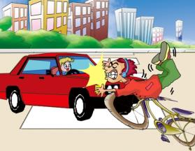
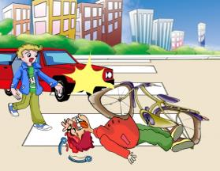
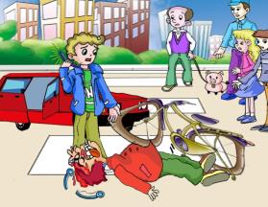
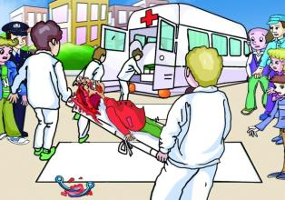
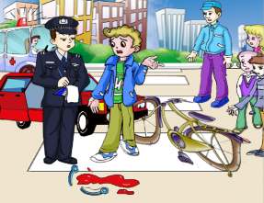
3a
Talk about the following pictures in groups and complete the sentences.
have an accident
badly hurt
call 120 at once
send…to the hospital
ask about

Slide 18
Talk about the following pictures in groups and complete the sentences.
3a
While the bicycle rider was crossing the road, ___________________________.
When the driver came out to have a look, he found ___________________________.
As soon as the driver saw what happened, he ________________________________________.
After the doctors came, ____________________________________.
After the police arrived, ____________________________________.
he had an accident
the rider was badly hurt
called 120 at once
they sent the rider to the hospital
he asked about the accident

Slide 19
Project
Suppose you are a witness (目击者) of the accident in 3a. Try to tell your partners about it.

Slide 20
Homework
Review the key points in Section A.
Write a passage about the accident in 3a.
Collect as many traffic rules as you can.
Preview Section B.

Slide 21
The end.
Thank you!

