Slide 1
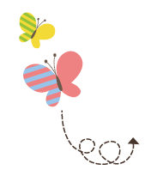
Unit 4 Did You Have a Nice Trip ?
五年级下册
Lesson 21 Look at the Photos !
WWW.PPT818.COM

Slide 2
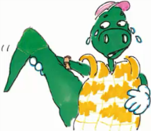
1. Danny’s story
Jenny： Look at this photo . We were on the train to Beijing.
Danny：We played with the baby. It was fun.
Jenny：Danny was at the Palace Museum.
Steven：What happened ？
Jenny：He hurt his tail. He was sad.
Jenny：We were on the Great Wall.
Steven：Wow，it’s so great!
Jenny：We were very happy .

Slide 3
知识点1
photo / fəʊtəʊ/ n. 照片；相片
发音：
字母组合ph 发的是/f /。
a photo of... 一张……的照片
take a photo 拍照
短语：
同义词：
picture 照片

Slide 4
易错点
提示
复数形式为photos。
We took a lot of photos in the park.
我们在公园里拍了很多照片。
例句：

Slide 5
知识点2
We were on the train to Beijing.
我们在去北京的火车上。
be 动词的过去式
主语的数 | 一般现在时 | 一般过去时
单数 | am, is | was /wɒz/
复数 | are | were /wɜː(r) /
例句：
The girl was in the park just now.
这个女孩刚才在公园。
We were in Beijing last year. 去年我们在北京。

Slide 6
含有be 动词的一般过去时的常用结构
（1）肯定句：主语+ was/were + 表语+ 其他．
His father was very busy last week.
他父亲上周很忙。
例句：
（ 2）否定句：主语+ was/were + not + 表语+ 其他．
They were not at home last night.
他们昨天晚上不在家。
例句：

Slide 7
含有be 动词的一般过去时的常用结构
（3）一般疑问句：Was/Were + 主语+ 表语+ 其他？
Was his father very busy last week?
他父亲上周很忙吗？
例句：
（ 2）特殊疑问句：特殊疑问词+ was/were + 主语+ 其他？
Where were they last night?
他们昨天晚上在哪儿？
例句：

Slide 8
知识点 3
What happened ？发生了什么事？
此句型用于询问过去发生了什么事。what 是疑问词，意为“什么”，happen 意为“发生”，因为询问过去发生了什么事情，所以应该用happen 的过去式happened。如果要问某人或某物发生了什么事，用句子结构“What happened to sb./sth. ？”
用法：

Slide 9
What happened to your car ？你的车怎么了？
例句：
What _______Tom ?
A. happened to B. happen to
C. happened
典例
A

Slide 10
知识点 4
happy / hæpi/ adj. 高兴的；快乐的
I am happy today. 今天我很高兴。
例句：
a happy day 快乐的一天
be happy to do... 高兴做……
短语：
对比记忆法：
happy 高兴的 sad 悲伤的

Slide 11
对比记忆法：
用身体的各个部位、多个感官（如耳听、嘴读等）一起来记忆单词的方法就是感官记忆法。
魔法记忆：
高兴（happy）你就拍拍手，
害怕（afraid）你就跺跺脚，
难过（sad）你就眨眨眼，
生气（angry）你就晃晃头，
担心（worried）你就把耳朵揪，
无忧无虑乐悠悠。

Slide 12
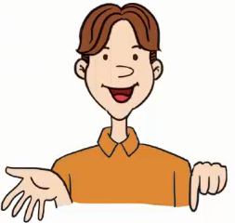
2. Is and was
Let’s find the differences ！
1. He is eight years old this year.
He was seven years old last year.
2. I am happy today ！
I was sad yesterday.
3. We are in Canada this week.
We were in China last week.

Slide 13
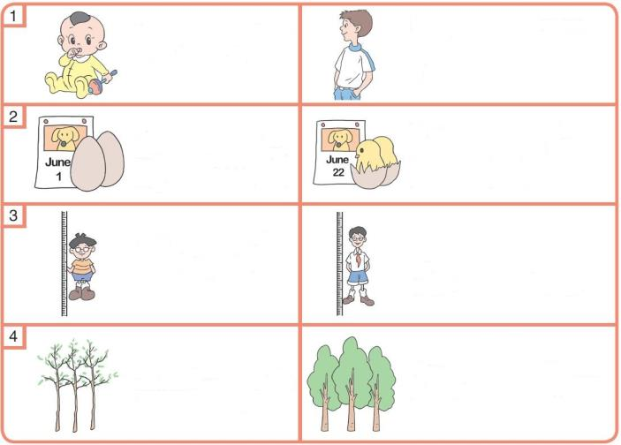
3. Let’s do it!
1. Read and write “am”，“is”，“are” “was” or “were”．
I _____ a baby in 2002.
was
I _____ a boy now.
am
They _____ eggs on June 1.
They _____ baby
chickens now.
were
are
Li Ming _____
short in 2003.
was
He _____ tall now.
is
The trees _____
small last year.
were
They _____ big now.
are

Slide 14
3. Let’s do it!
2. Talk and write.
Look at this photo. We were at the Palace Museum. We went there by bus. We had fun.
__________________________________________________
__________________________________________________
__________________________________________________

Slide 15
一、单项选择。
1. This is my family ______.
A. photo B. photos C. pictures
2. We ______at Tom’s party yesterday.
A. are B. were C. be
A
B

Slide 16
3. I ______tired yesterday，so I go shopping with her.
A. am；don’t B. was；am not C. was；didn’t
4. —Where ______ you just now ？
—I ______ on the playground.
A. are；were B. did；was C. were；was
C
点拨：
句子时态是一般过去时。句子中的动词用过去式。含实义动词的句子变否定句时需要用didn't来帮忙，后面的动词用原形。
C

Slide 17
二、根据句意用be 动词的正确形式填空。
（ 1）I ______happy today.
（ 2）He ______ short in 2012.
（ 3）T he children ______ in Beijing last year.
（ 4） We ______ in Shanghai now.
（ 5） This ______ a photo of my father.
am
was
were
are
is

Slide 18
三、根据图片、首字母和句意将句子补充完整。
（1）Lucy is s .
（2）Lucy is h .
（3）Lucy is w .
ad
appy
orried

Slide 19
本节课我们学习了以下知识，请同学们一定加强巩固，以便能和同学们进行灵活交流哦！
重点词汇：photo, happy➢
重点短语：be happy to do...
重点句式：We were on the train to Beijing.
What happened?

Slide 20
1 熟记本节课所学的句型和单词，必须会听、说、读、写。
2 将Danny’s story的对话朗读流利。
3 完成配套的课后作业。

