Slide 1
Unit 5 Topic 3
Now it is a symbol of England.
Section C
WWW.PPT818.COM

Slide 2
Act out the conversation of 1a in Section B.
Name | People they admire most | Reason
Kangkang | Abraham Lincoln | poor and no much education, never gave up, became one of the famous presidents of the USA
Susanna | Marie Curie | discovered radium, won the Nobel Prize for two times
Li Ming | Thomas Edison | exploring spirit, many great inventions

Slide 3
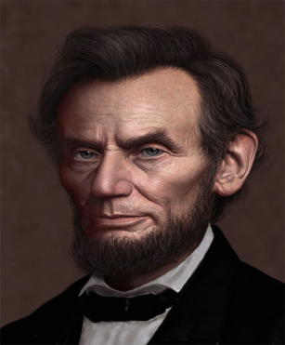
Kangkang’s hero is Abraham Lincoln. Although he was poor and didn’t have much education, he never gave up reading books and became one of the famous presidents of the USA.

Slide 4
1a Read and understand. Work in pairs and put the following statements
about Abraham Lincoln in the correct order.
Then read the passage and check your answers.
He left home.
His father remarried.
He was elected president.
His mother died.
He set the slaves free.
He received a law license and became a lawyer.
He was born in 1809.
He was shot and died the next day.
The correct order: 7 4 2 1 6 3 5 8

Slide 5
1b Read 1a again and mark T (True) or F (False).
In Illinois, Lincoln studied by himself because there were no schools there. ( )
T
Abraham Lincoln was born in Kentucky in 1809. His mother died when he was ten years old. Later, his family moved to Illinois and his father remarried. The family was poor, so they had to struggle just to live. In Illinois, there were neither teachers nor schools, but Lincoln's stepmother encouraged him to study. He learned to read and write while working on the farm.
既不是……也不是……

Slide 6
1b Read 1a again and mark T (True) or F (False).
2. Lincoln became a famous lawyer soon after he left
home. ( )
T
At twenty-one, Lincoln left home. He soon received a law license and became a lawyer. People trusted him and began to call him “Honest Abe”.
v.信任，信赖，相信

Slide 7
1b Read 1a again and mark T (True) or F (False).
3. The Civil War broke out after Lincoln had been the
president for a year. ( )
F
During the following years, he took a more active part in politics. Soon he was not only a highly respected lawyer but also a well-known politician. He was elected the sixteenth president of the United States in 1861, and in the same year the Civil War broke out.
爆发

Slide 8
1b Read 1a again and mark T (True) or F (False).
4. The southern states wanted to break up the country.
( )
T
The Civil War was between the southern states that wanted to leave the Union and form their own country, and the northern states that wanted to keep all the states as one country. The southern states wanted to keep the laws that allowed them to own slaves. Both the northern states and President Lincoln wanted to get rid of those laws. On April 9, 1865, the Civil War ended and all slaves were set free.
丢弃，摆脱，扔掉
释放；解放

Slide 9
1b Read 1a again and mark T (True) or F (False).
5. On April 14, 1865, Lincoln died from his wounds. ( )
F
Less than a week later, on April 14, 1865, Abraham Lincoln was shot at the Ford Theatre in Washington, DC. He died the next day from his wounds.
死于……

Slide 10
Notes:
1. trust v.﹠n. 信任，信赖，相信
2. break out 爆发
3. get rid of 丢弃，摆脱，扔掉
4. set free 释放；解放
5. die from 死于……

Slide 11
1c Read 1a again and match the words with their meanings.
1. struggle A. to give somebody hope, courage
or support
2. encourage B. to feel sure that somebody or
something is good, right and
3. trust honest
C. someone who works in politics
4. politician D. to fight or try hard to do
something

Slide 12
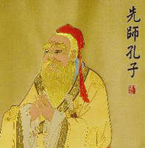
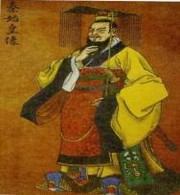
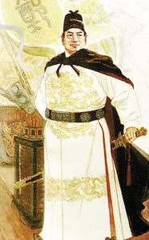
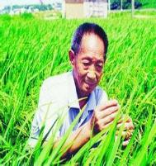
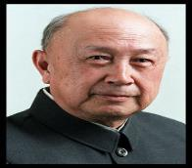
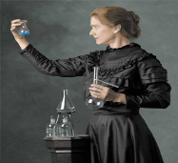
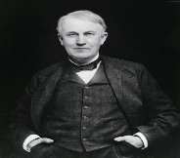
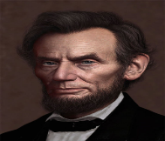
2 Work in groups and complete the following tasks.
1. Tell your group members the story of one of the famous
people you have learned in this unit.

Slide 13
2 Work in groups and complete the following tasks.
2. Discuss the meanings of the following words by Abraham Lincoln.
I’m a slow walker, but I never walk backwards.
我走得很慢，但我从来不会后退。
I will study and prepare, and my opportunity
will come.
我要学习，做好准备，我的机会会来的。
My great concern is not whether you have failed, but whether you are content with your failure.
我最担心的不是你会不会失败，而是你是否满足于你的失败。

Slide 14
Suppose there will be a class meeting on the topic of My Hero. Write a speech about your hero, including the following information.
Pre-writing
1. a brief introduction of his/her life story
2. his/her greatest achievement/
contribution
3. what you have learned from him/her

Slide 15
Write the speech about your hero according to the result of discussion.
While-writing
Name | Yang Liwei
Birthplace | Liaoning Province
Job | a pilot (1987)
Life story | joined the Chinese Space Program with 13 other pilots; trained for five years
Greatest achievement | travelled around the earth by Shenzhou Ⅴ for 21 hours in 2003
Spirit | brave and hard-working

Slide 16
Proofread the speech:
Post-writing
Spelling (拼写)
Grammar (语法)
Punctuation error (标点)

Slide 17
Sum up
Words:
trust v.﹠n. 信任，信赖，相信
unit n. 单元
Phrases:
break out 爆发
get rid of 丢弃，摆脱，扔掉
set free 释放；解放
die from 死于……
break up 拆开，分散；粉碎

Slide 18
Sum up
Grammar:
both…and…
neither…nor…
either…or…
not only…but also…

Slide 19
Homework
Read 1a and review the key points.
Complete the speech.
Search for more information and pictures about pyramids and other wonders of the world.

