Slide 1
Lesson 2
It’s warm in spring.
WWW.PPT818.COM

Slide 2
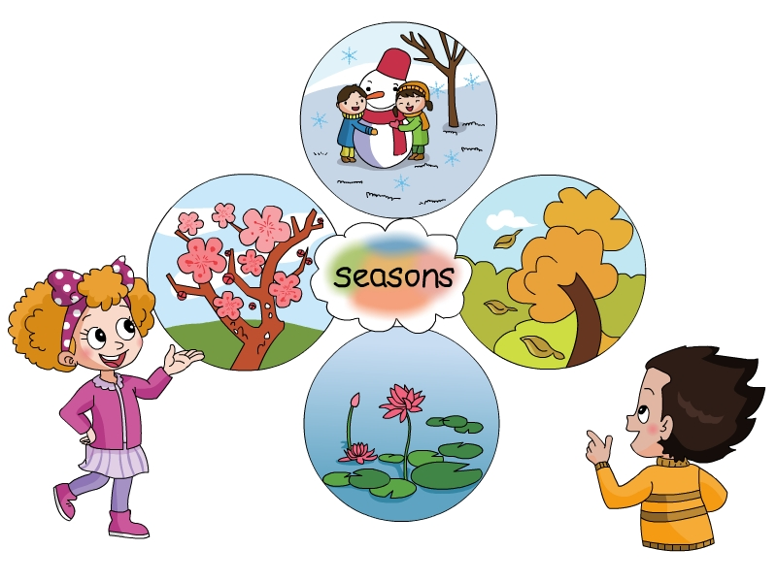
cold
warm
cool
hot

Slide 3
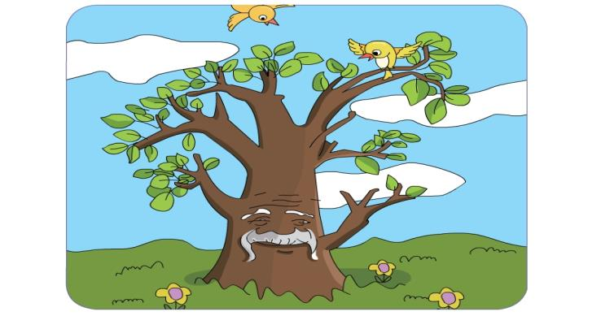
It’s warm in spring.

Slide 4
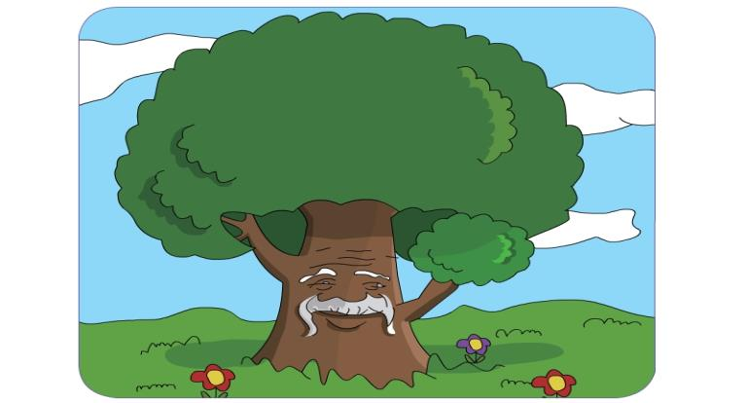
It’s hot in summer.

Slide 5
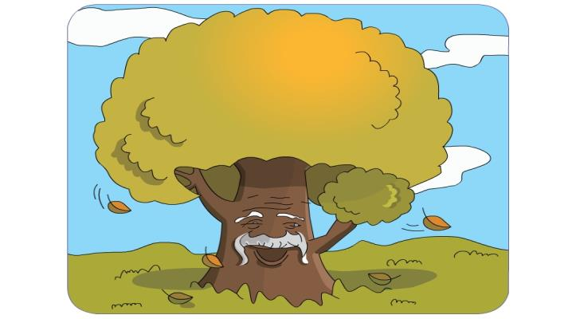
It’s cool in autumn.

Slide 6
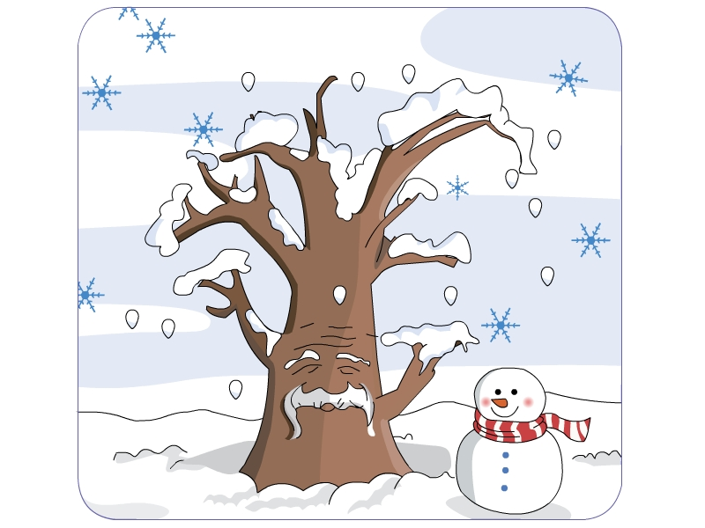
It’s cold in winter.

Slide 7
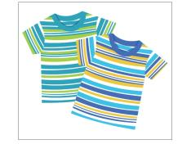
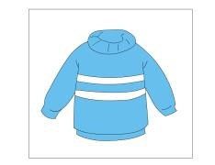
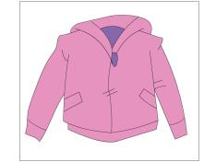
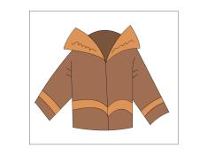
T-shirt
sweater
jacket
coat
hot
warm
cool
cold

Slide 8
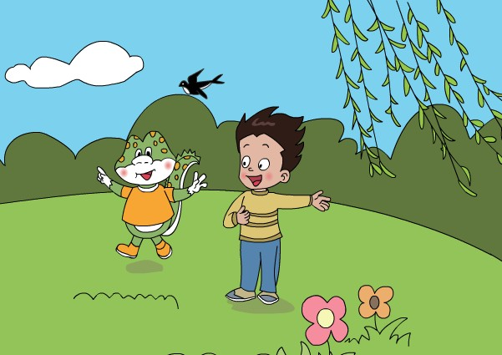
warm
It’s in spring.
We often wear .
sweaters

Slide 9
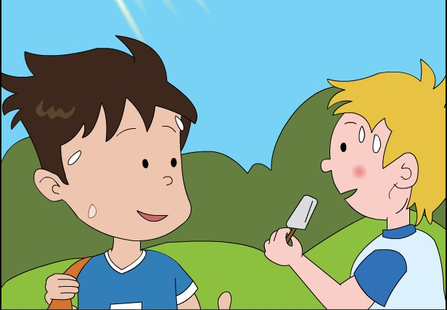
hot
It's in summer.
We often wear .
T-shirts

Slide 10
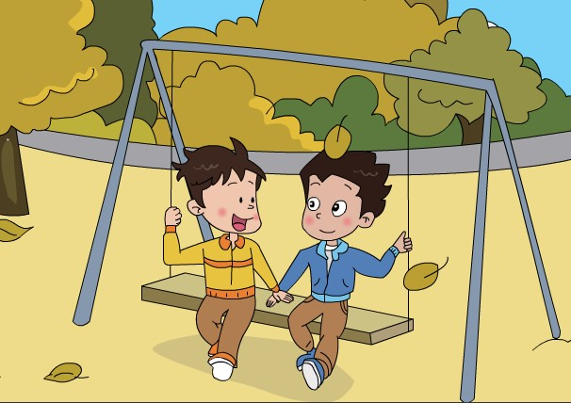
cool
It's in autumn.
We often wear .
jackets

Slide 11
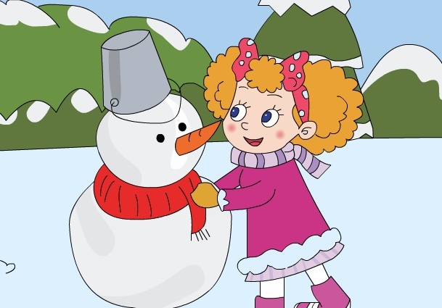
cold
It's in winter.
We often wear .
coats

Slide 12
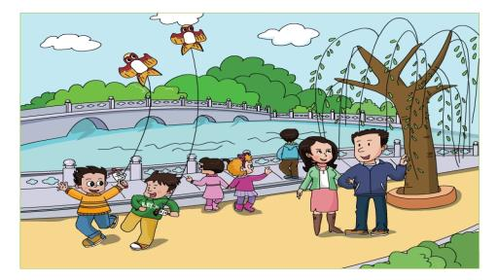
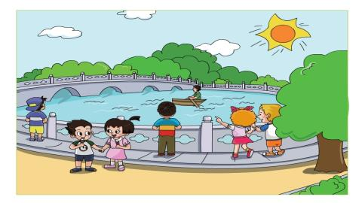

Slide 13
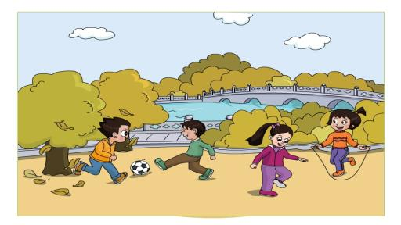
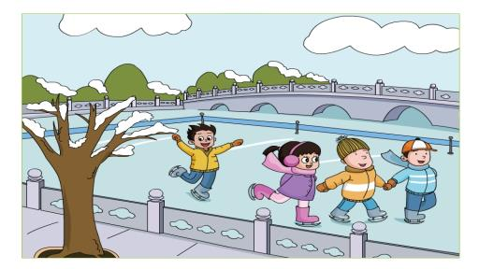

Slide 14
Goodbye

